Slide 1
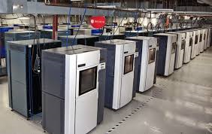
3D PRINTING TECHNOLOGY The Security of Mechanical Keys
AN OVERVIEW OF EMERGING TECHNOLOGY AND HOW IT CAN THREATEN TRADITIONAL KEY CONTROL AND SECURITY

Slide 2
3D PRINTING TECHNOLOGY: OVERVIEW OF CRITICAL ISSUES
WHO: VIRTUALLY ANYONE CAN OBTAIN A KEY IF THEY HAVE ACCESS TO THE TARGET KEY
WHAT: ANY CONVENTIONAL KEY AND MANY HIGH SECURITY KEYS AND KEYWAYS
WHERE: NO GEOGRAPHIC LIMITATIONS, ESPECIALLY WITH 3D PRINT SHOP ACCESS ON LINE
WHY: TO OBTAIN AN UNAUTHORIZED DUPLICATE KEY OR BLANK TO OPEN A LOCK, OR TO EXTRAPOLATE THE TOP LEVEL MASTER KEY, OR TO DEFEAT THE SECURITY OF A FACILITY

Slide 3
COMPROMISE OF KEYS MEANS COMPROMISE OF SECURITY
HOW: PHOTOGRAPHY, VISUAL DECODING AND MEASUREMENT, MOLDS, IMPRESSIONS, FAX, EASY ENTRIE FOR KEYWAY REPLICATION, INTERNET PUBLICATION OF SPECIFICATIONS, MANY OTHER TECHNIQUES.
ACCESS TO A TARGRT KEY CAN OFTEN BE EASILY OBTAINED
BORROWED KEY OR PHYSICAL ACCESS OR POSESSION
USER IN POSSESSION OF A KEY, EVEN BRIEFLY
PHOTOGRAPH OF A KEY CARRIED BY ANOTHER PERSON
PHOTOGRAPH OF A KEYWAY TO MAKE BLANKS + VISUAL DECODING
WHY: TO OBTAIN AN UNAUTHORIZED DUPLICATE KEY OR BLANK TO OPEN A LOCK, OR TO EXTRAPOLATE THE TOP LEVEL MASTER KEY, OR TO DEFEAT THE SECURITY OF A FACILITY

Slide 4
LOCKS ARE OFTEN THE FIRST AND LAST PHYSICAL BARRIER
CLASSIFICATION OF LOCKS
Conventional mechanical locks
High security mechanical locks
Electro-Mechanical locks
Electronic cylinders
Electronic access control systems
RFID, NFC, Bluetooth Access

Slide 5
MANY WAYS TO OPEN LOCKS
Picking
Impressioning
Decoding
Bumping
Key simulation, replication, duplication
Master key through extrapolation
Key jiggling and manipulation
Key interchange and unintended master keys

Slide 6
STANDARDS: LOCKS AND KEYS
UNITED STATES
Underwriters Laboratories UL 437
BHMA High Security 156.30
EUROPEAN COMMITTEE FOR STANDARDIZATION
CEN 1300 High security locks
CEN 1303 Cylinders for locks

Slide 7
STANDARDS: WHAT THEY DEFINE
SECURITY LEVELS for MECHANICAL CYLINDERS
Conventional: Low to Medium security
High Security: Highest security available
STANDARDS AND SECURITY: HOW DIFFICULT IT IS TO OPEN LOCKS: 3T-2R RULE
Time
Tools
Training
Reliability of attack
Repeatability of attack

Slide 8
CONVENTIONAL CYLINDERS
ATTRIBUTES
No patent protection
No real key control: blank keys are available
Reduced quality of materials
No control over manufacture of blanks
Usually easy to pick, bump, decode, or impression unless enhanced security features
Minimal forced entry protection
Minimal resistance to all forms of attack

Slide 9
HIGH SECURITY LOCKS
THREE PRIMARY CRITERIA
FORCED ENTRY
Generally five minutes resistance to attack
High drill resistance
COVERT ENTRY
Ten to fifteen minutes resistance to attacks
KEY CONTROL
Patent protected keys and mechanisms
Protection from duplication
Control of blanks and keys
Restricted keyways

Slide 10
USE OF CONVENTIONAL LOCKS
MANY FACILITIES DO NOT USE HIGH SECURITY LOCKS
PREDICTABLE RESULTS
Easy to compromise by forced and covert methods
Easy to copy keys
Easy to compromise master key systems
Easy to bump open
Often, only the appearance of security

Slide 11
WHY USE HIGH SECURITY LOCKS Patent Protection
PATENT PROTECTION
Protected designs of internal mechanism and keys
Illegal to duplicate, replicate, or manufacture protected keys
Keys are not readily available without authority
Keys contain interactive or special elements or designs to make copying and simulation difficult
More difficult to bump open

Slide 12
WHY USE HIGH SECURITY LOCKS Resistance to Covert Attacks
COVERT ENTRY
Secondary locking systems, such as sidebars, rotating pins, sliders, magnetics, telescoping pins
Multiple sets of active locking components
Proprietary bitting and side-bit milling
Complex shapes
Interactive elements between lock and key

Slide 13
WHY USE HIGH SECURITY LOCKS Forced Entry Resistance
FORCED ENTRY
More difficult to open by force:
Protection against grinding, drilling, sawing, pulling, prying, torque, wrenching
Special anti-drill protection
More secure materials
Higher tolerances

Slide 14
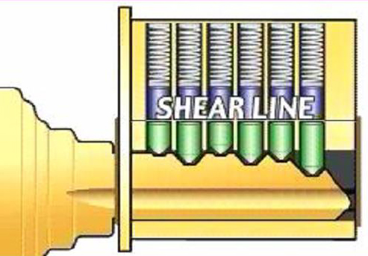
KEYS FOR MECHANICAL LOCKS: What are they?
A SMALL SOLID OBJECT TO MATE WITH INTERNAL ACTIVE ELEMENTS IN THE LOCK

Slide 15
KEYS FOR MECHANICAL LOCKS
TRADITIONAL KEYS CAN BE MADE OF MANY MATERIALS
Metal: brass, nickel silver, steel, aluminum
NON-TRADITIONAL WAYS TO MAKE KEYS
Plastic
Epoxy
Low temperature metals
Casting

Slide 16
KEYS: THE COMMON ELEMENT
KEYS ARE THE CRITICAL AND COMMON ELEMENT FOR CONVENTIONAL AND HIGH SECURITY LOCKS
3D PRINTER and SCANNER TECHNOLOGY
Will force a change in the design of high security keys
Will require the standards to be upgraded
Traditional conceptions of key control will change
New Patent Protection will develop
Will require a re-evaluation of facility security

Slide 17
KEYS Conventional vs. High Security
WIDESPREAD AVAILABILITY vs. KEY CONTROL
KEYWAYS: COMMERCIAL vs. RESTRICTED
SECTIONAL KEYWAYS
BITTING: Traditional, dimple, angled, unique shapes, multiple rows
MOVABLE OR INTERACTIVE ELEMENTS: Examples: Mul-t-Lock, Keso, Vachette, Tesa
MAGNETICS: Evva
ELECTRONIC ELEMENTS
MULTIPLE SECURITY LAYERS: Secondary bitting examples: Medeco, Primus, Assa Twin

Slide 18
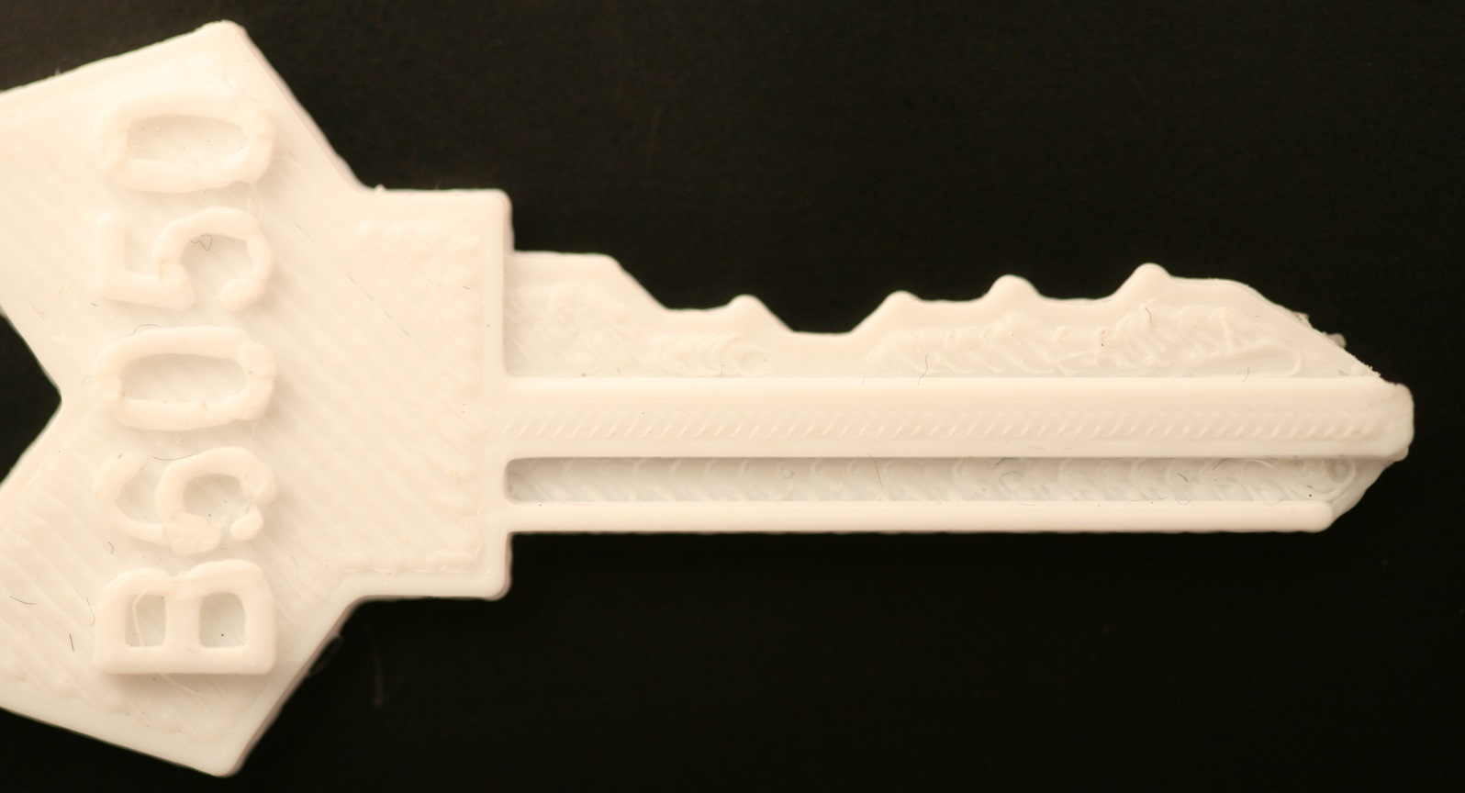
THE EASIEST WAY TO OPEN A LOCK: With a Key

Slide 19
TRADITIONAL METHODS TO PRODUCE MECHANICAL KEYS
TWO PRIMARY ISSUES:
Obtaining or producing the blanks
Creating the bitting and knowing the values
Key machines: manual copying or code cutting
Impressioning the lock
Impression of the key (Great Train Robbery)
Molds, Silicone, Epoxy
Photography and milling machine
Decoding by micrometer or gauge and hand-filing or code cutting
Visual decoding for bitting levels
Disassembly of lock and determining bitting values
Decoding tools
Variable key simulation systems
Easy Entrie milling machine

Slide 20
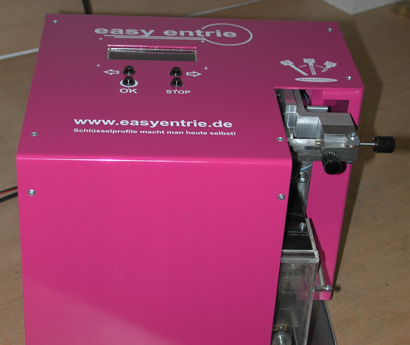
EASY ENTRIE MILLING MACHINE

Slide 21
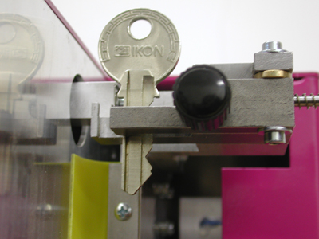
EASY ENTRIE PROBE KEY BLANK MEASUREMENT

Slide 22
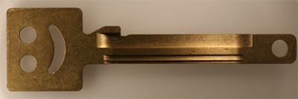
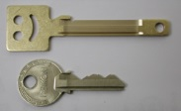
MILLED BLANKS

Slide 23
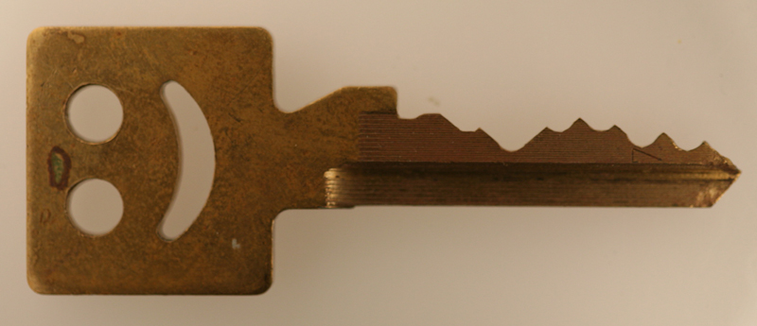
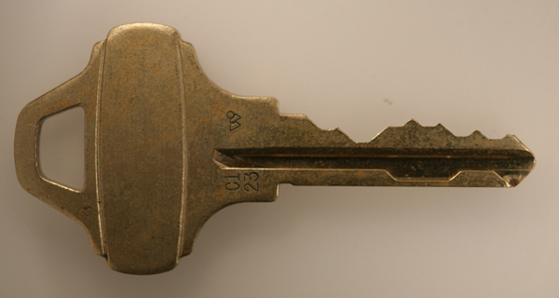
MILLING OF BLANKS WITH EAS ENTRIE

Slide 24
SECURITY AGAINST DUPLICATION, SIMULATION, OR REPLICATION
METHODS TO ENHANCE KEY CONTROL
Unique keyways
Undercuts
Complex bitting
Side-bit milling, angled cuts
Unique or difficult-to-decode bitting patterns
Multiple or complex angles or bores in bitting
Interactive elements
Magnetics
Electronic elements
THE REAL WORLD
“Do Not Duplicate”
Patent protection

Slide 25
CONVENTIONAL KEYS: KEY SECURITY
EASY AVAILABILITY OF BLANIKS
DEPTH AND SPACE INFORMATION AVAILABLE
NO SPECIAL CUTTER REQUIRED
CAN BE PHOTOGRAPHED AND DECODED
NO RESTRICTIONS ON ACCESS TO KEYS
EASY TO MAKE BUMP KEYS WHICH WILL OPEN MOST PIN TUMBLER LOCKS

Slide 26
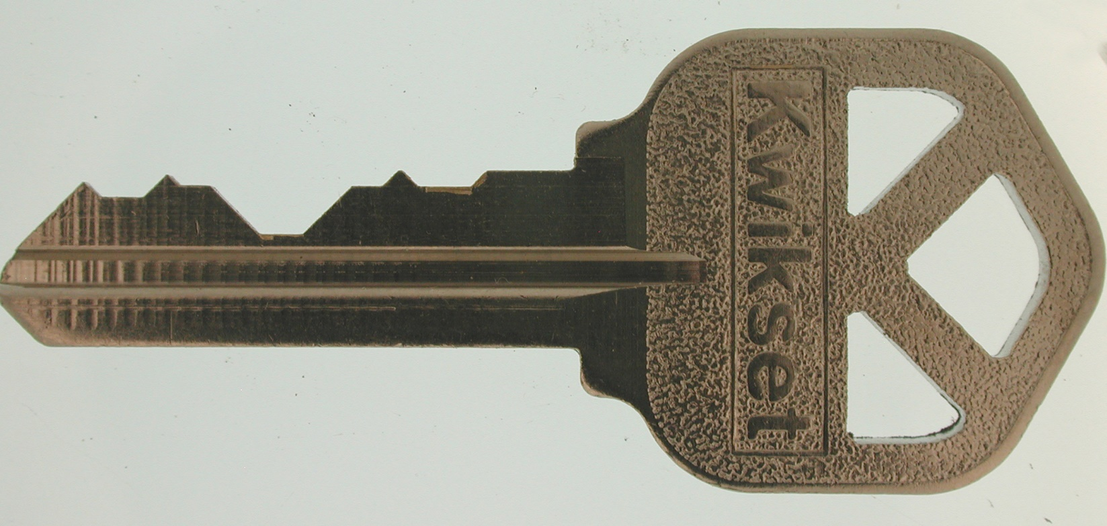
CONVENTIONAL KEYS: MINIMAL SECURITY

Slide 27
HIGH SECURITY LOCKS: PHYSICAL KEY SECURITY
PATENT PROTECTED
RESTRICTED KEYWAYS
PHYSICAL PROTECTIVE MEASURES
COMPLIANCE WITH UL, BHMA STANDARDS
MORE DIFFICULT TO DUPLICATE, SIMULATE, OR REPLICATE

Slide 28
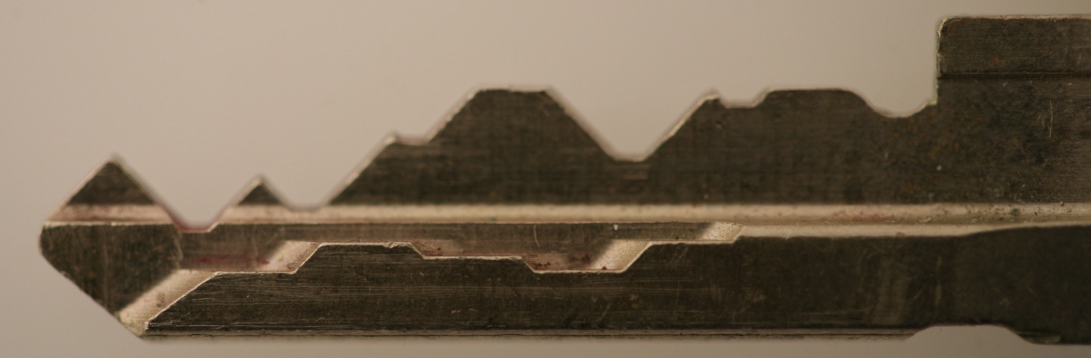
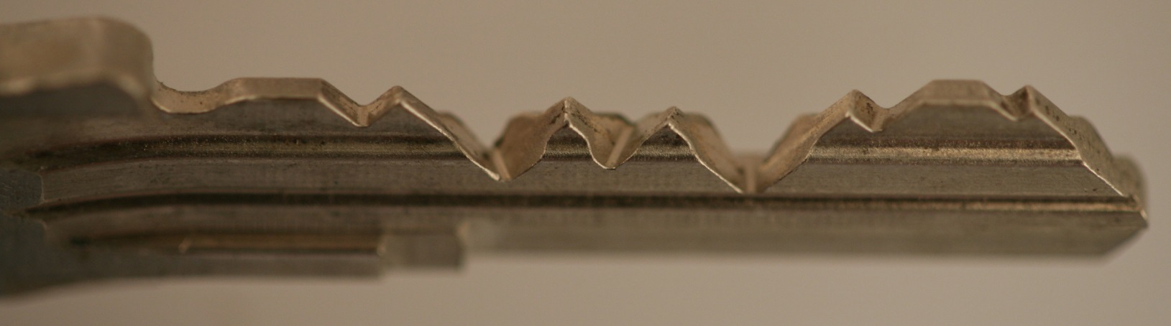
DIFFERENT SECURITY MEASURES Special bitting designs

Slide 29
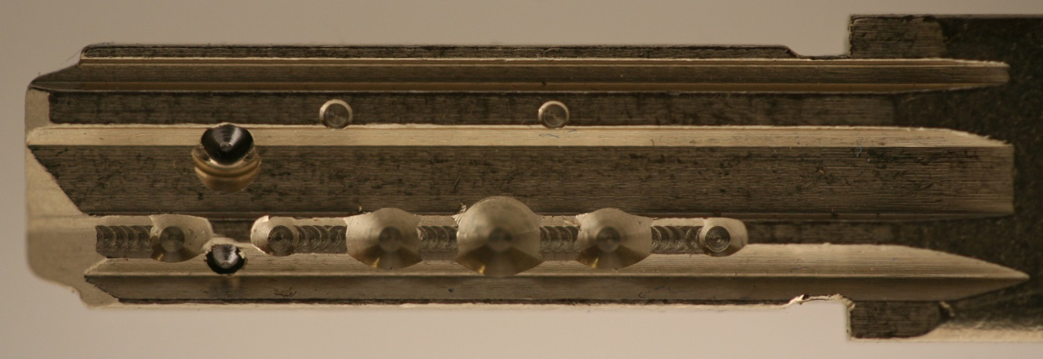
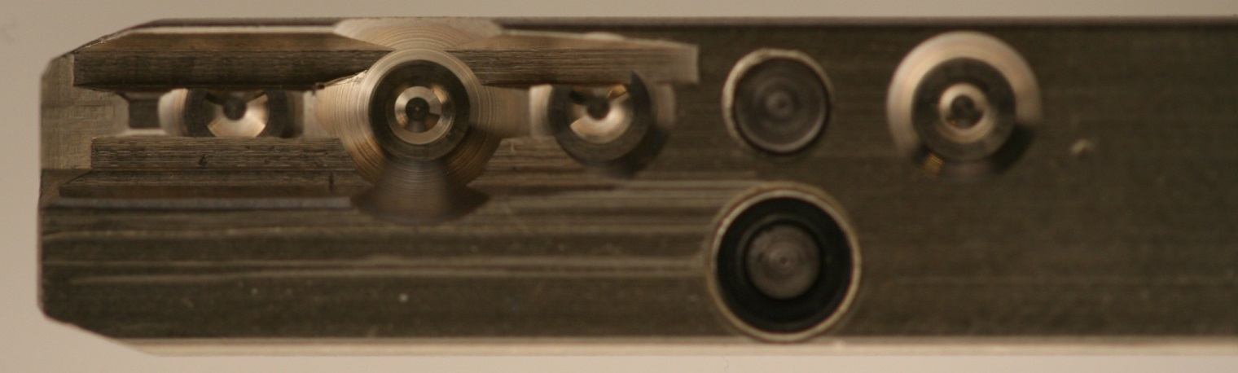
DIFFERENT SECURITY MEASURES Interactive elements

Slide 30
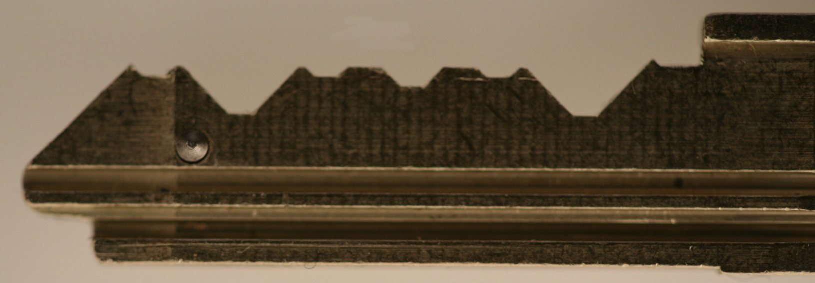
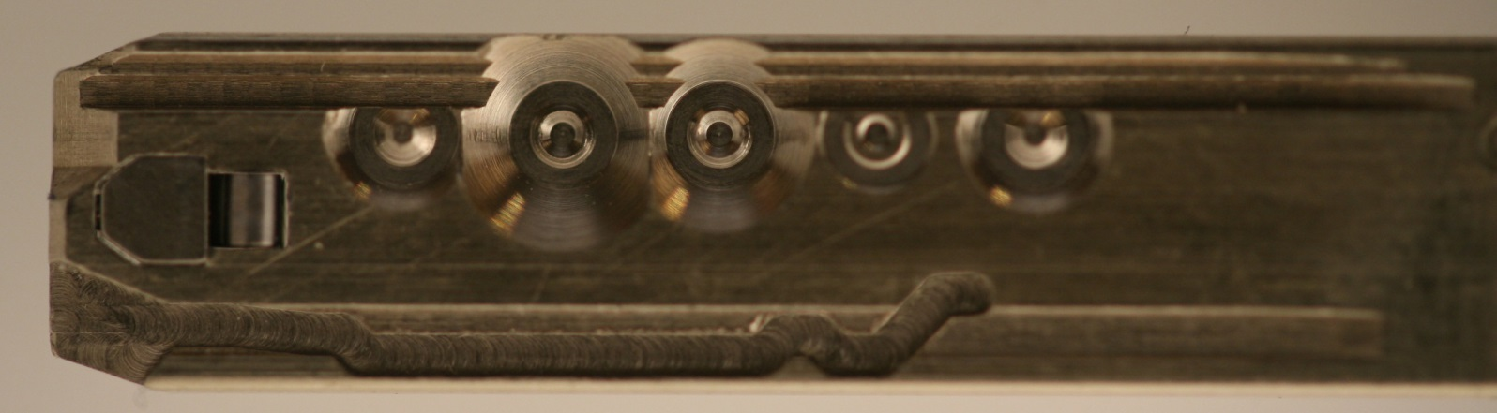
DIFFERENT SECURITY MEASURES Interactive elements

Slide 31
NEW TECHNOLOGY: NEXT GENERATION TO REPRODUCE KEYS
Scanners
High-resolution photographs
3D printers
Inexpensive computer-controlled milling machines
Materials other than metals
Remote file servers
On-line print shops “Kinko’s for keys”

Slide 32
3D PRINTER TECHNOLOGY: SIX CRITICAL QUESTIONS
WHAT IS IT?
HOW DOES IT WORK?
HOW DIFFICULT TO PRODUCE KEYS?
ACCESS TO TECHNOLOGY?
AVAILABILITY AND COST?
IS IT A THREAT TO SECURITY?

Slide 33
3D PRINTER REVOLUTION
Availability everywhere, even at Microsoft stores
Upload files to print shop
Download files from server
Parts on demand
Price from $1000-$650,000
3D is a software-bases system
STL files, CAD output
Key not difficult to develop and generate
Images from scanners and high res photographs

Slide 34
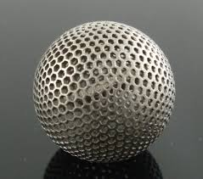
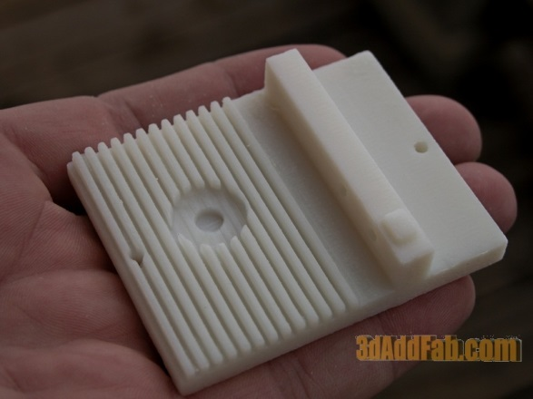
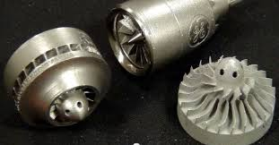
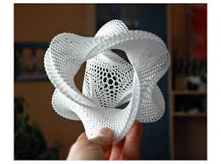
3D PRINTED PARTS

Slide 35
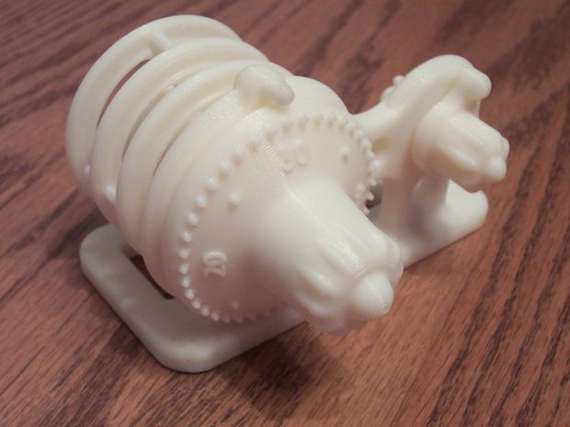
3D PRINTED LOCK

Slide 36
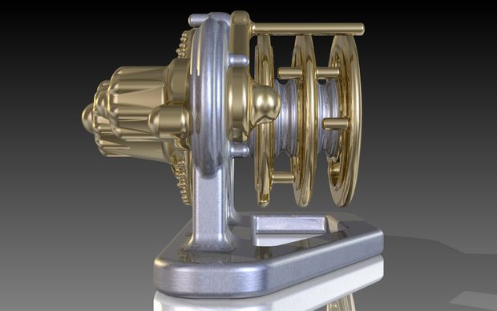
3D PRINTED LOCK

Slide 37
ISSUES RELATING TO SECURITY
Legal
Technical
Intellectual Property
Security
Standards regarding Key Control
Access to blanks and Protection of master key systems
Production of bump keys
3D Print commercial print houses, enforcement of Intellectual Property Rights

Slide 38
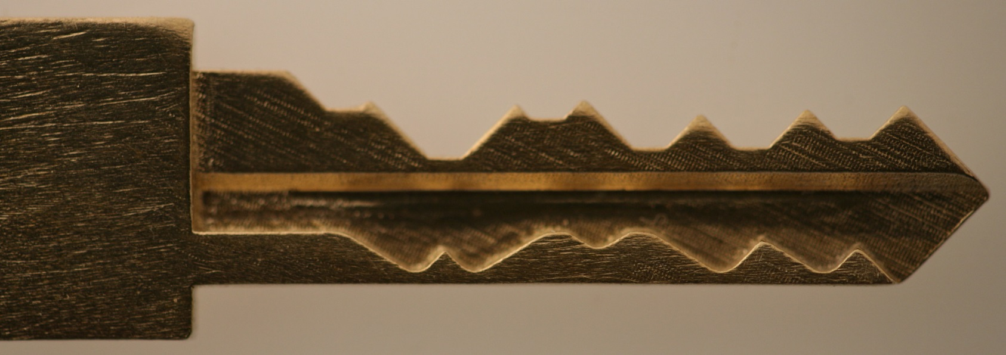
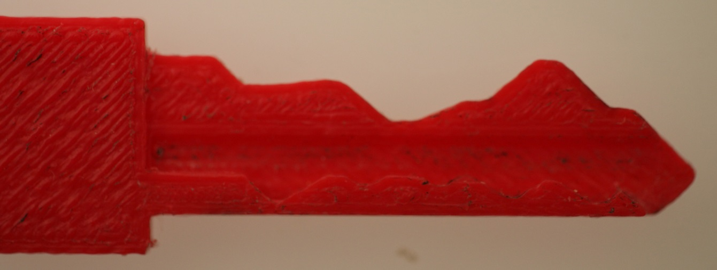
OUR 3D RESEARCH PROJECT: It started at M I T and DefCon 21

Slide 39
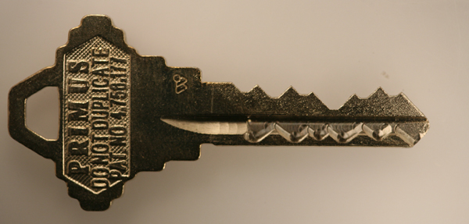
SCHLAGE PRIMUS ORIGINAL KEY

Slide 40
THE PROBLEM: TECHNOLOGY HAS CAUGHT UP WITH A PIECE OF METAL CALLED A KEY
3D PRINTER TECHNOLOGY
Can duplicate restricted keys
Can create blanks for high security systems
Can replicate or simulate some interactive elements
Can create some forms of springs
Can scan keys and feed directly to printers
Can upload and download files of key profiles and bitting from online servers
Can violate patent protection with little remedy

Slide 41
METAL KEYS vs. 3D TECHNOLOGY MORE PROBLEMS
CONVENTIONAL AND SOME HIGH SECURITY KEYS
Can be easily decoded
Keyways can be replicated from photographs
Keys can be easily copied
Traditional key control can be circumvented
Employees can obtain copies of keys
Restricted keyways circumvented
Physical presence not required to obtain a key
Key profiles may be available for download

Slide 42
WHAT CAN’T 3D DO TODAY?
REPRODUCE MAGNETIC ELEMENTS
REPRODUCE ELECTRONIC CREDENTIALS
PRINT ORGANIC MATERIALS
BUT NOT SO FAST!

Slide 43
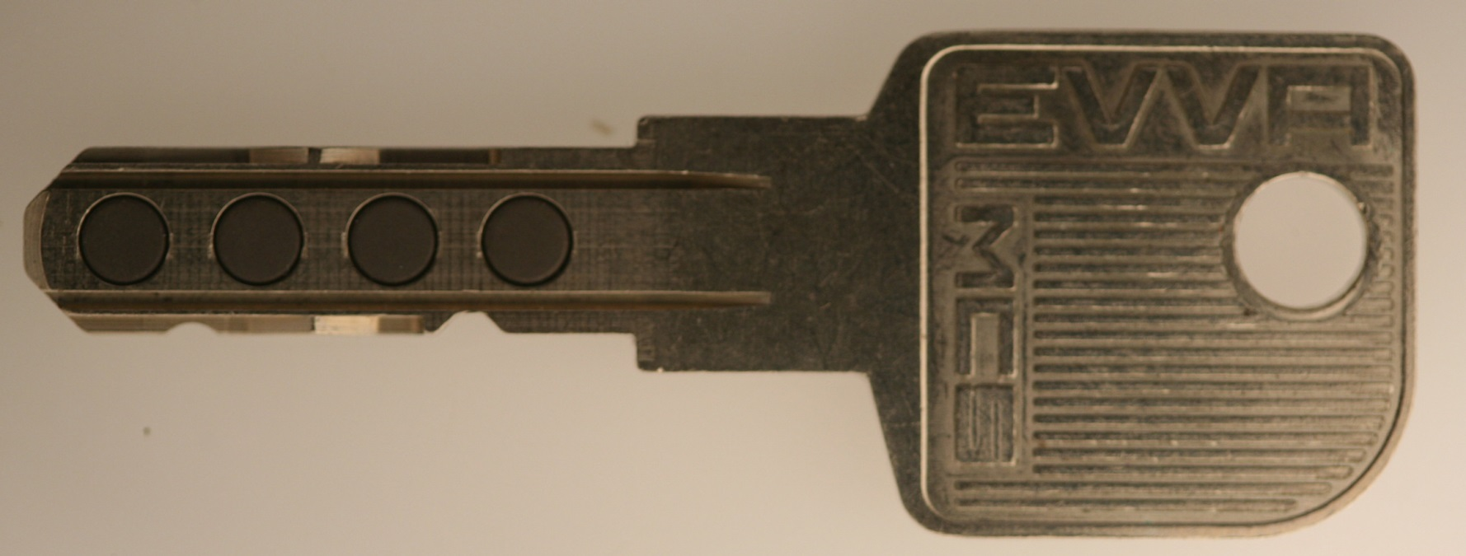
MAGNETIC-BASED KEY ELEMENTS EVVA Magnetic Code System

Slide 44
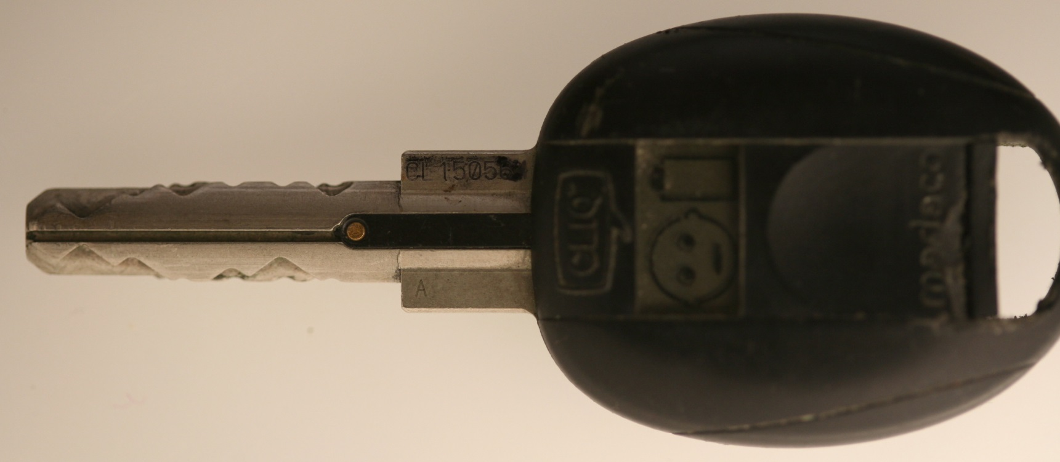
KEY WITH BITTING AND CREDENTIALS For Electro-mechanical Cylinders

Slide 45

ELECTRONIC CREDENTIALS: For E-Cylinders

Slide 46
3D CANNOT DO TODAY: But probably tomorrow
Can embed foreign elements like magnets
Can mix materials like plastic and metal
Can create or simulate spring-biased elements
Will be able to print circuitry

Slide 47
3D BASICS
THREE-DIMENSIONAL SOLID OBJECTS FROM ANY SHAPE FROM A DIGITAL MODEL
ADDITIVE PROCESS REATHER THAN SUBTRACTIVE LIKE MACHINING
DEVELOPED IN 1980s
BUILDS LAYERS WITH DIFFERENT MATERIALS
USES PLASTICS, NYLON, ABS, METALS
CAN CREATE MOLDS FOR CASTING
USES LASERS AND HIGH TEMPERATURE
COMPARE TO INK JET PRINTERS

Slide 48
3D RESOLUTION
3D PRINTABLE FILES (STL FORMAT)
PRINTER RESOLUTION X-Y IN dpi OR MICROMETERS
TYPICAL RESOLUTION: 250 dpi = 100 µm .004”
HIGH RESOLUTION 1600 dpi = 16 µm = .0006”
PROCESSES: THE WAY LAYERS ARE DEPOSITED AND MATERIALS

Slide 49
3D PROCESSES
SLM = SELECTIVE LASER MELTING Melt or soften material to produce layers
DMLS = DIRECT METAL LASER SINTERING
SLS = SELECTIVE LASER SINTERING
FDM = FUSED DEPOSITION MODELING
SLA = STEREO LITHOGRAPHY
LOM = LAMINATED OBJECT MANUFACTURING

Slide 50
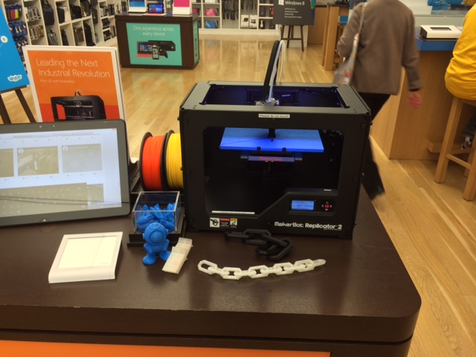
MAKERBOT POPULAR FDM PRINTER

Slide 51
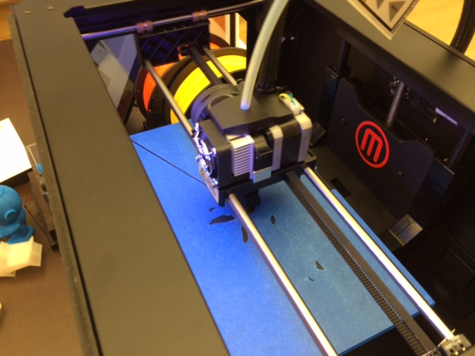
MAKERBOT PRINT HEAD

Slide 52
PROFESSIONAL PRINT HOUSES: High Resolution Capabilities

Slide 53
SECURITY THREATS FROM 3D PRINTING TECHNOLOGY
PRODUCTION OF BLANK KEYS
To duplicate keys without authorization
Create blanks from photographs of keyways
Download restricted blanks with bitting after decoding the target key
Create bump keys for virtually any keyway
Compromise master key systems

Slide 54
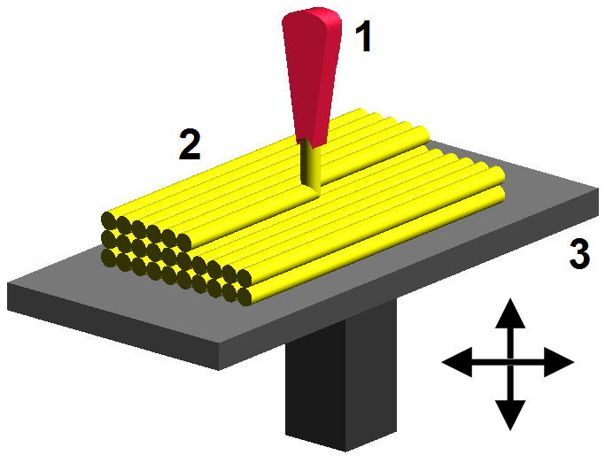
PROCESSES AND MATERIALS
FDM FUSED DEPOSITION MODELING
2 = nozzle ejecting molten plastic
3 = deposited material

Slide 55
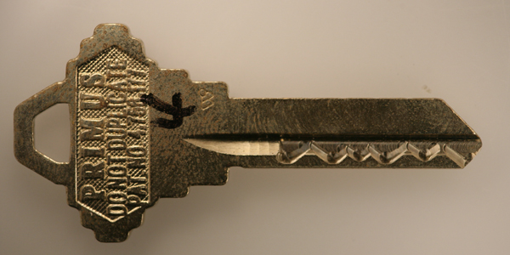
ORIGINAL PRIMUS TO 3D CREATED KEY

Slide 56
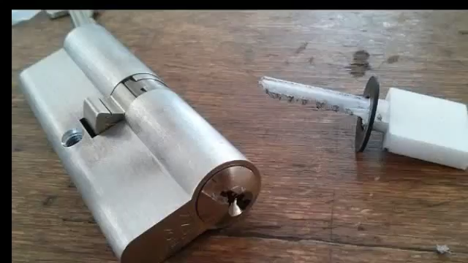
3D THREAT: BLANKS TO CREATE BUMP KEYS

Slide 57
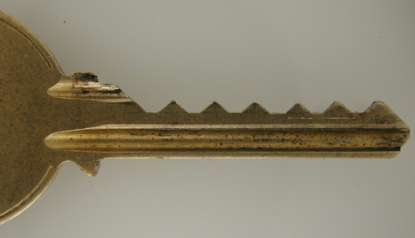
BUMP KEY

Slide 58
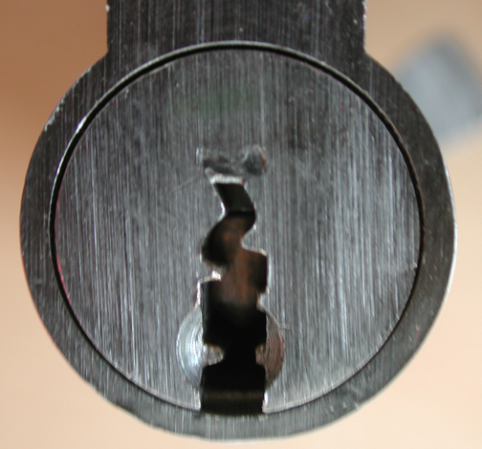
CREATION OF BLANKS
PHOTOGRAPH OF KEYWAY
PROCESS THROUGH SOFTWARE LIKE ADOBE
TRANSLATE TO 3D PRINT FILE OR EASY ENTRIE

Slide 59
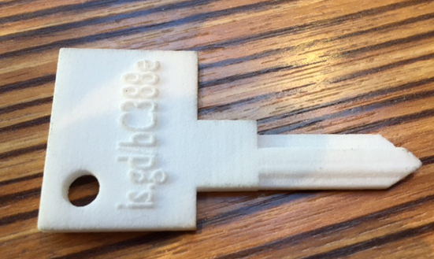
3D PRINTED BLANK: PHOTOGRAPH TO STL FILE

Slide 60
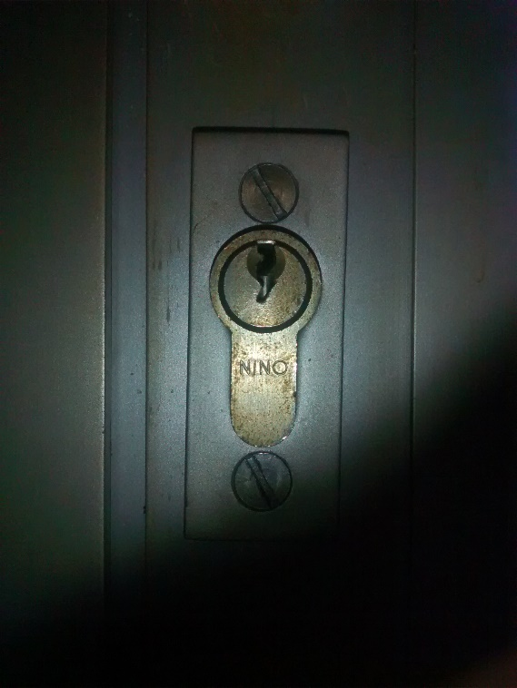
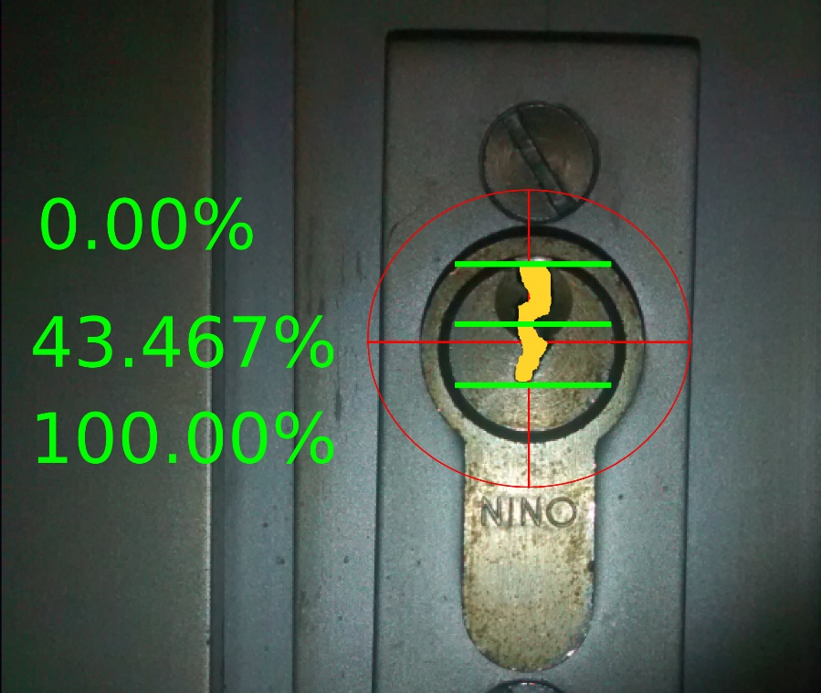
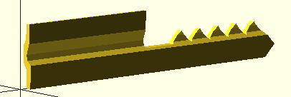
JOS WEYERS: SPORT LOCKPICKING

Slide 61
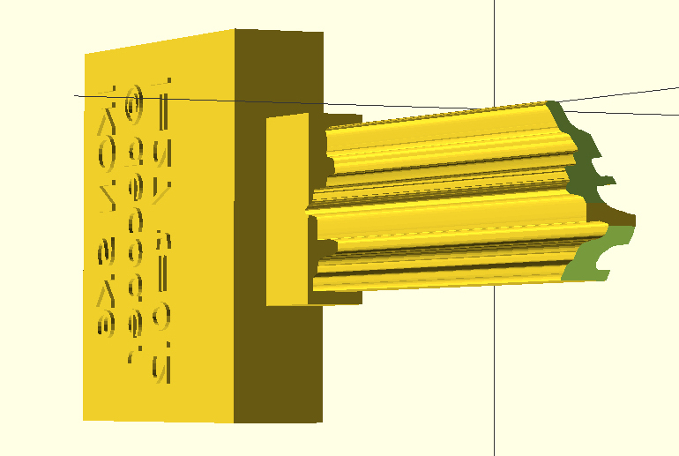
3D CREATED BUMP KEYS

Slide 62
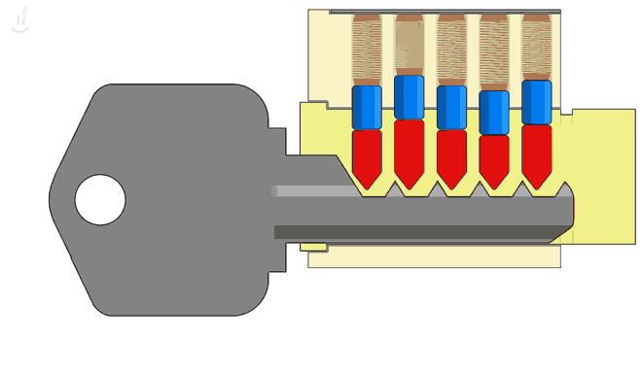
THE THREAT FROM BUMP KEYS

Slide 63

3D CREATED BUMP KEY

Slide 64

JOS WEYERS: BLANKS FROM KEYWAYS

Slide 65
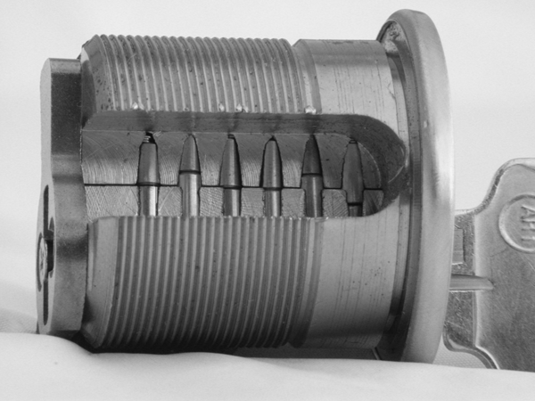
TOP LEVEL MASTER KEY DECODING KEY BLANK ARE CRITICAL

Slide 66
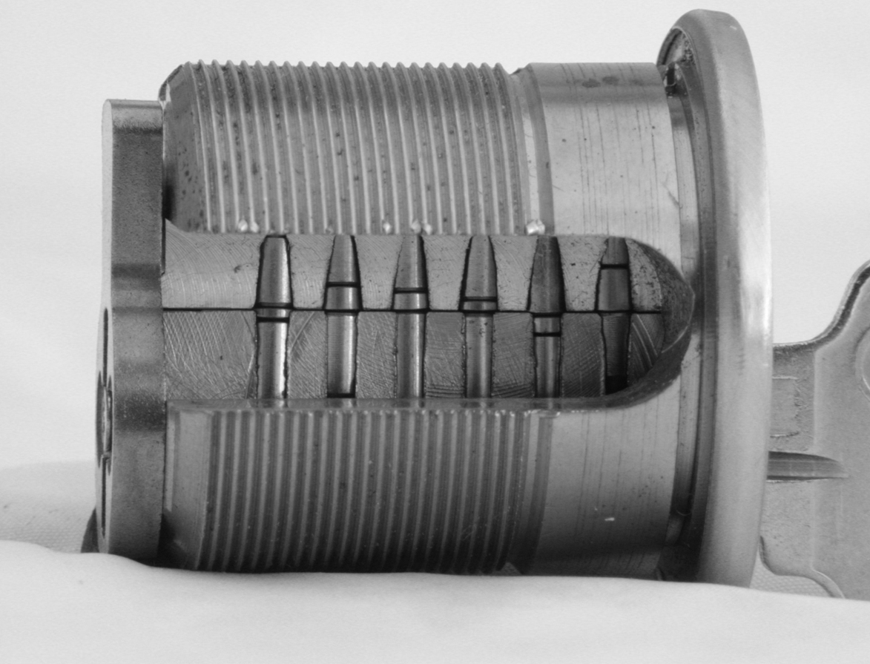
MASTER KEY SYSTEM EXTRAPOLATION

Slide 67
SUMMARY
THE NEW TECHNOLOGY IS A GREATER THREAT THAN LOCK BUMPING
WILL REQUIRE NO SKILL TO DUPLICATE A KEY: JUST MONEY
PRESENT KEY CONTROL WITH REGARD TO BLANK ACCESS AND DUPLICATION WILL BE CIRCUMVENTED
BHMA HIGH SECURITY LOCK STANDARDS WILL BE INEFFECTIVE AND NEED TO BE MODIFIED FOR HIGH SECURITY SYSTEMS
MANUFACTURERS WILL RESPOND WITH 3D-SECURE BLANKS AND SYSTEMS

Slide 68
SUMMARY
CAN AFFECT VIRTUALLY ALL MECHANICAL KEYS UNLESS THEY CONTAIN CERTAIN INTERACTIVE ELEMENTS
ALL CONVENTIONAL KEYS WILL BE SUBJECT TO ATTACK
MANY HIGH SECURITY KEYS WILL BE ABLE TO BE COPIED
INTERNAL THREAT TO SECURITY BY KEYMAIL, OR PHOTOGRAPH OF KEYS

Slide 69
SECURITY VULNERABILITIES NOW AND IN THE FUTURE
3D IS NOT MAINSTREAM YET
CONSUMER 3D PRINTERS NOT HIGH RESOLUTION, ONLY FOR CONVENTIONAL KEYS
SOME SKILL IS NEEDED TO PRODUCE KEYS
ON-LINE PRINT HOUSES ARE THE THREAT
REMOTE FILE SERVERS AND PROFILES
SCANNERS + HIGH RES PRINTER THREAT
MANY WAYS TO PRODUCE KEYS, 3D IS ONLY ONE OF THEM
THE SKY IS NOT FALLING, YET
HIGH SECURITY FACILITIES SHOULD PLAN FOR FUTURE SYSTEMS

Slide 70
REGULATION AND LEGISLATION
Trafficking in patented designs and restricted keyways including:
Public safety systems
DoD and USPS
Fire Department building access
Keys for critical infrastructure
Equivalent to Digital Millennium Copyright Act

Slide 71

JEFF HANSON STRATASYS-REDEYE

Slide 72
SECURITY LABS INVESTIGATIVE LAW OFFICES
© 2014 Marc Weber Tobias
Contact: mwtobias@security.org
1.605.334.1155

