Slide 1
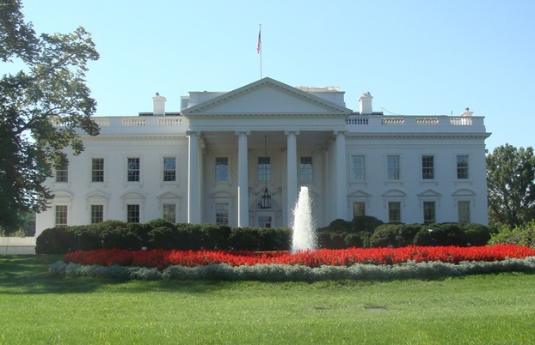
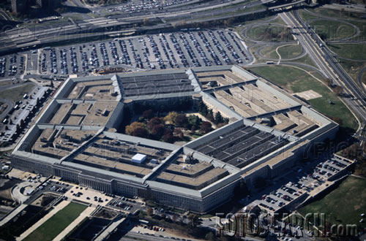
LSS+^{x} HIGH SECURITY SUPPLEMENT to LSS+
THE COMPROMISE OF MEDECO HIGH SECURITY LOCKS:
New Techniques of Forced, Covert, and Surreptitious Entry

Slide 2
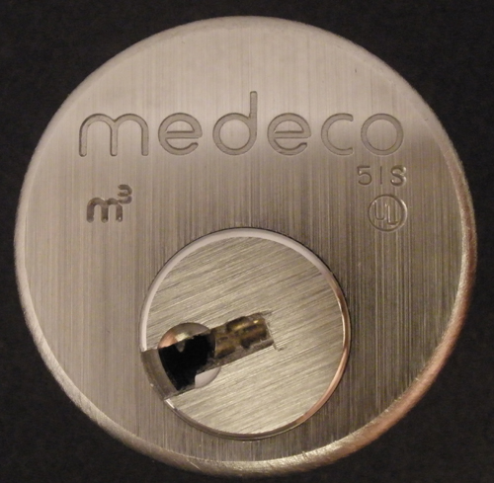
MEDECO HIGH SECURITY

Slide 3
MEDECO HIGH SECURITY: What it means
UL, BHMA/ANSI, Vd.S Certified
High level of protection against attack
Picking: 10-15 minute resistance
No bumping
Forced Entry: 5 minutes, minimum
Key control
Protect restricted and proprietary keyways
Stop duplication, replication, simulation of keys

Slide 4
ATTACK METHODOLOGY FOR HIGH SECURITY LOCKS
Assume and believe nothing
Ignore the experts
Think “out of the box”
Consider prior methods of attack
Always believe there is a vulnerability
WORK THE PROBLEM
Consider all aspects and design parameters
Do not exclude any solution

Slide 5
HIGH SECURITY LOCKS: Critical Design Issues
Multiple security layers
More than one point of failure
Each security layer is independent
Security layers operate in parallel
Difficult to derive intelligence about a layer

Slide 6
HIGH SECURITY: Three Critical Design Factors
Resistance against forced entry
Resistance against covert and surreptitious entry
Key control and “key security”
Vulnerabilities for each requirement

Slide 7
EXPLOIT DESIGN FEATURES AND SYSTEM PARAMETERS
Codes: design, progression
Key bitting design
Tolerances
Keying rules
Medeco master and non-master key systems
Interaction of critical components and locking systems
Keyway and plug design

Slide 8
KEY CONTROL
High security requirement

Slide 9
KEY CONTROL and “KEY SECURITY”
Duplicate
Replicate
Simulate
“Key control” and “Key Security” may not be synonymous!

Slide 10
KEY SECURITY: A Concept
Key control = physical control of keys
Prevent manufacture and access to blanks
Control generation of keys by code
Patent protection
Key security = compromise of keys
Duplication
Replication
Simulation

Slide 11
KEYS: CRITICAL ELEMENTS
Length = number of pins/sliders/disks
Height of blade = depth increments = differs
Thickness of blade = keyway design
Paracentric design
Keyway modification to accommodate other security elements
Finger pins
Sliders

Slide 12
KEY CONTROL: Critical issues
Simulation of code or key components
Security of locks = key control and key security
All bypass techniques simulate actions of key
Easiest way to open a lock is with the key

Slide 13
COVERT and FORCED ENTRY RESISTANCE
High security requirement

Slide 14
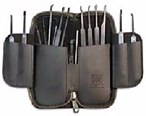
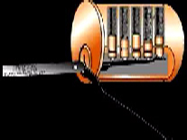
CONVENTIONAL PICKING

Slide 15
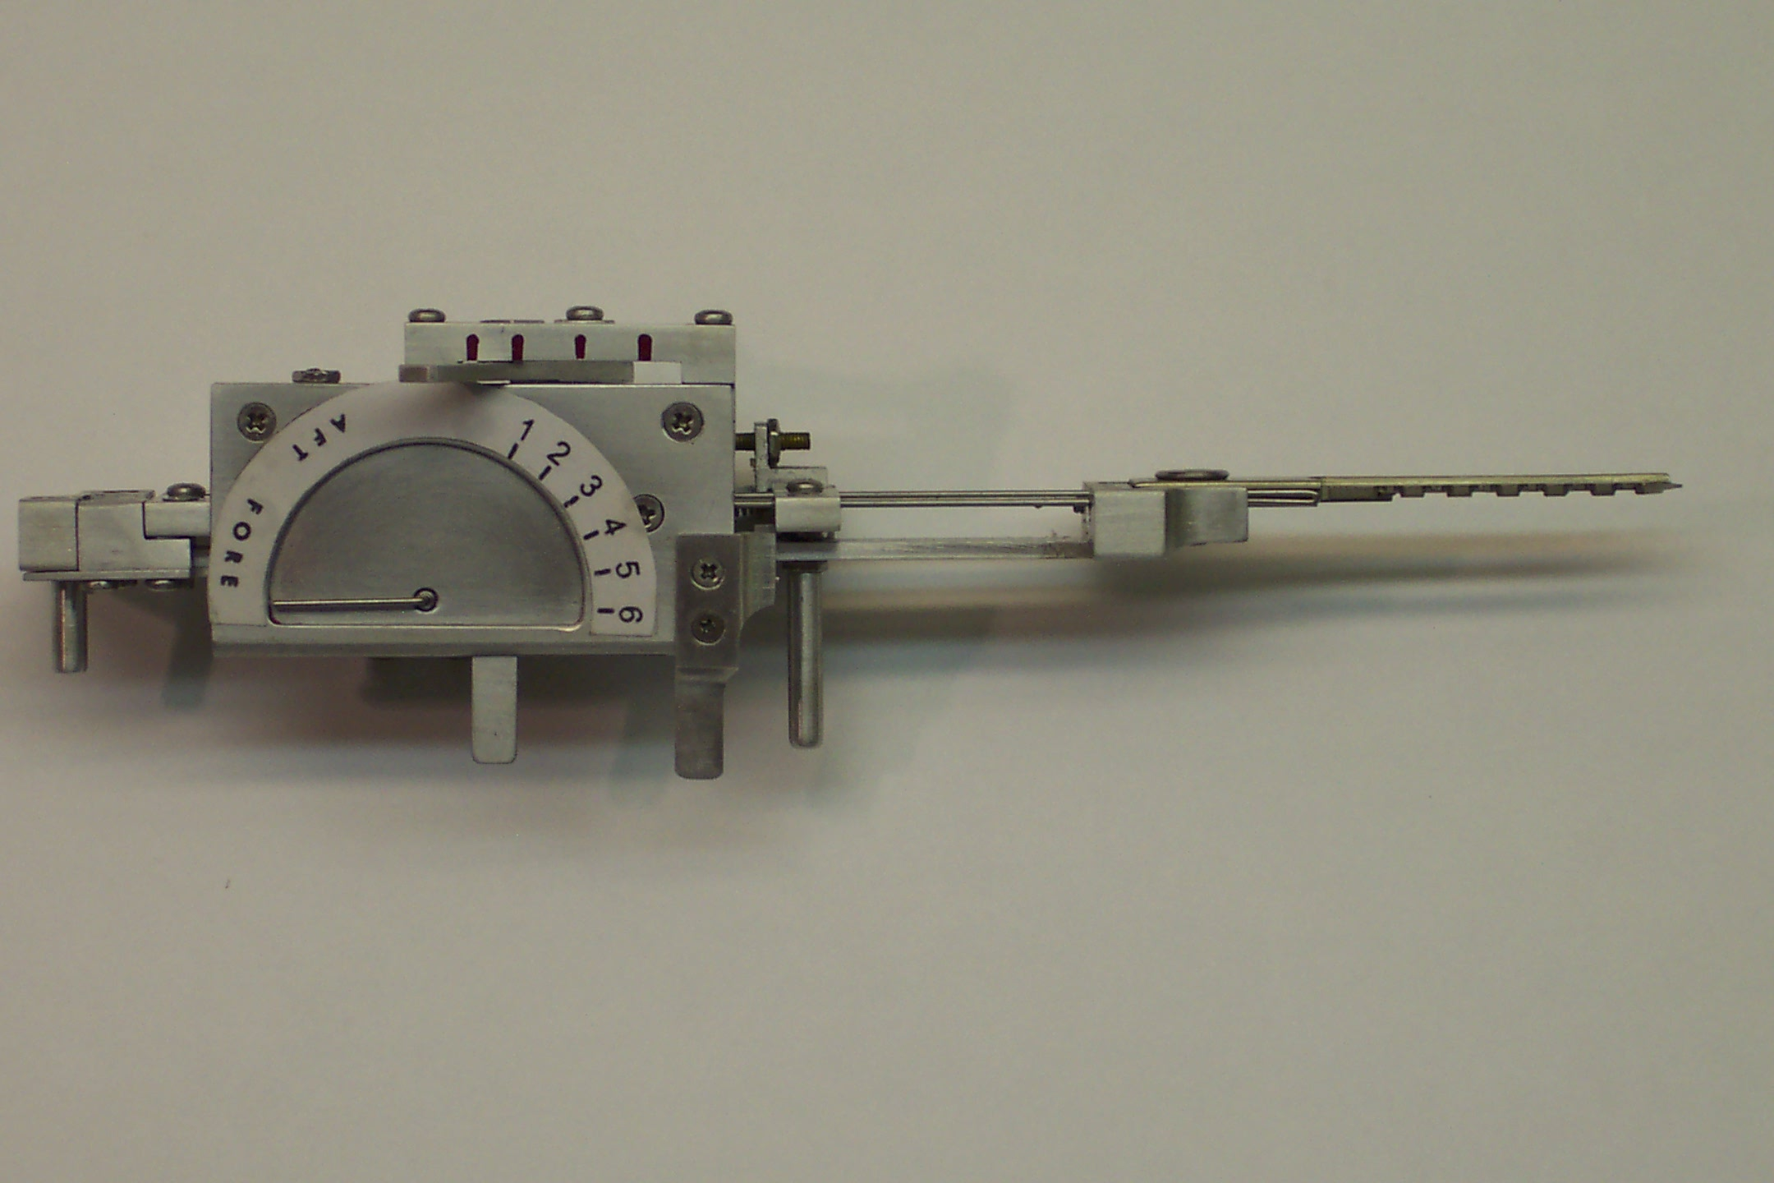
TOBIAS DECODER: Medeco decoder: by “Crackpot!”

Slide 16

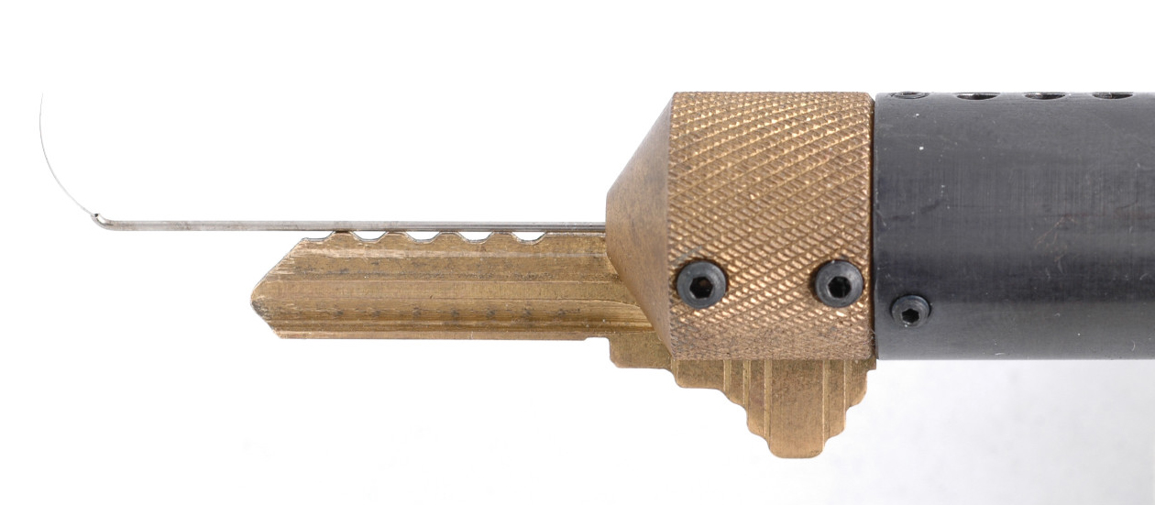
SOPHISTICATED DECODERS
John Falle: Wire Shim Decoder

Slide 17
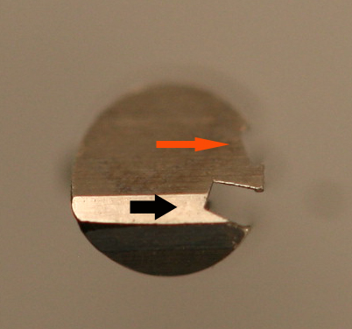
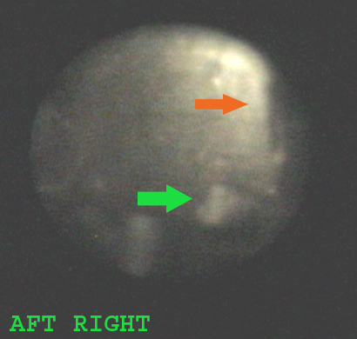
DECODE PIN ANGLES

Slide 18
FORCED ENTRY RESISTANCE
High security requirement

Slide 19
FORCED ATTACK METHODS
Original deadbolt design
Interim deadbolt design
Final deadbolt version
Reverse picking attack
Mortise, Rim, and IC
Simulated key in plastic
Set shear line
Turn the plug

Slide 20
SIDEBAR ATTACK: Physical Strength
Independent protection
Integrated with pin tumblers or other critical locking components
Compress plug
Defeat of sidebar as one security layer: result and failures
Anti-drill protection

Slide 21
FORCED ENTRY ATTACKS
Direct compromise of critical components
Medeco deadbolt 1 and 2 manipulate tailpiece
Hybrid attack: two different modes
Medeco reverse picking
Defeat of one security layer: result
Medeco Mortise and rim cylinders, defeat shear line

Slide 22
MEDECO CASE HISTORY
Exploited vulnerabilities
Reverse engineer sidebar codes
Analyze what constitutes security
Analyze critical tolerances
Analyze key control issues
Analyze design enhancements for new generations of locks: Biaxial and m3 and Bilevel

Slide 23
DESIGN = VULNERABILITIES
Basic design: sidebar legs + gates
How they work: leg + gate interface
Tolerance of gates
Biaxial code designation
Biaxial pin design: aft position decoding
M3 slider: geometry
M3 keyway design
Deadbolt design

Slide 24
MEDECO DESIGN: Exploit design vulnerabilities
EXPLOIT BEST DESIGN FEATURES
Sidebar leg – true gate channel
Code assignment: Biaxial 1985
Gate – sidebar leg tolerance
M3 design 2003
Widen keyway .007”
Slider geometry, .040” offset

Slide 25
MEDECO LOCKS: Why are they Secure?
2 shear lines and sidebar for Biaxial
3 independent security layers: m3
Pins = 3 rotation angles, 6 permutations
Physical pin manipulation difficult
False gates and mushroom pins
ARX special anti-pick pins
High tolerance

Slide 26
MEDECO LOCKS: 3 Independent Security Layers
Layer 1: PIN TUMBLERS to shear line
Layer 2: SIDEBAR: 3 angles x 2 positions
Layer 3: SLIDER – 26 positions
TO OPEN:
Lift the pins to shear line
Rotate each pin individually
Move the slider to correct position

Slide 27
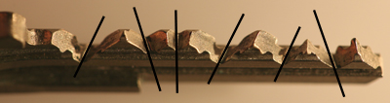
MEDECO TWISTING PINS: 3 Angles + 2 Positions

Slide 28
SECURITY CONCEPTS: Sidebar IS Medeco Security
GM locks, 1935, Medeco re-invented
Heart of Medeco security and patents
Independent and parallel security layer
Integrated pin: lift and rotate to align
Sidebar blocks plug rotation
Pins block manipulation of pins for rotation to set angles

Slide 29
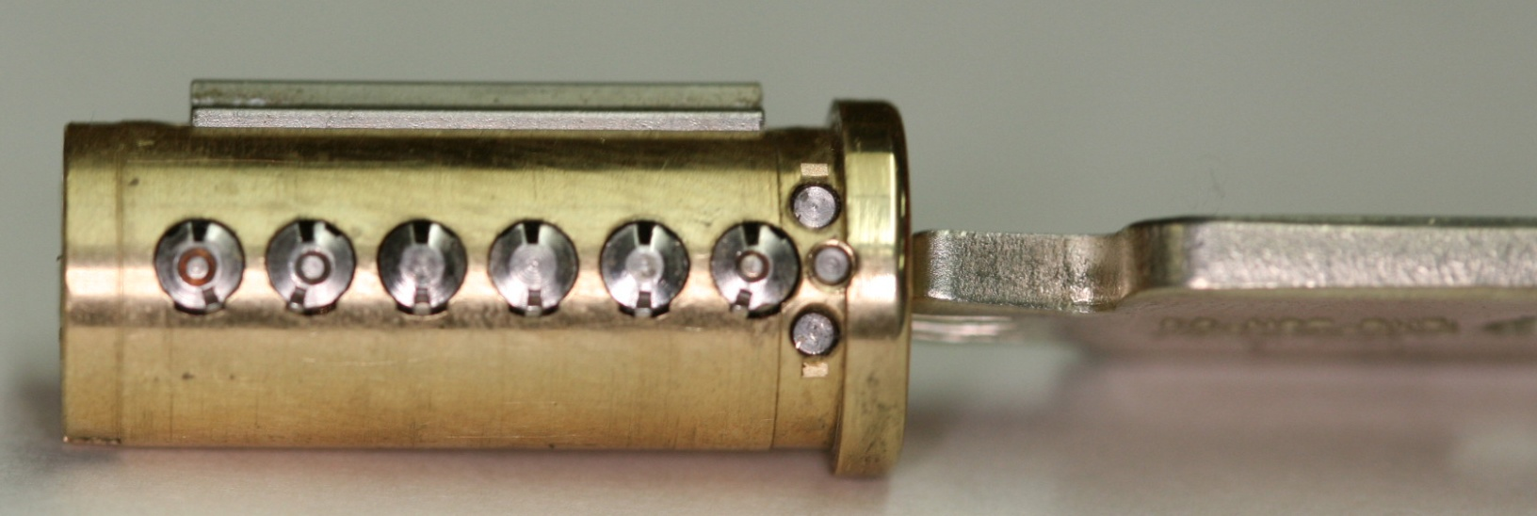
PLUG AND SIDEBAR: All pins aligned

Slide 30
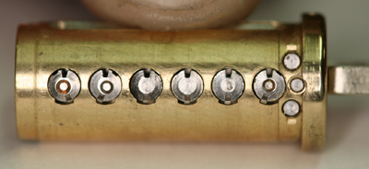
SIDEBAR RETRACTED

Slide 31
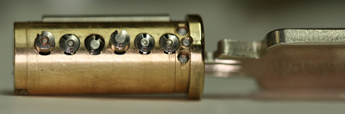
PLUG AND SIDEBAR: Locked

Slide 32
MEDECO CODEBOOK: At the heart of security
All locksmiths worldwide must use
All non-master keyed systems
New codes developed for Biaxial in 1983
Chinese firewall: MK and Non-MK
Codebook defines all sidebar codes

Slide 33
MEDECO RESEARCH: Results of Project
Covert and surreptitious entry in as little as 30 seconds: standard requires 10-15 minutes
Forced entry: four techniques, 30 seconds, affect millions of locks
Complete compromise of key control
Duplication, replication, simulation of keys
Creation of bump keys and code setting keys
Creation of top level master keys

Slide 34
RESULTS OF PROJECT: Bumping
Reliably bump open Biaxial and m3 locks
Produce bump keys on Medeco blanks and simulated blanks
Known sidebar code
Unknown sidebar code

Slide 35
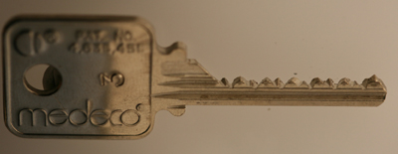
MEDECO BUMP KEY

Slide 36
RESULTS OF PROJECT: Key Control and Key Security
Total compromise of key control and key security, vital to high security locks
Duplicate, replicate, simulate keys for all m3 and some Biaxial keyways
Restricted keyways, proprietary keyways
Government and large facilities affected
Attack master key systems
Produce bump keys
Produce code setting keys

Slide 37
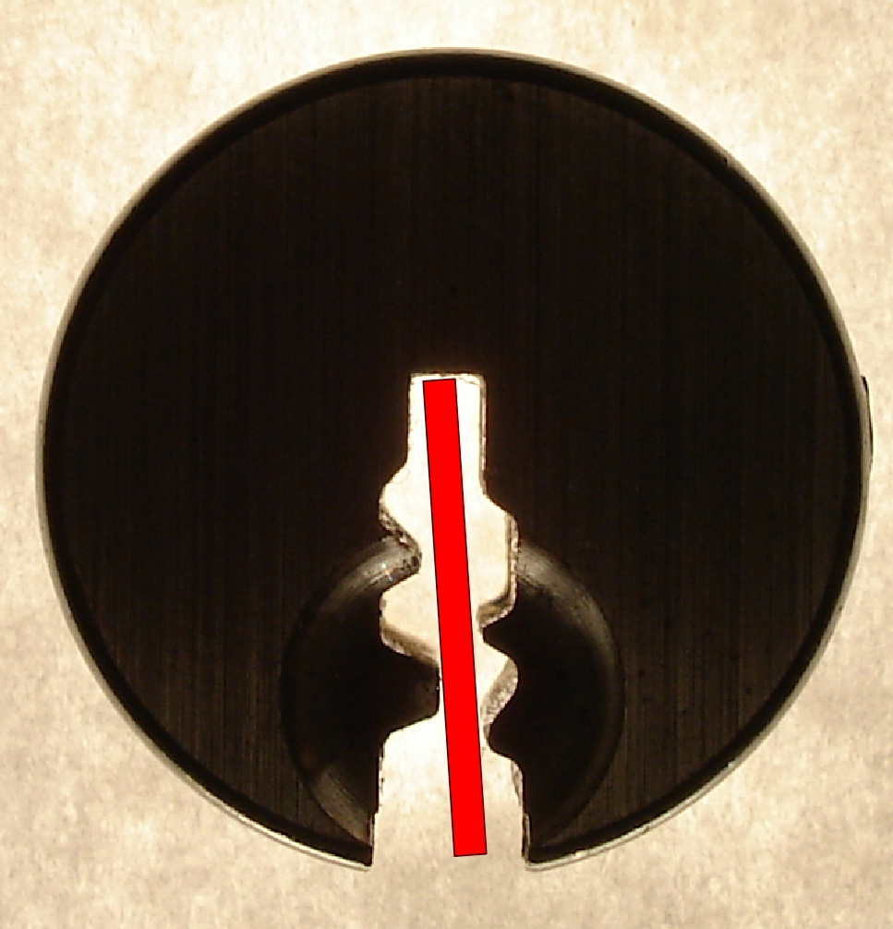
SIMULATED BLANKS: Any m3 and Many Biaxial Locks

Slide 38
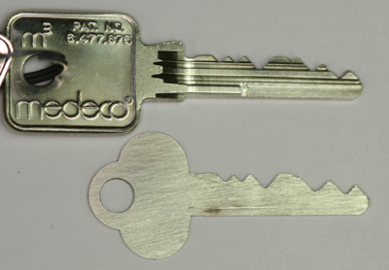
SIMULATED BLANKS

Slide 39
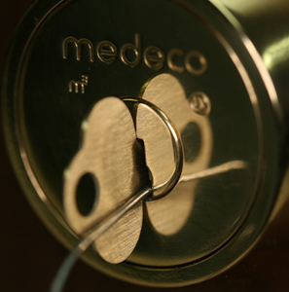
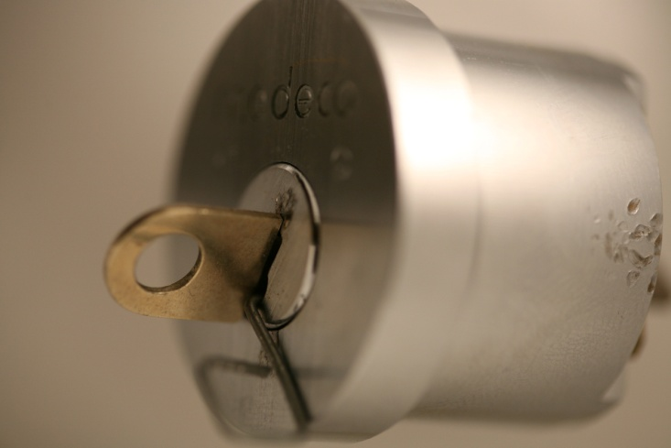
M3 SLIDER: Bypass with a Paper clip

Slide 40
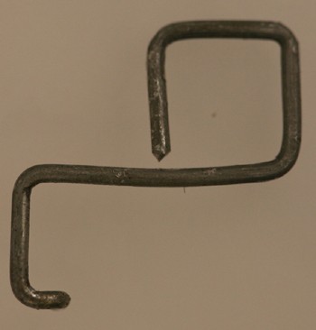
SECURITY OF m3: High Tech Wire!

Slide 41
RESULTS OF PROJECT: Picking
Pick the locks in as little as 30 seconds
Standard picks, not high tech tools
Use of another key in the system to set the sidebar code
Pick all pins or individual pins
Neutralize the sidebar as security layer

Slide 42
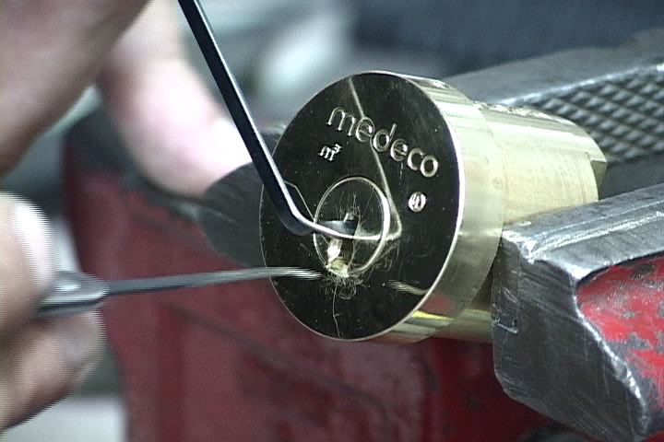
PICKING A MEDECO LOCK

Slide 43
RESULTS OF PROJECT: Decode Top Level Master Key
Determine the sidebar code in special system where multiple sidebar codes are employed to protect one or more locks
Decode the TMK
OWN the system

Slide 44
RESULTS OF PROJECT: Forced Entry Techniques
Deadbolt attacks on all three versions
Deadbolt 1 and 2: 30 seconds
Deadbolt 3: New hybrid technique of reverse picking
Mortise and rim cylinders
Prior intelligence + simulated key
Interchangeable core locks

Slide 45
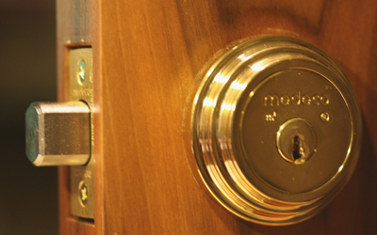
DEADBOLT ATTACK

Slide 46

DEADBOLT BYPASS: 2$ Screwdriver + $.25 materials

Slide 47
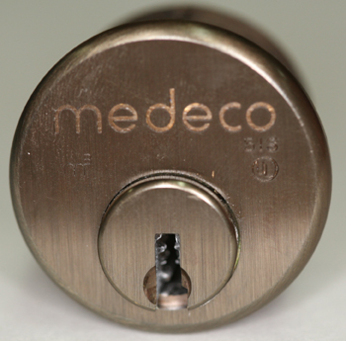
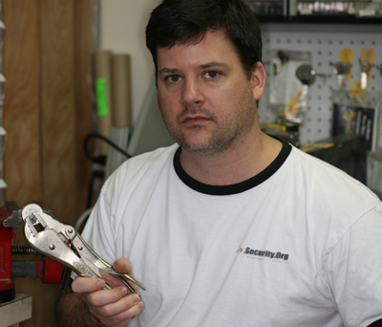
MORTISE CYLINDER

Slide 48
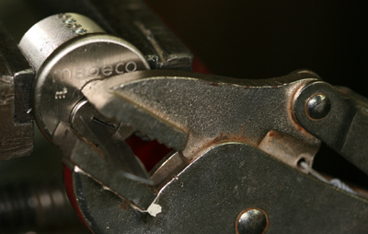
MORTISE ATTACK

Slide 49
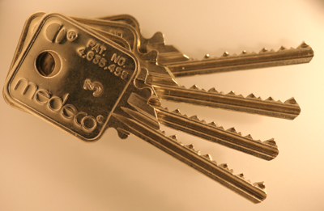
4 KEYS TO THE KINGDOM

Slide 50

REAL WORLD ATTACK: Bumping a Medeco Lock

Slide 51
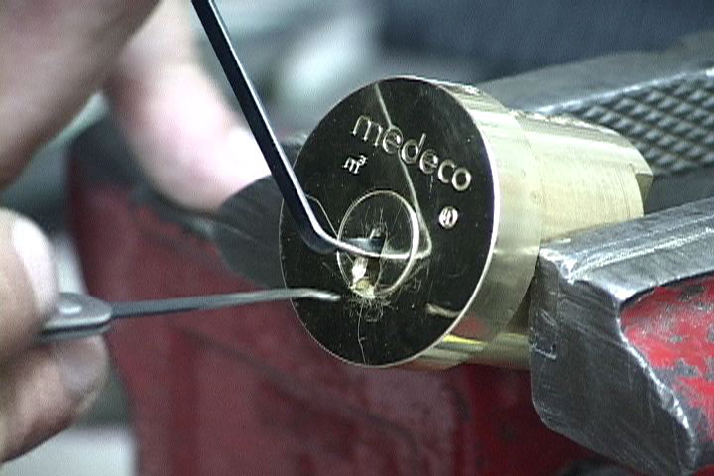
OPEN IN THIRTY SECONDS
Setting the Sidebar Code
Conventional pick tools

Slide 52
THE COMPROMISE OF MEDECO HIGH SECURITY LOCKS: New Techniques of Forced, Covert, and Surreptitious Entry
© 2008 Marc Weber Tobias and
Tobias Bluzmanis
www.security.org
mwtobias@security.org

