Slide 1


LSS+^{x} HIGH SECURITY SUPPLEMENT to LSS+
THE COMPROMISE OF MEDECO HIGH SECURITY LOCKS:
New Techniques of Forced, Covert, and Surreptitious Entry

Slide 2
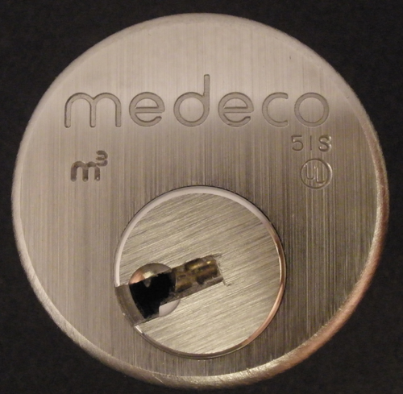
MEDECO HIGH SECURITY

Slide 3
MEDECO HIGH SECURITY: What it means
UL, BHMA/ANSI, Vd.S Certified
High level of protection against attack
Picking: 10-15 minute resistance
No bumping
Forced Entry: 5 minutes, minimum
Key control
Protect restricted and proprietary keyways
Stop duplication, replication, simulation of keys

Slide 4
ATTACK METHODOLOGY FOR HIGH SECURITY LOCKS
Assume and believe nothing
Ignore the experts
Think “out of the box”
Consider prior methods of attack
Always believe there is a vulnerability
WORK THE PROBLEM
Consider all aspects and design parameters
Do not exclude any solution

Slide 5
EXPLOIT DESIGN FEATURES AND SYSTEM PARAMETERS
Codes: design, progression
Key bitting design
Tolerances
Keying rules
Medeco master and non-master key systems
Interaction of critical components and locking systems
Keyway and plug design

Slide 6
KEY CONTROL
High security requirement

Slide 7
KEY CONTROL and “KEY SECURITY”
Duplicate
Replicate
Simulate
“Key control” and “Key Security” may not be synonymous!

Slide 8
KEY SECURITY: A Concept
Key control = physical control of keys
Prevent manufacture and access to blanks
Control generation of keys by code
Patent protection
Key security = compromise of keys
Duplication
Replication
Simulation

Slide 9
KEY CONTROL: Critical issues
Simulation of code or key components
Security of locks = key control and key security
All bypass techniques simulate actions of key
Easiest way to open a lock is with the key

Slide 10
COVERT and FORCED ENTRY RESISTANCE
High security requirement

Slide 11
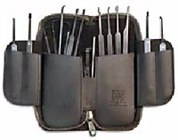
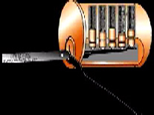
CONVENTIONAL PICKING

Slide 12
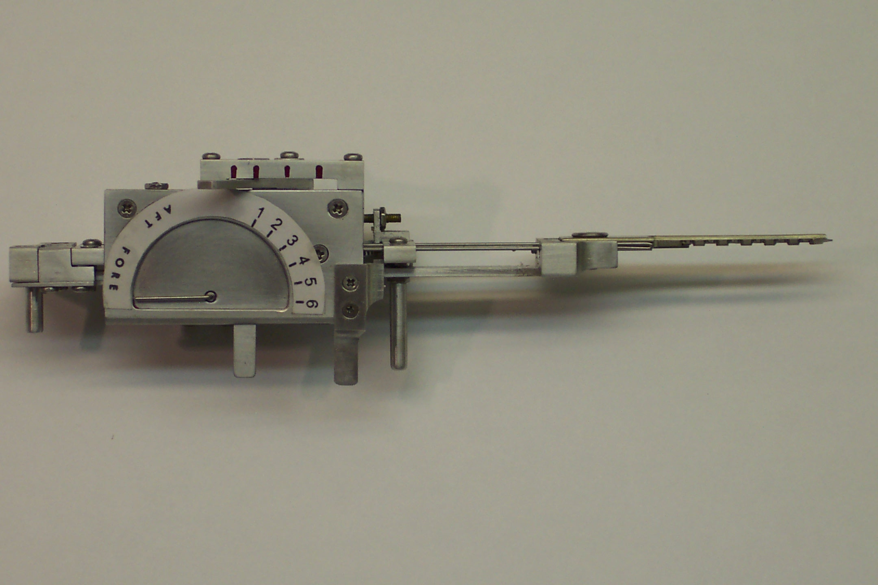
TOBIAS DECODER: Medeco decoder: by “Crackpot!”

Slide 13

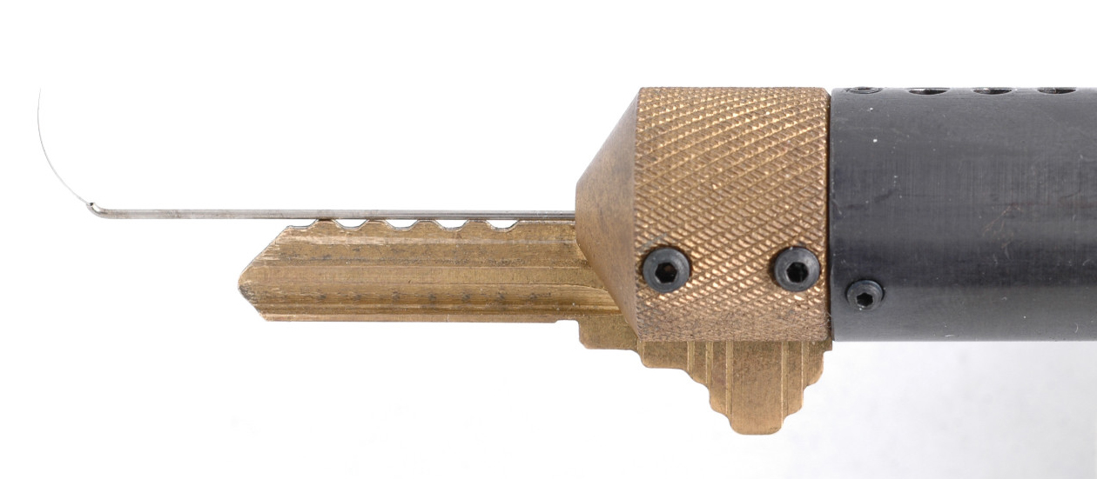
SOPHISTICATED DECODERS
John Falle: Wire Shim Decoder

Slide 14
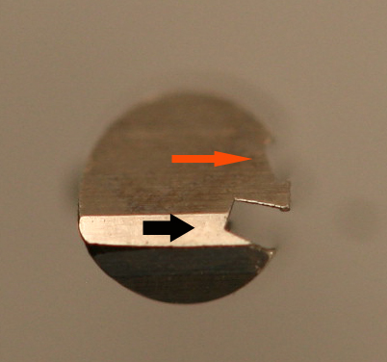
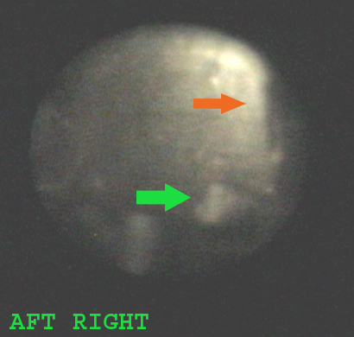
DECODE PIN ANGLES

Slide 15
FORCED ENTRY RESISTANCE
High security requirement

Slide 16
FORCED ATTACK METHODS
Original deadbolt design
Interim deadbolt design
Final deadbolt version
Reverse picking attack
Mortise, Rim, and IC
Simulated key in plastic
Set shear line
Turn the plug

Slide 17
FORCED ENTRY ATTACKS
Direct compromise of critical components
Medeco deadbolt 1 and 2 manipulate tailpiece
Hybrid attack: two different modes
Medeco reverse picking
Defeat of one security layer: result
Medeco Mortise and rim cylinders, defeat shear line

Slide 18
MEDECO CASE HISTORY
Exploited vulnerabilities
Reverse engineer sidebar codes
Analyze what constitutes security
Analyze critical tolerances
Analyze key control issues
Analyze design enhancements for new generations of locks: Biaxial and m3 and Bilevel

Slide 19
DESIGN = VULNERABILITIES
Basic design: sidebar legs + gates
How they work: leg + gate interface
Tolerance of gates
Biaxial code designation
Biaxial pin design: aft position decoding
M3 slider: geometry
M3 keyway design
Deadbolt design

Slide 20
MEDECO DESIGN: Exploit design vulnerabilities
EXPLOIT BEST DESIGN FEATURES
Sidebar leg – true gate channel
Code assignment: Biaxial 1985
Gate – sidebar leg tolerance
M3 design 2003
Widen keyway .007”
Slider geometry, .040” offset

Slide 21
MEDECO LOCKS: 3 Independent Security Layers
Layer 1: PIN TUMBLERS to shear line
Layer 2: SIDEBAR: 3 angles x 2 positions
Layer 3: SLIDER – 26 positions
TO OPEN:
Lift the pins to shear line
Rotate each pin individually
Move the slider to correct position

Slide 22
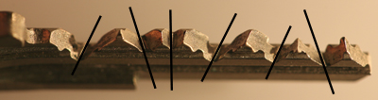
MEDECO TWISTING PINS: 3 Angles + 2 Positions

Slide 23
SECURITY CONCEPTS: Sidebar IS Medeco Security
GM locks, 1935, Medeco re-invented
Heart of Medeco security and patents
Independent and parallel security layer
Integrated pin: lift and rotate to align
Sidebar blocks plug rotation
Pins block manipulation of pins for rotation to set angles

Slide 24
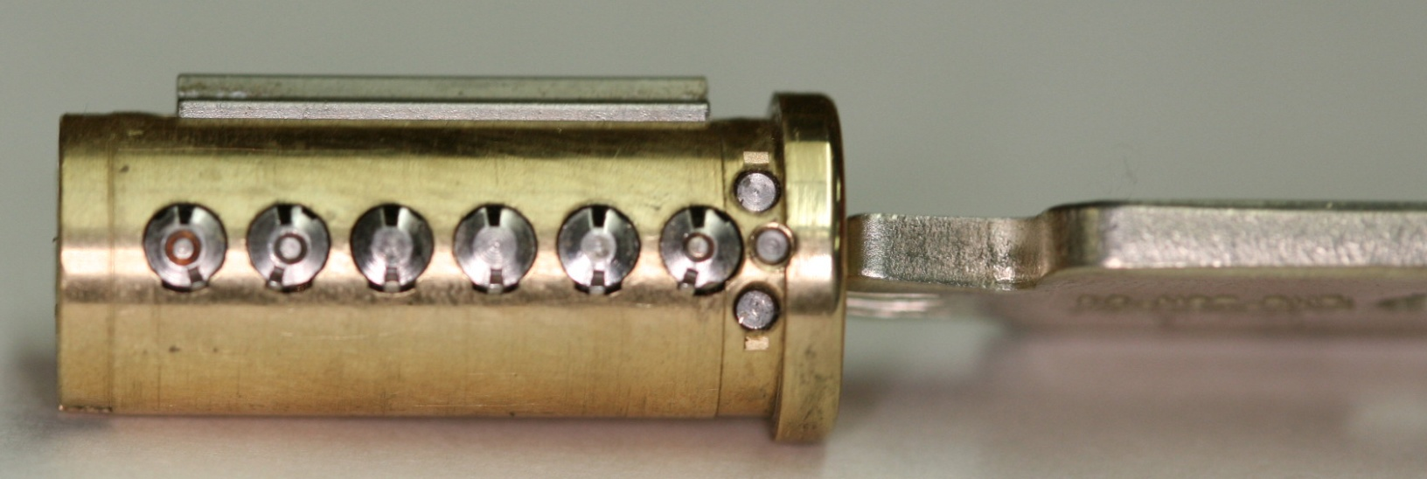
PLUG AND SIDEBAR: All pins aligned

Slide 25
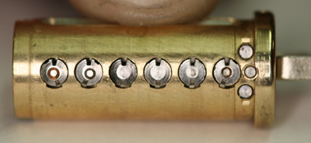
SIDEBAR RETRACTED

Slide 26
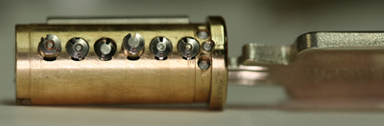
PLUG AND SIDEBAR: Locked

Slide 27
MEDECO CODEBOOK: At the heart of security
All locksmiths worldwide must use
All non-master keyed systems
New codes developed for Biaxial in 1983
Chinese firewall: MK and Non-MK
Codebook defines all sidebar codes

Slide 28
MEDECO RESEARCH: Results of Project
Covert and surreptitious entry in as little as 30 seconds: standard requires 10-15 minutes
Forced entry: four techniques, 30 seconds, affect millions of locks
Complete compromise of key control
Duplication, replication, simulation of keys
Creation of bump keys and code setting keys
Creation of top level master keys

Slide 29
RESULTS OF PROJECT: Bumping
Reliably bump open Biaxial and m3 locks
Produce bump keys on Medeco blanks and simulated blanks
Known sidebar code
Unknown sidebar code

Slide 30
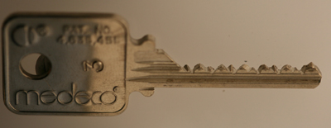
MEDECO BUMP KEY

Slide 31
RESULTS OF PROJECT: Key Control and Key Security
Total compromise of key control and key security, vital to high security locks
Duplicate, replicate, simulate keys for all m3 and some Biaxial keyways
Restricted keyways, proprietary keyways
Government and large facilities affected
Attack master key systems
Produce bump keys
Produce code setting keys

Slide 32
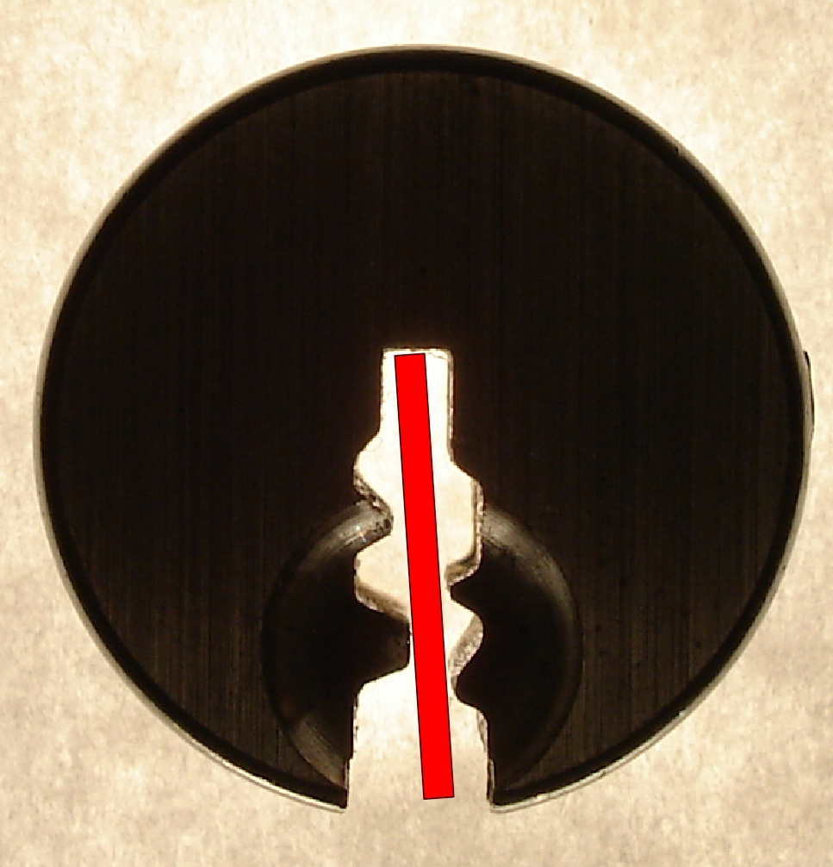
SIMULATED BLANKS: Any m3 and Many Biaxial Locks

Slide 33
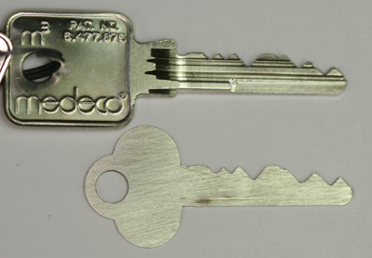
SIMULATED BLANKS

Slide 34
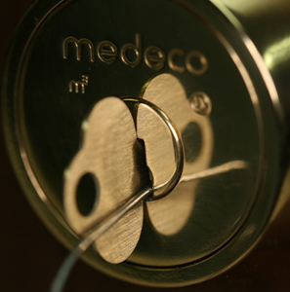
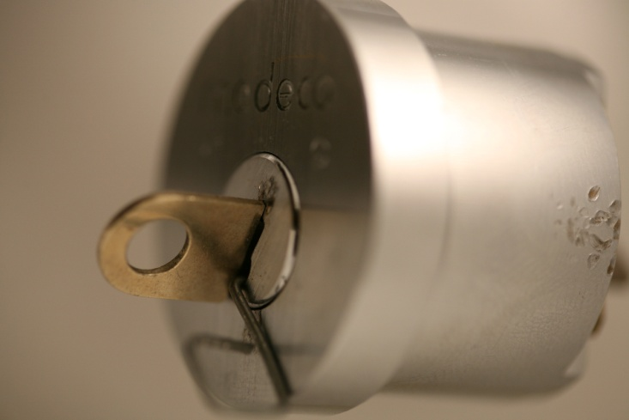
M3 SLIDER: Bypass with a Paper clip

Slide 35
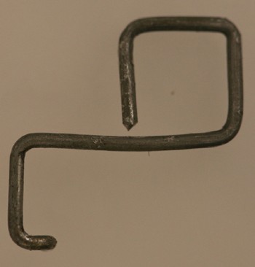
SECURITY OF m3: High Tech Wire!

Slide 36
RESULTS OF PROJECT: Picking
Pick the locks in as little as 30 seconds
Standard picks, not high tech tools
Use of another key in the system to set the sidebar code
Pick all pins or individual pins
Neutralize the sidebar as security layer

Slide 37
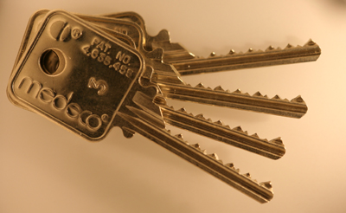
CODE SETTING KEYS

Slide 38
CODE SETTING KEYS
FACTORY BLANKS
SIMULATED BLANKS FOR ANY m3 and MANY BIAXIAL KEYWAYS
USE A CHANGE KEY TO SET CODE

Slide 39

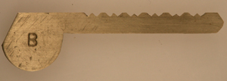
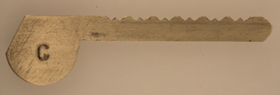
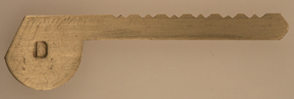
CODE SETTING KEYS: SIMULATED BLANKS

Slide 40
SET THE SIDEBAR CODE

Slide 41
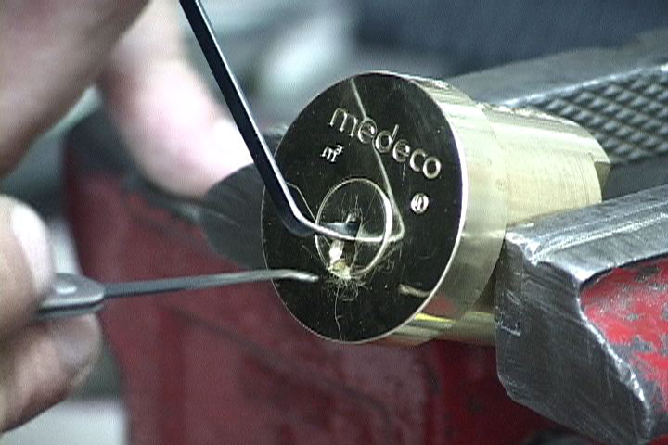
CONVENTIONAL PICKING
Setting the Sidebar Code
Conventional pick tools

Slide 42
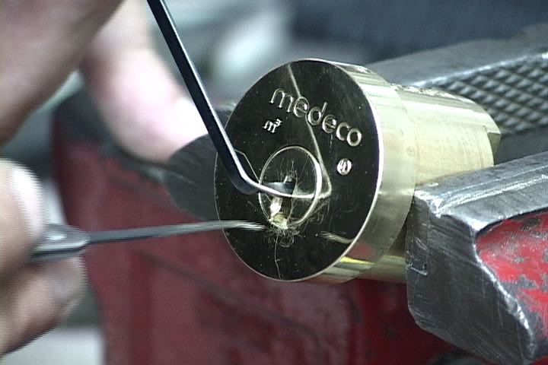
PICKING A MEDECO LOCK

Slide 43
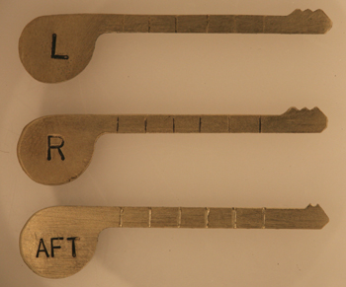
SET INDIVIDUAL ANGLES

Slide 44
RESULTS OF PROJECT: Decode Top Level Master Key
Determine the sidebar code in special system where multiple sidebar codes are employed to protect one or more locks
Decode the TMK
OWN the system

Slide 45
RESULTS OF PROJECT: Forced Entry Techniques
Deadbolt attacks on all three versions
Deadbolt 1 and 2: 30 seconds
Deadbolt 3: New hybrid technique of reverse picking
Mortise and rim cylinders
Prior intelligence + simulated key
Interchangeable core locks

Slide 46
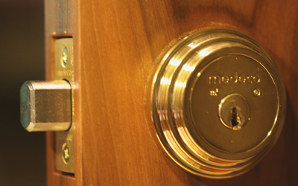
DEADBOLT ATTACK

Slide 47

DEADBOLT BYPASS: 2$ Screwdriver + $.25 materials

Slide 48
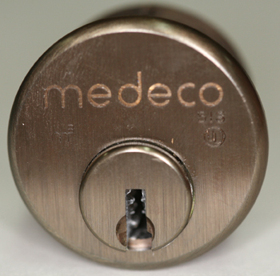
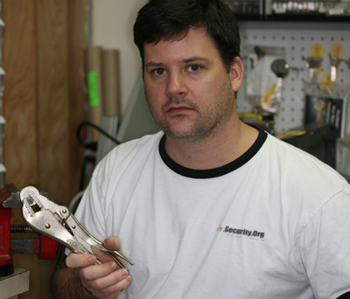
MORTISE CYLINDER

Slide 49
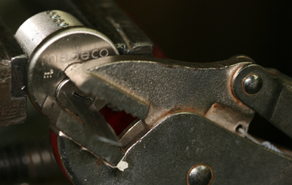
MORTISE ATTACK

Slide 50

REAL WORLD ATTACK: Bumping a Medeco Lock

Slide 51
OPEN IN THIRTY SECONDS
Setting the Sidebar Code
Conventional pick tools

Slide 52
THE COMPROMISE OF MEDECO HIGH SECURITY LOCKS: New Techniques of Forced, Covert, and Surreptitious Entry
© 2008 Marc Weber Tobias and
Tobias Bluzmanis
www.security.org
mwtobias@security.org

