Slide 1
MEDECO “VIRTUALLY RESISTANT” SECURITY
A Case Study in Real World
Security Vulnerabilities

Slide 2
HIGH SECURITY LOCKS
SPECIFY FOR FACILITY PROTECTION
COVERT ENTRY
FORCED ENTRY
KEY CONTROL
MINIMUM SECURITY CRITERIA
Minimum attack times
Resistance to certain forms of entry
UL 437 and BHMA/ANSI 156.30

Slide 3
COVERT ENTRY PROTECTION: The Theory
MINIMUM SECURITY CRITERIA IN UL 437 and BHMA/ANSI 156.30
PROTECT AGAINST CERTAIN FORMS OF COVERT ENTRY
ASSURE MINIMUM RESISTANCE TIMES TO OPEN

Slide 4
COVERT ENTRY OF MEDECO LOCKS: RESULT
BUMPING
Modified change key
Simulated key
PICKING
With change key
With code setting keys
EXTRAPOLATE TMK
DECODE BILEVEL SYSTEM TO COMPROMISE m3 SYSTEM

Slide 5
MEDECO INSECURITY: Real World Threats - Covert
FOUR KEYS TO PICK AND BUMP PRE-12/07 LOCKS
SIXTEEN OR LESS KEYS FOR 2008 LOCKS
PICKING IN AS LITTLE AS 27 SECONDS
Using any change key on same sidebar code
With code setting keys
Angle setting keys
ARX pins

Slide 6
MEDECO INSECURITY: Real World Threats - Covert
BUMPING
With correct blank and sidebar code
With simulated blank
With or without ARX pins

Slide 7
FORCED ENTRY PROTECTION: Theory
LOCKS ARE SECURE AGAINST FORCED METHODS OF ATTACK
MINIMUM TIMES SPECIFIED IN UL 437 and BHMA/ANSI 156.30
ATTACK RESISTANCE: 5 MINUTES

Slide 8
MEDECO INSECURITY: Real World Threats – Forced
DEADBOLT Pre-12/2007
Thirty seconds
Complete circumvention of security
Simple tools, easy to accomplish
DEADBOLT 2008
Reverse picking attack
MORTISE, RIM, ICORE
Hybrid attack, compromise of key control

Slide 9
MEDECO INSECURITY: Real World Threats - Keys
VIOLATION OF KIEY CONTROL and KEY SECURITY
Compromise of entire facility
Improper generation of keys

Slide 10
MEDECO INSECURITY: Key Control Protective Measures
FACILITY RESTRICTIONS
No paper clips
No Copiers, scanners, cameras
No scissors or X-Acto knives
No plastic report covers
No Shrinky-Dink plastic
No printers
No email or Fax connections to outside world

Slide 11
MEDECO INSECURITY: Real World Threats - Keys
NO KEY CONTROL OR KEY SECURITY
All m3 and some Biaxial keyways
Keyways (restricted and proprietary)
M3 Step = no security
Copy keys
Produce any blank
Generate Top Level Master Key
Cut any key by code

Slide 12
MEDECO INSECURITY: The Threat from Within
COMPROMISE OF KEY CONTROL + HYBRID ATTACK
Mortise, Rim, Interchangeable cores
MEDECO KEY CONTROL v. CONVENTIONAL KEYS
Conventional keys = 1 layer of security
Medeco keys = 3 layers of security

Slide 13
MEDECO INSECURITY: The Threat from Within
OBTAIN KEY DATA TO OPEN LOCKS BY HYBRID ATTACK
KEY CONTROL IS CIRCUMVENTED
BRIEF ACCESS TO A KEY FOR A TARGET LOCK
Compromise of the lock or system
By insiders
By criminals outside of an organization

Slide 14
MEDECO INSECURITY: Key Control and Layers of Security
THREE LAYERS OF SECURITY
Shear Line
Sidebar
Slider in m3
HYBRID ATTACK: NEUTRALIZE EACH LAYER OF SECURITY
Shear line = Plastic key
Sidebar and Slider = Torque on plug

Slide 15
MEDECO KEY CONTROL: Appearance v. Reality
WHAT IS IT SUPPOSED TO MEAN?
ARE THE STANDARDS SUFFICIENT?
REAL WORLD VULNERABILITIES
[DO NOT DUPLICATE IMAGE]

Slide 16
KEY CONTROL: The Theory
PROTECTION OF BLANKS OR CUT KEYS FROM ACQUISITION OR USE:
Unauthorized duplication
Unauthorized replication
Unauthorized simulation
restricted keyways
proprietary keyways
sectional keyways

Slide 17
KEYS and KEY CONTROL
KEYS ARE THE EASIEST WAY TO OPEN LOCKS
Change key or master key
Duplicate correct bitting
Bump keys
Rights amplification: modify keys
PROTECTION OF KEYS
Side bit milling: Primus and Assa
Interactive elements: Mul-T-Lock
Magnets: EVVA MCS

Slide 18
SECURITY THREAT: Failure of Key Control: Duplicate
IMPROPER ACQUISITION OR USE OF KEYS BY EMPLOYEES OR CRIMINALS
Unauthorized access to facilities or areas
Bump keys
Use for rights amplification
Compromise master key systems

Slide 19
SECURITY THREAT: Failure of Key Control: Replicate
HIGH SECURITY LOCKS AND KEYS
Designed to prevent replication
REPLICATION TECHNIQUES
EASY ENTRIE MILLING MACHINE
SILINCONE CASTING
PLASTIC AND EPOXY

Slide 20
SECURITY THREAT: Failure of Key Control: Simulate
M3 KEYWAY
Wider than Biaxial
No paracentric keyway
COMPONENTS OF MEDECO KEYS
Ward pattern and paracentric keyway
Bitting
M3 Slider
SECURITY THREAT
Bypass wards in paracentric keyway
Create new blanks

Slide 21
RESULT: Failure of Key Control
Restricted and proprietary keyways
M3 Slider: bypass with paper clip
Sabotage potential
Make keys to open your locks
Duplicate from codes or pictures
TMK extrapolation
Set the sidebar code

Slide 22
COMPROMISE THE SYSTEM: Obtaining the Critical Data
TECHNIQUES TO OBTAIN KEY DATA
Impressioning methods
Decoding: visual and Key Gauges
Photograph
Scan keys
Copy machine

Slide 23
KEY CONTROL: Why Most Keys are Vulnerable
CONVENTIONAL LOCKS: Single Layer
KEYWAY = KEY CONTROL
LEGAL PROTECTION DOES NOT PREVENT REAL WORLD ATTACKS
KEYS = BITTING HEIGHT + KEYWAY
Bypass the keyway
Raise pins to shear line

Slide 24
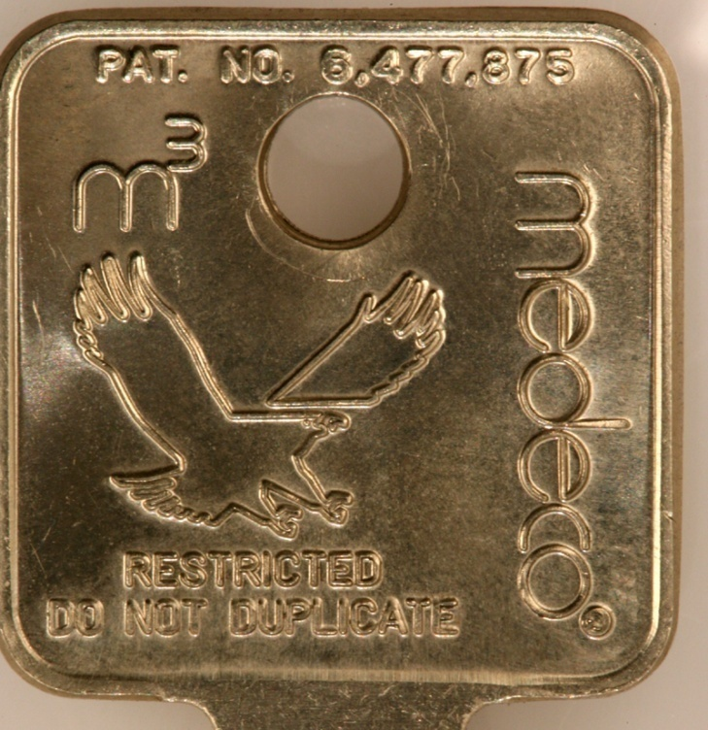
MEDECO KEY CONTROL: Virtually Impossible to Copy
[medeco quote from adv]

Slide 25
MEDECO KEY CONTROL: The Problem
CIRCUMVENTING SECURITY LAYERS
KEYWAYS CAN BE BYPASSED
BLANKS CAN BE SIMULATED
SIDEBAR CODES ARE SIMULATED
SLIDER CAN BE BYPASSED
NO REAL LEGAL PROTECTION EXCEPT FOR M3 STEP

Slide 26
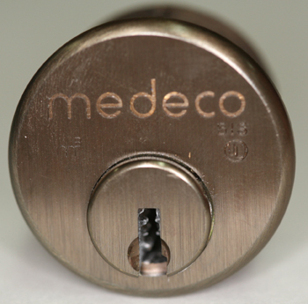
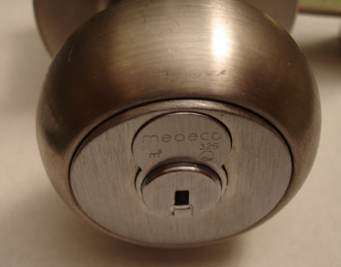
MORTISE, RIM, IC: A Special Form of Attack
HYBRID ATTACK
Will damage the lock
Entry in ten seconds
Millions of Locks affected

Slide 27
“KEYMAIL”: The New Security Threat from Within
NEW AND DANGEROUS THREAT
THE NEW MULTI-FUNCTION COPIER
It scans, copies, prints, and allows the production of MEDECO keys
[medeco copier photo]

Slide 28
KEYMAIL: How It Works for Mortise, IC, and Rim Cylinders
ACCESS TO THE TARGET KEY
CAPTURE AN IMAGE
PRINT THE IMAGE
PRODUCE A KEY
OPEN THE LOCK

Slide 29
PLASTIC KEYS: PROCEDURE
OBTAIN IMAGE OF THE KEY
Scan, copy, or photograph a Medeco key
Email and print the image remotely
Print 1:1 image on paper or plastic Shrinky Dink
Trace onto plastic or cut out the key bitting
INSERT KEY INTO PLUG
Neutralize three layers of security
Open Mortise, Rim, IC cylinders

Slide 30
ACCESS TO TARGET KEY
BORROW BRIEFLY
AUTHORIZED POSSESSION
USE
COLLUSION WITH EMPLOYEE WHO HAS ACCESS TO A KEY

Slide 31
CAPTURE AN IMAGE
COPIER
TRACE THE KEY
CELL PHONE CAMERA
SCANNER

Slide 32
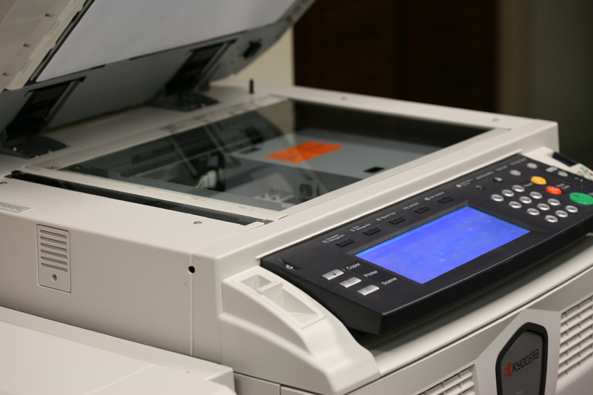
OBTAIN DATA - COPIER

Slide 33
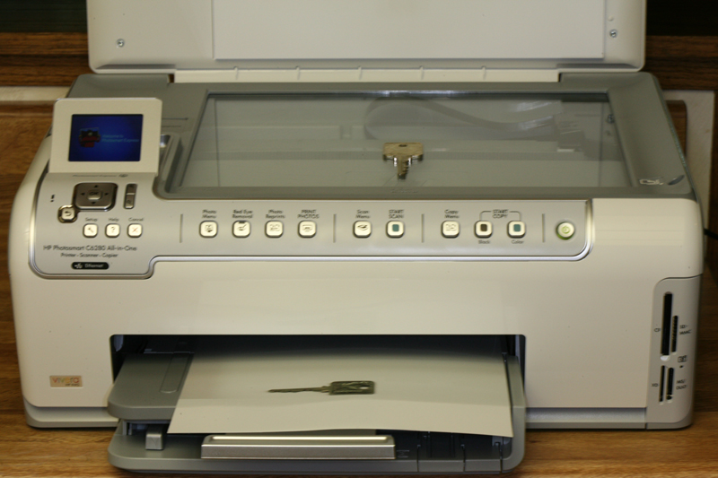
OBTAIN DATA
SCANNER

Slide 34
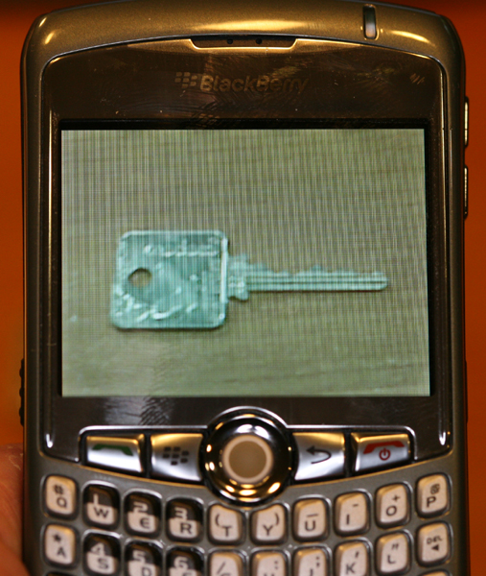
OBTAIN DATA
CELL PHONE

Slide 35
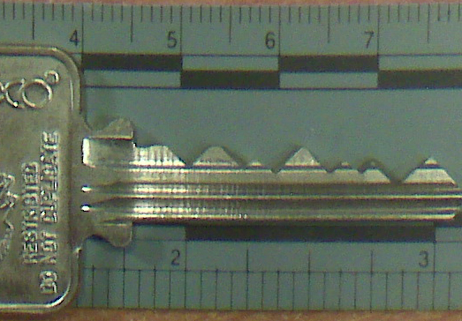
BLACKBERRY CURVE
CAPTURED IMAGE

Slide 36
RESULTING IMAGE
REPRODUCE THE IMAGE
On Paper
On plastic sheet
On Adhesive Labels
On Shrinky dinks® plastic
On a piece of copper wire
On a simulated metal key

Slide 37
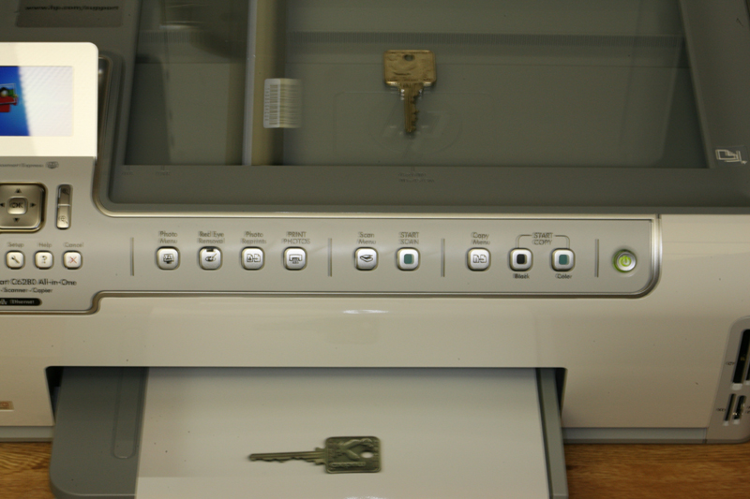
PRINT IMAGE ON PLASTIC OR PAPER

Slide 38
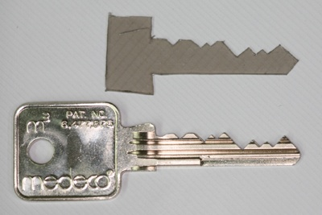
SET THE SHEAR LINE
PLASTIC KEY SETS SHEAR LINE

Slide 39
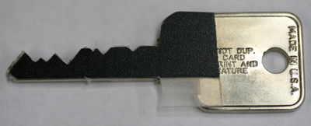

SET THE SHEAR LINE

Slide 40
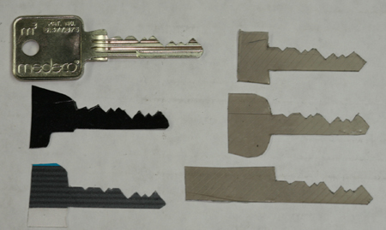
SET THE SHEAR LINE

Slide 41
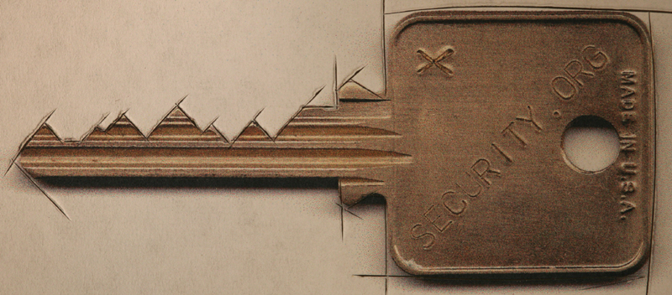
CUT A FACSIMILE OF KEY
KEY REQUIREMENTS
Vertical bitting only
No sidebar data
No slider data

Slide 42
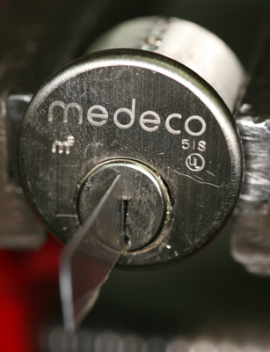
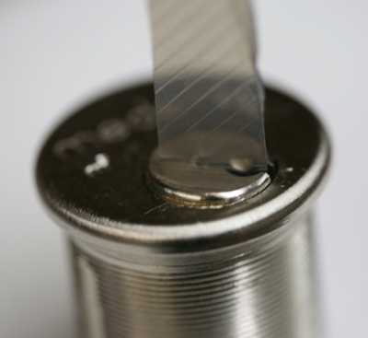
SET THE SHEAR LINE: OPEN THE LOCK

Slide 43
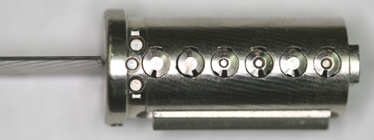
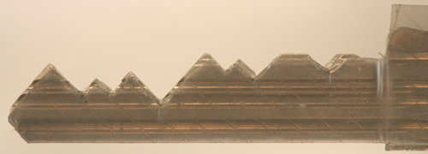
NEUTRALIZE SHEAR LINE

Slide 44
LOCKS, LIES, AND VIDEOTAPE: MEDECO CASE STUDY
MEDECO CASE STUDY
Medeco security: “Our locks are bump-proof, virtually bump-proof, and Virtually Resistant”
We Never claimed our Locks were bump-proof!
Our deadbolts are secure, no problem!
We have spent hundreds of hours and cannot replicate any of the Tobias attacks!

Slide 45
MEDECO RECOGNIZES LOCKSPORT: NDE: May, 2008
BASED ON RESPONSIBLE DISCLOSURE ABOUT MEDECODER
Give Medeco time to fix the vulnerability
Right result, wrong reason
No t new: 15 year old bypass
Problem in millions of locks
Concept not applicable

Slide 46
KNOWN VULNERABILITIES IN MEDECO LOCKS
RESPONSIBLE DISCLOSURE v. IRRESPONSIBLE NON-DISCLOSURE
Serious vulnerabilities disclosed
Notice to manufacturer for 18 months
Failure to disclose to dealers or customers
Misrepresentation, half truth, misleading advertising and use of language that means nothing

Slide 47
RESPONSIBLE DISCLOSURE: It is a Two-Way Street
DISCOVERY OF VULNERABILITY
Locksport, hacker, security expert disclosure to manufacturers
Manufacturers to dealers and consumers
SIGNIFICANT QUESTIONS
When discovered
New lock or embedded base
Number of users affected
National security issues

Slide 48
RESPONSIBILITIES
Locksport and hacker responsibility
Disclose vulnerability in new lock design or upgrade
What about current locks that are installed
Give time to fix? When relevant?

Slide 49
HIGH SECURITY LOCK MANUFACTURERS
Responsibility of high security lock manufacturer are different
High security is different than normal mfg or corporation
Protect high value targets, critical infrastructure
Duties
Tell the truth
Disclose security vulnerabilities to customers and dealers

Slide 50
RESPONSIBLE DISCLOSURE: REALITY, AND LIABILITY
WHAT TO DISCLOSE AND TO WHOM
TWO COMPONENTS
PUBLIC RIGHT AND NEED TO KNOW
SECURITY BY OBSCURITY
ASSUME THE RISK, ONLY CAN BE BASED UPON KNOWLEDGE
BAD GUYS KNOW
LOCKS NOT LIKE SOFTWARE
NOTICE ONLY PROSPECTIVE TO FIX PROBLEMS

Slide 51
DISCLOSURE TO MANUFACTURER: Prospective or Retroactive Effect
PROSPECTIVE IMPLEMENTATION OF FIX BY MANUFACTURER
Only applies to new locks or new product
Does not apply to embedded base
Does not help the consumer unless manufacturer does a recall or field fix
QUESTION OF LIABILITY AND COST
Who will pay for retroactive upgrade?
“Enhancement” to new bypass technique or liability to remedy?

Slide 52
MEDECO TIMELINE
1994 ARX pins and John Falle decoder
2006 Bumping of conventional locks
Medeco issues press release: Bump-Proof
2006-2007 Data to Medeco regarding bumping, picking, and key control
2007 Tobias Deadbolt attack
2007 JennaLynn Bumps a Biaxial
2008 Jon King Medecoder and Medeco recognition of Locksport community

Slide 53
MEDECO: Responsible or Irresponsible Actions?
BUMPING CLAIMS BY MEDECO
August 4, 2006 Press Release: “Our Locks are Bump-Proof!”
2007: Retroactive change, “Our Locks are Virtually Bump-Proof”
2007: “Our locks are virtually resistant!”

Slide 54
MEDECO BUMPING CLAIM: “We never said it: Others did!”
WHAT IS THE TRUTH?
August 4, 2006 press release: “Bump-proof”
2007 - Retroactively changed the language: “Virtually Bump-proof”
The Medeco Problem: www.archive.org
TV, Advertising, DVD, Medeco website
The Smoking Gun: August 12, 2006

Slide 55
WE NEVER SAID OUR LOCKS WERE BUMP-PROOF
AUGUST 15, 2006
U.S. Patent and Trademark Office filing by Medeco Security Locks, Inc. lawyer G. Franklin Rothwell, Application 78952460
Word mark: BUMP PROOF
Abandoned: February 9,2007

Slide 56
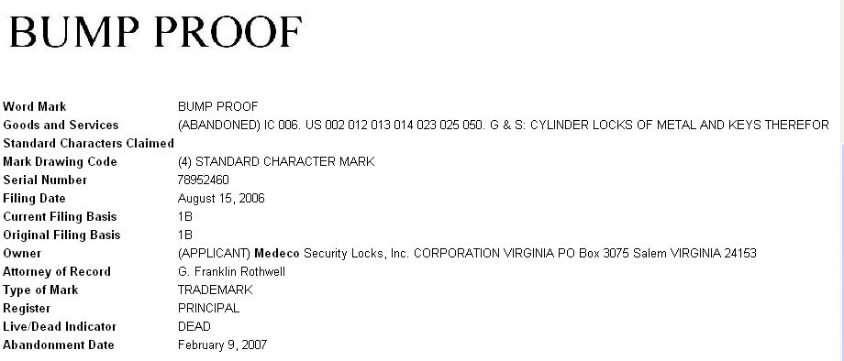
BUMP PROOF: USPTO FILING FOR THE WORD MARK

Slide 57
ABOUT CLAIMS OF PICKING MEDECO LOCKS
NOBODY HAS PROVED THEY CAN PICK OUR LOCKS IN 40 YEARS
False demonstrations, special locks
They are lying
We cannot replicate anything
THE REAL PROBLEM
They cannot open their own locks
Failure of imagination

Slide 58
RESPONSIBLE DISCLOSURE BY LOCK MANUFACTURERS
KNOWLEDGE OF VULNERABILITY
Known or suspected
Make responsible notifications
Let users and dealers assess risks
Duty to tell the truth
Duty to fix the problem

Slide 59
MEDECO LOCKS ARE VULNERABLE
MEDECO KNOWS
Vulnerability from Bumping, Picking, Key control, Forced Entry techniques
Should be candid with dealers and users so they understand the potential risks
Failure to tell the truth = irresponsible non-disclosure
Dealers and customers have a need and a right to know

Slide 60
VULNERABILITIES: Full Disclosure Required
SECURITY BY OBSCURITY
It does not work with Internet
It is the User’s security
They have a right to assess their own risks
Criminals already have information
Disclosure: benefits outweigh risks
Liability for failure to disclose

Slide 61
LESSONS LEARNED
THE MEDECO CASE
Nothing is impossible
Corporate arrogance does not work
HIGH SECURITY LOCK MAKERS
Engineering, Security, Integrity
Duty to tell the truth

Slide 62
OPEN IN THIRTY SECONDS
© 2008 Marc Weber Tobias, Matt Fiddler
http://www.security.org
http://in.security.org
mwtobias@security.org
mjfiddler@security.org
tbluzmanis@security.org

