Slide 1
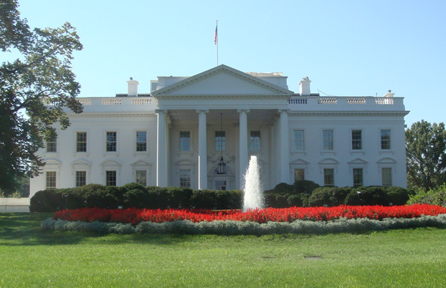
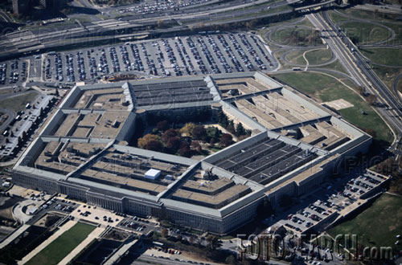
OPEN IN THIRTY SECONDS:
Cracking One of the Most Secure Locks in America
A story of corporate arrogance, embedded design deficiencies, and misstatements

Slide 2

MEDECO LOCKS PROTECT THE ROYAL PALACE

Slide 3
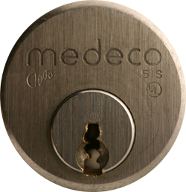
MEDECO HIGH SECURITY

Slide 4
STORY OF LOCKS, LIES, and HIGH INSECURITY
Dominant high security lock maker
40 year history of security
Many expert attempts to crack with limited success, complicated tools
Misstatements and disinformation
18 month research project results:
Total compromise of security

Slide 5
HIGH SECURITY LOCKS: Why Important?
Protect Critical Infrastructure, high value targets
Stringent security requirements
High security Standards
Threat level is higher
Protect against Forced, Covert entry

Slide 6
MEDECO HISTORY
Dominant high security lock maker in U.S.
Owns 70+ Percent of U.S. high security market for commercial and government
Major government contracts
In UK, France, Europe, South America
Relied upon for highest security everywhere
Considered almost invincible by experts

Slide 7
WHY THE MEDECO CASE STUDY IS IMPORTANT
Insight into design of high security locks
Patents are no assurance of security
Appearance of security v. Real World
Undue reliance on Standards
Manufacturer knowledge and Representations
Methodology of attack

Slide 8
ATTACK METHODOLOGY FOR HIGH SECURITY LOCKS
Assume and believe nothing
Ignore the experts
Think “out of the box”
Consider prior methods of attack
Always believe there is a vulnerability
WORK THE PROBLEM
Consider all aspects and design parameters
Do not exclude any solution

Slide 9
MEDECO TIMELINE
1970 Original Lock introduced
1985 Biaxial, Second generation
2003 m3 Third generation
2006 Bumping introduced to America
Medeco announces “Bump-Proof”
2007 Revised to “Virtually Bump-Proof”
2007 Revised to “Virtually Resistant”
2008 No public statements by Medeco

Slide 10
OUR TIMELINE
2003 Determine m3 slider problem
2006 Bumping demonstration: Medeco announces bump-proof locks
2006 key simulation: No more key control
2006 Demonstrated bumping and picking of Medeco locks
2007 File patents
2008: Book and CD

Slide 11
TOBIAS ATTACK: How it all started
2006: Marc Tobias, Barry Wels, Matt Fiddler introduce Bump keys to U.S. at Defcon and HOPE in July/August 2006
Medeco press release: “Bump-Proof”
Tobias Bluzmanis files patent for decoder, Medeco says he is a “crackpot”
Marc Tobias + Tobias Bluzmanis begin 18 month research project to crack Medeco

Slide 12
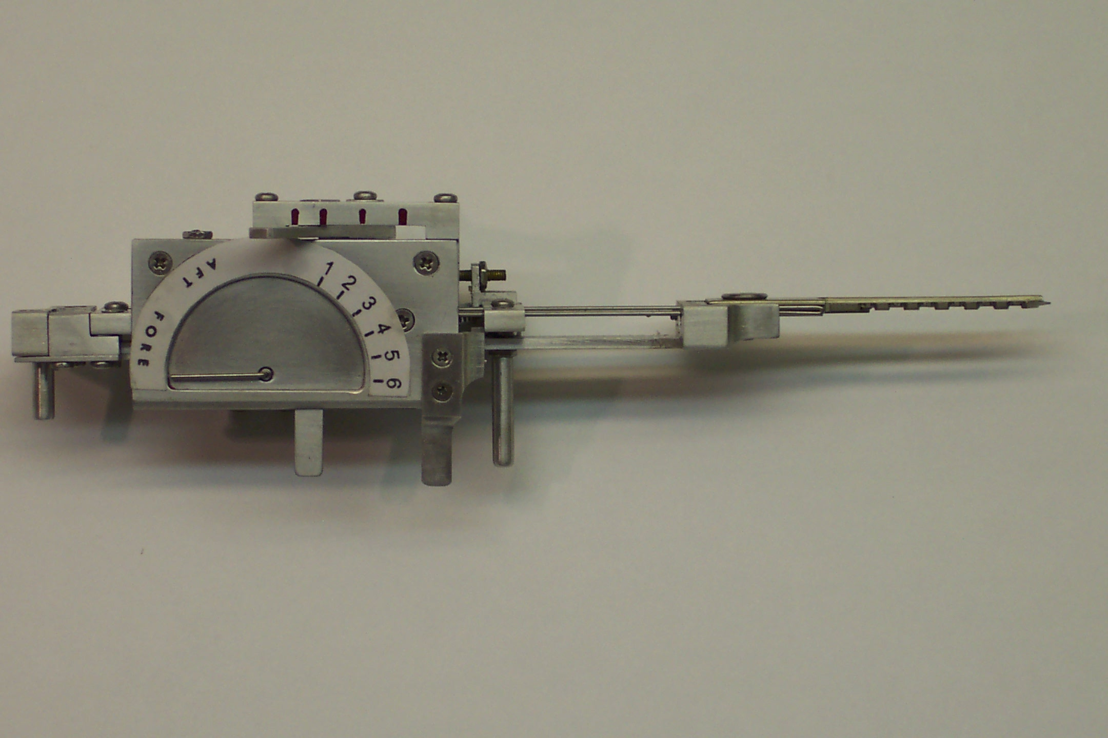
TOBIAS DECODER: Medeco said: “Crackpot!”

Slide 13
WHY WE DID IT?
Medeco is relied upon to protect everything
Biggest target + arrogance + vulnerable
40 year old technology
We determined we could bump the locks
Extremely complex project
Multiple security layers
MEDECO SAID WE COULD NOT DO IT!
An intellectual challenge!

Slide 14
CONVENTIONAL v. HIGH SECURITY LOCKS
CONVENTIONAL CYLINDERS
Easy to pick and bump open
No key control
Limited forced entry resistance
HIGH SECURITY CYLINDERS
UL and BHMA/ANSI Standards
Higher quality and tolerances
Resistance to Forced and Covert Entry
Key control

Slide 15
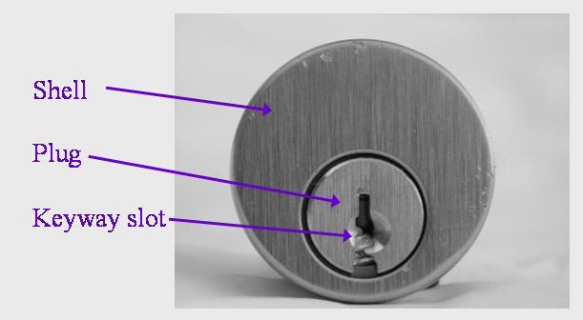
CONVENTIONAL PI N TUMBLER DESIGN

Slide 16
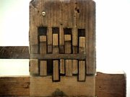
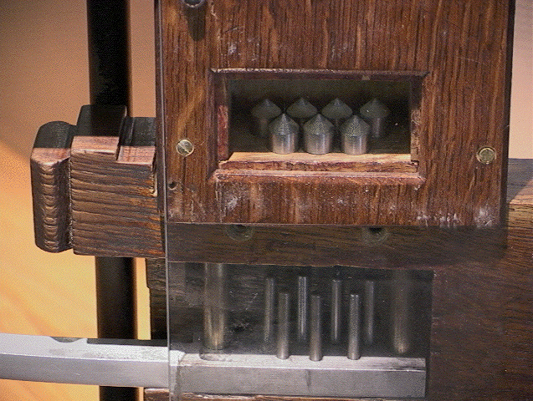
4,000 YEAR OLD DESIGN

Slide 17
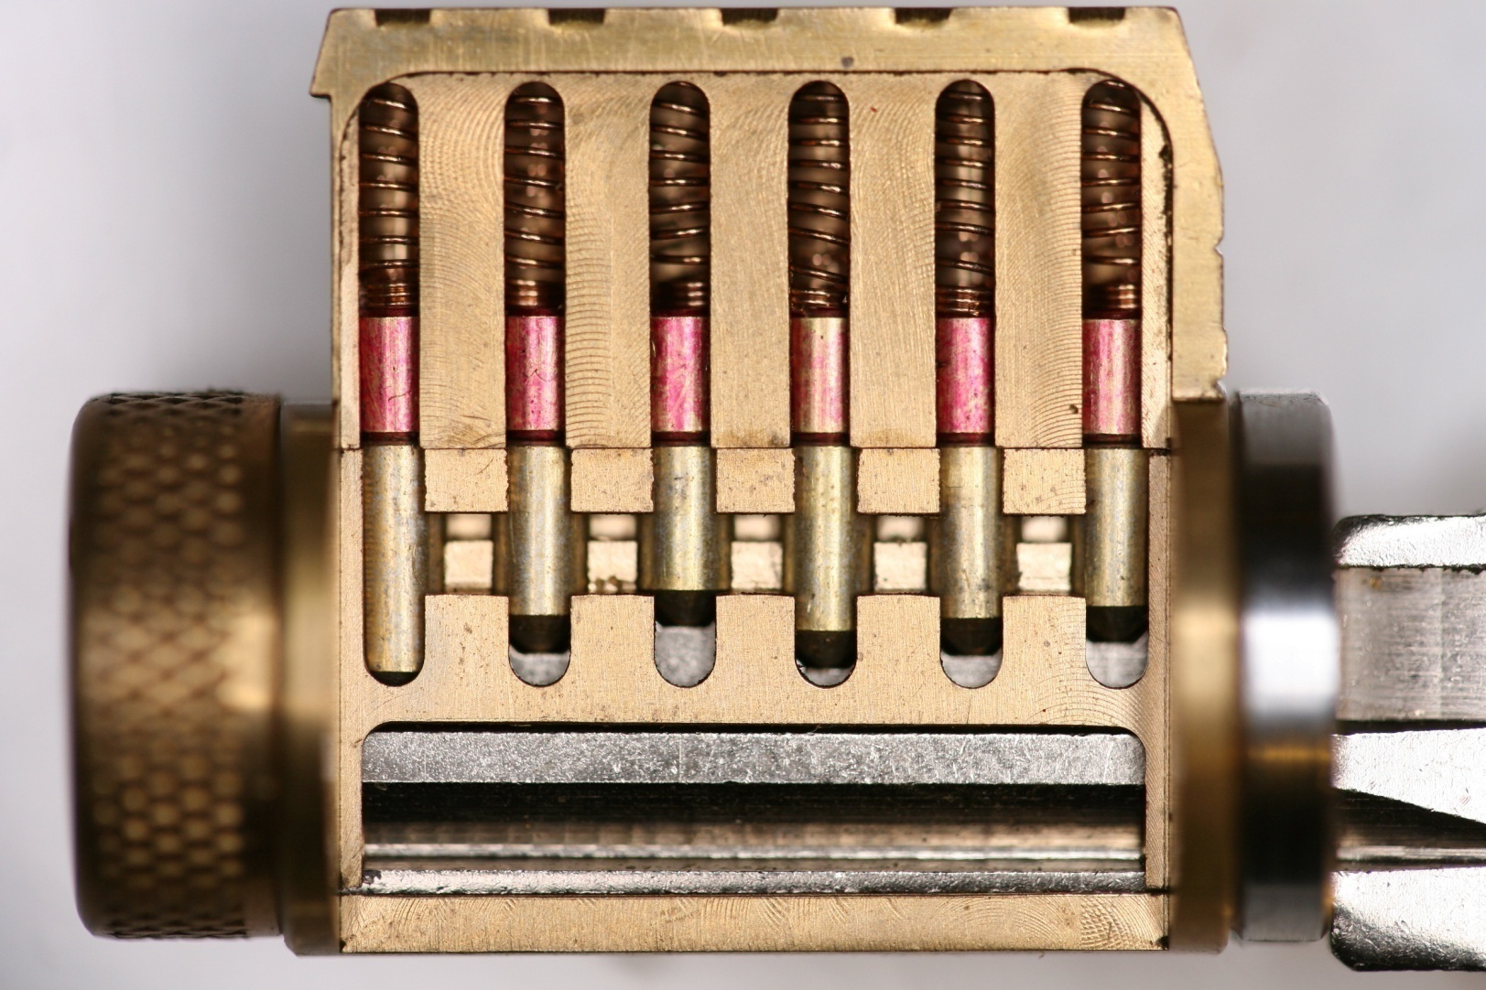
MODERN PIN TUMBLER

Slide 18
MEDECO LOCKS: Why are they Secure?
2 shear lines and sidebar for Biaxial
3 independent security layers: m3
Pins = 3 rotation angles, 6 permutations
Physical pin manipulation difficult
False gates and mushroom pins
ARX special anti-pick pins
High tolerance

Slide 19
MEDECO LOCKS: 3 Independent Security Layers
Layer 1: PIN TUMBLERS to shear line
Layer 2: SIDEBAR: 3 angles x 2 positions
Layer 3: SLIDER – 26 positions
TO OPEN:
Lift the pins to shear line
Rotate each pin individually
Move the slider to correct position

Slide 20
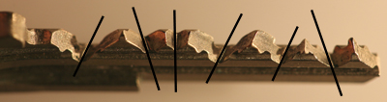
MEDECO TWISTING PINS: 3 Angles + 2 Positions

Slide 21
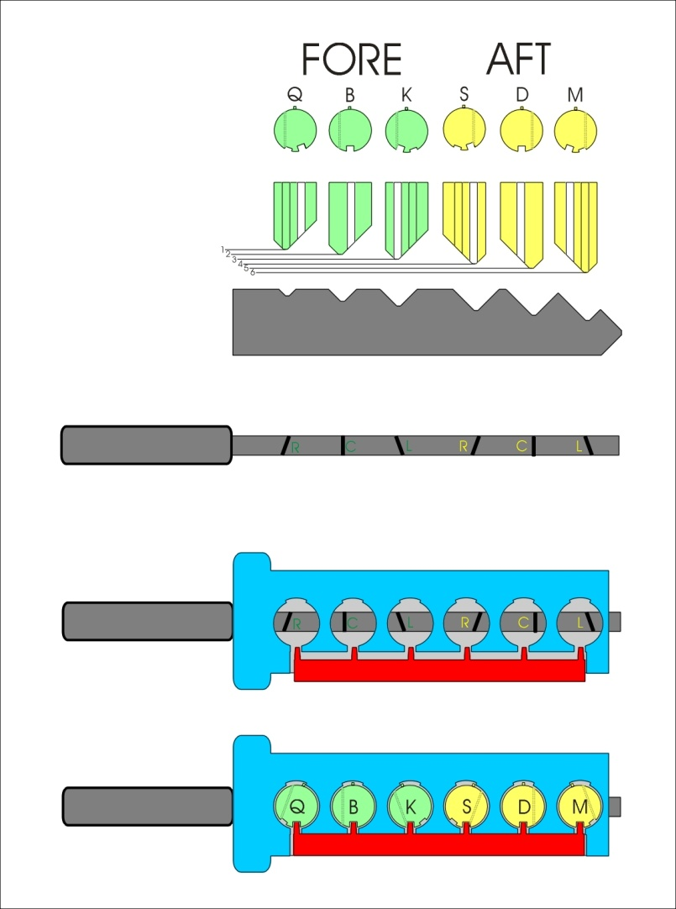
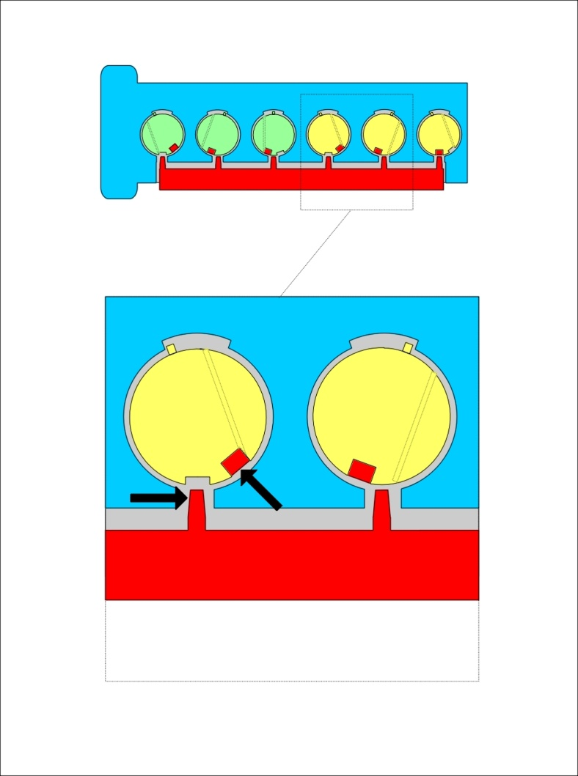
MEDECO ROTATING TUMBLER

Slide 22
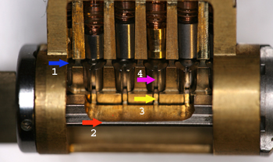
MEDECO LOCK CUTAWAY

Slide 23
SECURITY CONCEPTS: Sidebar IS Medeco Security
GM locks, 1935, Medeco re-invented
Heart of Medeco security and patents
Independent and parallel security layer
Integrated pin: lift and rotate to align
Sidebar blocks plug rotation
Pins block manipulation of pins for rotation to set angles

Slide 24
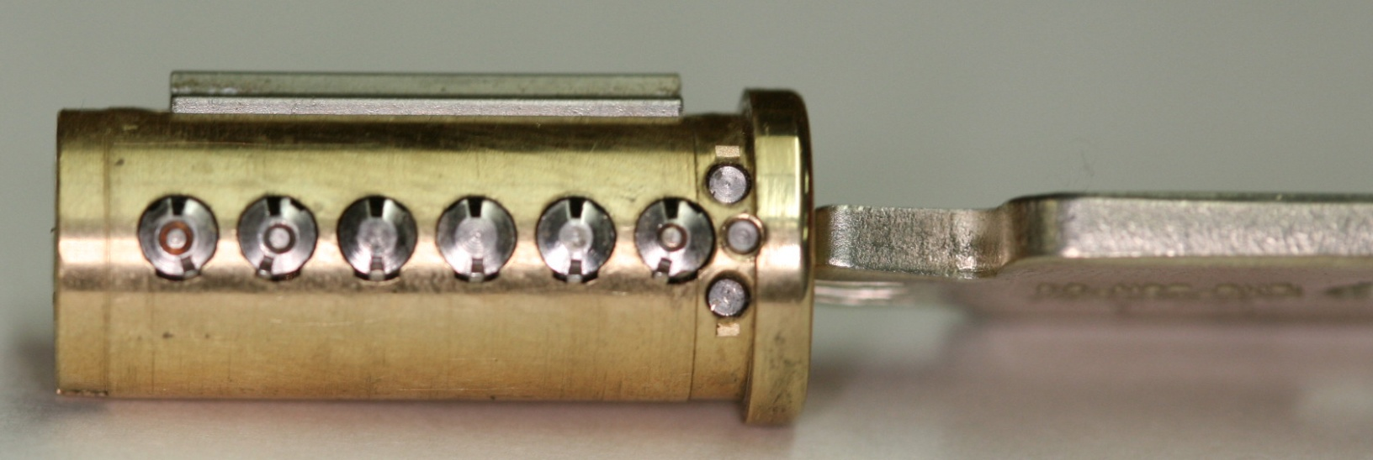
PLUG AND SIDEBAR: All pins aligned

Slide 25
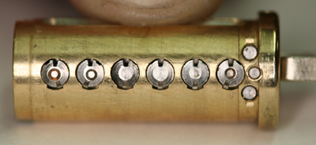
SIDEBAR RETRACTED

Slide 26
MEDECO MISTAKES
Failed to listen
Embedded design problems from beginning
Compounded problems with new designs with two new generations: Biaxial and m3
Failed to “connect the dots”
Failure of imagination
Lack of understanding of bypass techniques

Slide 27
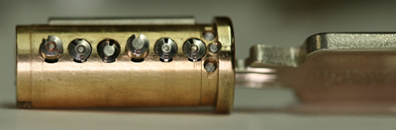
PLUG AND SIDEBAR: Locked

Slide 28
DESIGN = VULNERABILITIES
Basic design: sidebar legs + gates
How they work: leg + gate interface
Tolerance of gates
Biaxial code designation
Biaxial pin design: aft position decoding
M3 slider: geometry
M3 keyway design
Deadbolt design

Slide 29
MEDECO DESIGN: Exploit design vulnerabilities
EXPLOIT BEST DESIGN FEATURES
Sidebar leg – true gate channel
Code assignment: Biaxial 1985
Gate – sidebar leg tolerance
M3 design 2003
Widen keyway .007”
Slider geometry, .040” offset

Slide 30
MEDECO DESIGNS: More vulnerabilities
Biaxial pin design: fore and aft positions
Borescope decode of aft angles
Introduction of Bilevel in 2006
Compromise by decoding

Slide 31
MEDECO CODEBOOK: At the heart of security
All locksmiths worldwide must use
All non-master keyed systems
New codes developed for Biaxial in 1983
Chinese firewall: MK and Non-MK
Codebook defines all sidebar codes

Slide 32
KEY CODES: Vertical Bitting and Sidebar
Vertical bitting = 6 depths .025” increments
Sidebar Pins: 3 angles, 2 positions = 6 permutations
 | ORIGINAL | FORE | AFT
Left | L | K | M
Center | C | B | D
Right | R | Q | S

Slide 33
RESULTS OF PROJECT: Bumping
Reliably bump open Biaxial and m3 locks
Produce bump keys on Medeco blanks and simulated blanks
Known sidebar code
Unknown sidebar code

Slide 34
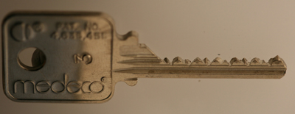
MEDECO BUMP KEY

Slide 35
RESULTS OF PROJECT: Key Control and Key Security
Total compromise of key control and key security, vital to high security locks
Duplicate, replicate, simulate keys for all m3 and some Biaxial keyways
Restricted keyways, proprietary keyways
Government and large facilities affected
Attack master key systems
Produce bump keys
Produce code setting keys

Slide 36
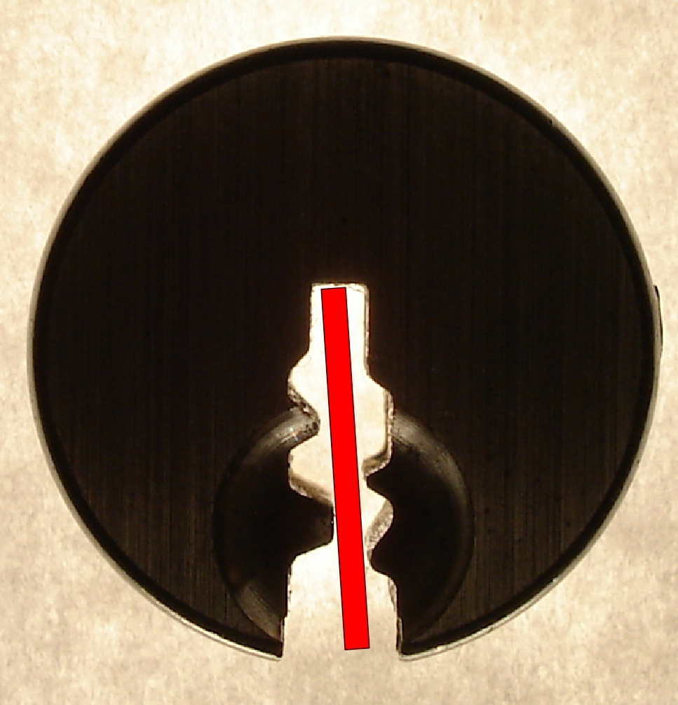
SIMULATED BLANKS: Any m3 and Many Biaxial Locks

Slide 37
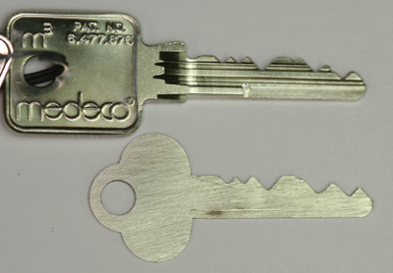
SIMULATED BLANKS

Slide 38
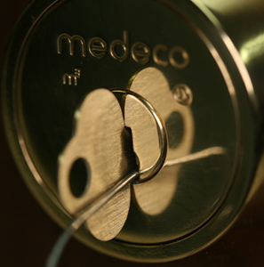
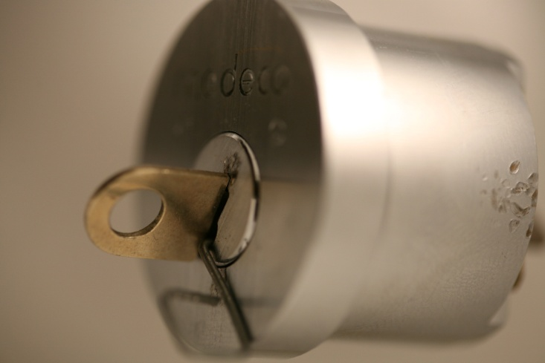
M3 SLIDER: Bypass with a Paper clip

Slide 39
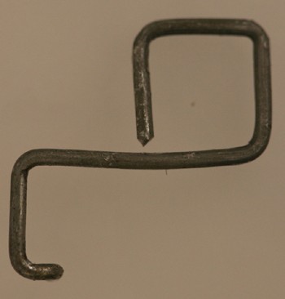
SECURITY OF m3: High Tech Wire!

Slide 40
RESULTS OF PROJECT: Picking
Pick the locks in as little as 30 seconds
Standard picks, not high tech tools
Use of another key in the system to set the sidebar code
Pick all pins or individual pins
Neutralize the sidebar as security layer

Slide 41
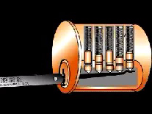
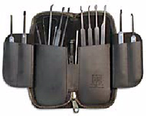
CONVENTIONAL PICKING

Slide 42
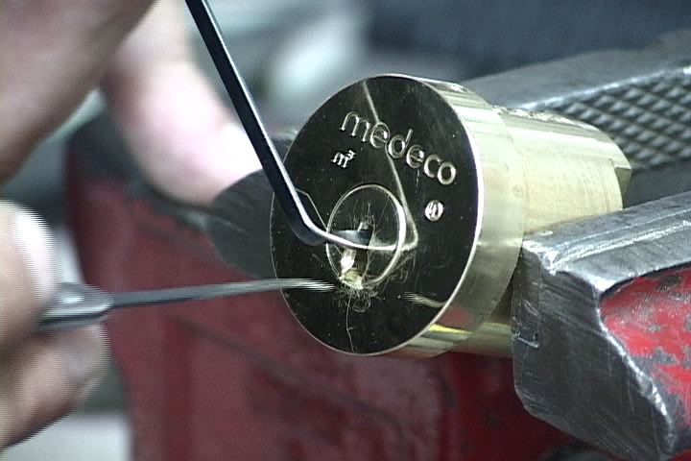
PICKING A MEDECO LOCK

Slide 43
RESULTS OF PROJECT: Decode Top Level Master Key
Determine the sidebar code in special system where multiple sidebar codes are employed to protect one or more locks
Decode the TMK
OWN the system

Slide 44
RESULTS OF PROJECT: Forced Entry Techniques
Deadbolt attacks on all three versions
Deadbolt 1 and 2: 30 seconds
Deadbolt 3: New hybrid technique of reverse picking
Mortise and rim cylinders
Prior intelligence + simulated key
Interchangeable core locks

Slide 45
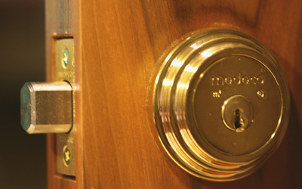
DEADBOLT ATTACK

Slide 46

DEADBOLT BYPASS: 2$ Screwdriver + $.25 materials

Slide 47
CONNECTING THE DOTS
CRITICAL FAILURES
Original → Biaxial
pin design
code assignment
Biaxial -→ m3 design
M3 slider geometry = .040” offset
Key simulation
.007” keyway widening

Slide 48
MORE DOTS!
FORCED ENTRY
Original Deadbolt design
Fatal design flaw: 30 seconds bypass
Later deadbolt designs: new attacks
Mortise and rim cylinders
Inherent design problem: .065” plug

Slide 49
MORE DOTS: BILEVEL LOCK
2007 Bilevel locks introduced
Integrate low and high security to compete
Flawed design, will affect system security when integrated into high security system
Borescope decoding of aft pins to compromise security of entire system

Slide 50
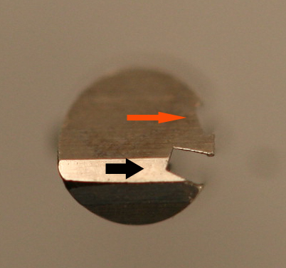
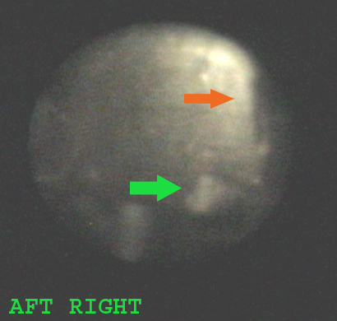
DECODE PIN ANGLES

Slide 51
CONNECTING THE DOTS: The Results
Biaxial Code assignment: Reverse Engineer for all non-master key systems
Gate tolerance: 4 keys to open
NEW CONCEPT: Code Setting keys
Sidebar leg-gate interface: NEW CONCEPT: Setting sidebar code
M3 Wider keyway: Simulated blanks
Slider design: paper clip offset

Slide 52
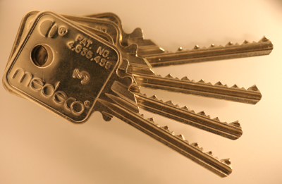
4 KEYS TO THE KINGDOM

Slide 53
LESSONS TO BE LEARNED
Patents do not assure security
Apparent security v. actual security
40 years of invincibility means nothing
New methods of attack
Corporate arrogance and misrepresentation
“If it wasn’t invented here” mentality
All mechanical locks have vulnerabilities

Slide 54
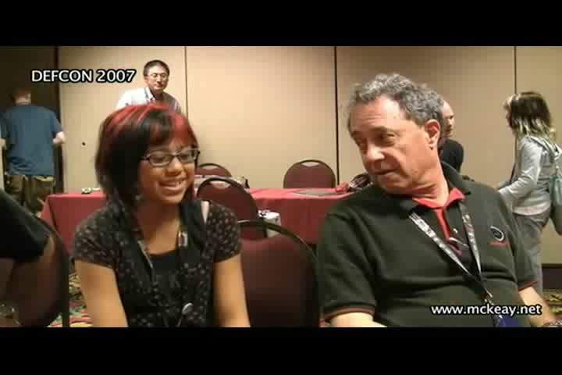
REAL WORLD ATTACK: Bumping a Medeco Lock

Slide 55
OPEN IN THIRTY SECONDS: Cracking one of the most secure locks in America
© 2008 Marc Weber Tobias and
Tobias Bluzmanis
www.security.org
mwtobias@security.org

