Slide 1

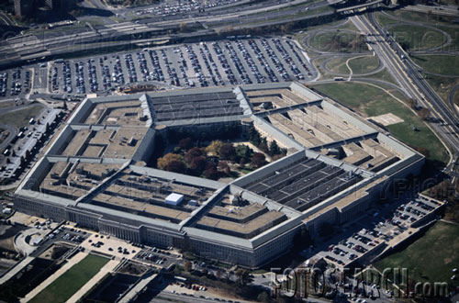
VULNERABILITIES
Bypass of Locks by exploiting design issues

Slide 2
HIGH SECURITY LOCKS: Why Important?
Protect Critical Infrastructure, high value targets
Stringent security requirements
High security Standards
Threat level is higher
Protect against Forced, Covert entry
Protect keys from compromise

Slide 3
CONVENTIONAL v. HIGH SECURITY LOCKS
CONVENTIONAL CYLINDERS
Easy to pick and bump open
No key control
Limited forced entry resistance
HIGH SECURITY CYLINDERS
UL and BHMA/ANSI Standards
Higher quality and tolerances
Resistance to Forced and Covert Entry
Key control

Slide 4
ATTACK METHODOLOGY FOR HIGH SECURITY LOCKS
Assume and believe nothing
Ignore the experts
Think “out of the box”
Consider prior methods of attack
Always believe there is a vulnerability
WORK THE PROBLEM
Consider all aspects and design parameters
Do not exclude any solution

Slide 5
HIGH SECURITY LOCKS: Critical Design Issues
Multiple security layers
More than one point of failure
Each security layer is independent
Security layers operate in parallel
Difficult to derive intelligence about a layer

Slide 6
HIGH SECURITY: Three Critical Design Factors
Resistance against forced entry
Resistance against covert and surreptitious entry
Key control and “key security”
Vulnerabilities for each requirement

Slide 7
QUESTIONS: BYPASS AND REVERSE ENGINEERING
Weakest link in lock to bypass (Medeco)
What locks the lock?
What locking elements lock and in what order. Is there a primary element to bypass?
Result if one layer fails: Can others be compromised?
What intelligence needed to open the lock?
Can Intelligence be simulated?

Slide 8
SYSTEM BYPASS: More Questions
How strong is the sidebar(s) against forced attack
Is the sidebar the only locking system?
What if defeat one of two sidebars or security layers?
Bitting design: spring biased?
Ability to manipulate each pin or slider to set its code?

Slide 9
SECONDARY SECURITY LAYERS: Techniques
Telescoping pins
Sliders and wafers
Sliders to set sidebars: Medeco
Pseudo-sidebars = virtual keyways
Sidebars
Most popular
Originated in America with GM locks
Many locking techniques

Slide 10
LAYERS OF SECURITY AND BYPASS CAPABILITY
How many
Ability to exploit design feature?
Integrated
Separate
Primus = 2 levels, independent, complex locking of secondary finger pins
Assa = 2 levels, independent, simple locking, one level

Slide 11
EXPLOIT DESIGN FEATURES AND SYSTEM PARAMETERS
Codes: design, progression
Key bitting design
Tolerances
Keying rules
Medeco master and non-master key systems
Interaction of critical components and locking systems
Keyway and plug design

Slide 12
EXPLOIT TOLERANCES
Sidebar locking: Medeco 10 v. 20 degree
Relation to codes
Simulation of codes: Medeco
Reverse engineer code progression of system from one or more keys?
Master key conventional v. positional system
Difficulty = replication of keys
Medeco v. MCS as example

Slide 13
ATTACKS: Two Primary Rules
“The Key never unlocks the lock”
Mechanical bypass
Alfred C. Hobbs: “If you can feel one component against the other, you can derive information and open the lock.”

Slide 14
METHODS OF ATTACK: High Security Locks
Picking and manipulation of components
Impressioning
Bumping
Vibration and shock
Shim wire decoding (Bluzmanis and Falle)
Borescope and Otoscope decoding
Direct or indirect measurement of critical locking components

Slide 15
ADDITIONAL METHODS OF ATTACK
Split key, use sidebar portion to set code
Simulate sidebar code
Use of key to probe depths and extrapolate
Rights amplification of key

Slide 16
KEY CONTROL
High security requirement

Slide 17
KEY CONTROL and “KEY SECURITY”
Duplicate
Replicate
Simulate
“Key control” and “Key Security” may not be synonymous!

Slide 18
KEY SECURITY: A Concept
Key control = physical control of keys
Prevent manufacture and access to blanks
Control generation of keys by code
Patent protection
Key security = compromise of keys
Duplication
Replication
Simulation

Slide 19
KEYS: CRITICAL ELEMENTS
Length = number of pins/sliders/disks
Height of blade = depth increments = differs
Thickness of blade = keyway design
Paracentric design
Keyway modification to accommodate other security elements
Finger pins
Sliders

Slide 20
KEY CONTROL: Critical issues
Simulation of code or key components
Security of locks = key control and key security
All bypass techniques simulate actions of key
Easiest way to open a lock is with the key

Slide 21
KEY CONTROL and “KEY SECURITY” ISSUES
Most keys are passive: align = open
Simulate components of key
Replicate critical components
Duplicate critical components
Require interactive element for security
MUL-T-LOCK element
MCS magnets

Slide 22
KEY CONTROL: Design Issues
Bitting design
Bitting and sidebar issues and conflicts and limitations in differs
Ability to decode one or more keys to break system
Consider critical elements of the key: require to insure cannot be replicated
Hybrid attacks using keys
Medeco mortise cylinder example

Slide 23
DUPLICATION AND REPLICATION OF KEYS
Key machine
Milling machine: Easy Entrie
Clay and Silicone casting
Key simulation: Medeco
Rights amplification
Alter similar keys

Slide 24
COVERT and FORCED ENTRY RESISTANCE
High security requirement

Slide 25
STANDARDS REQUIREMENTS
UL and BHMA/ANSI STANDARDS
TIME is critical factor
Ten or fifteen minutes
Depends on security rating
Type of tools that can be used
Must resist picking and manipulation
Standards do not contemplate more sophisticated methods

Slide 26
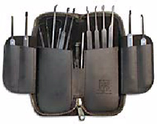
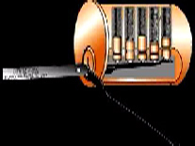
CONVENTIONAL PICKING

Slide 27
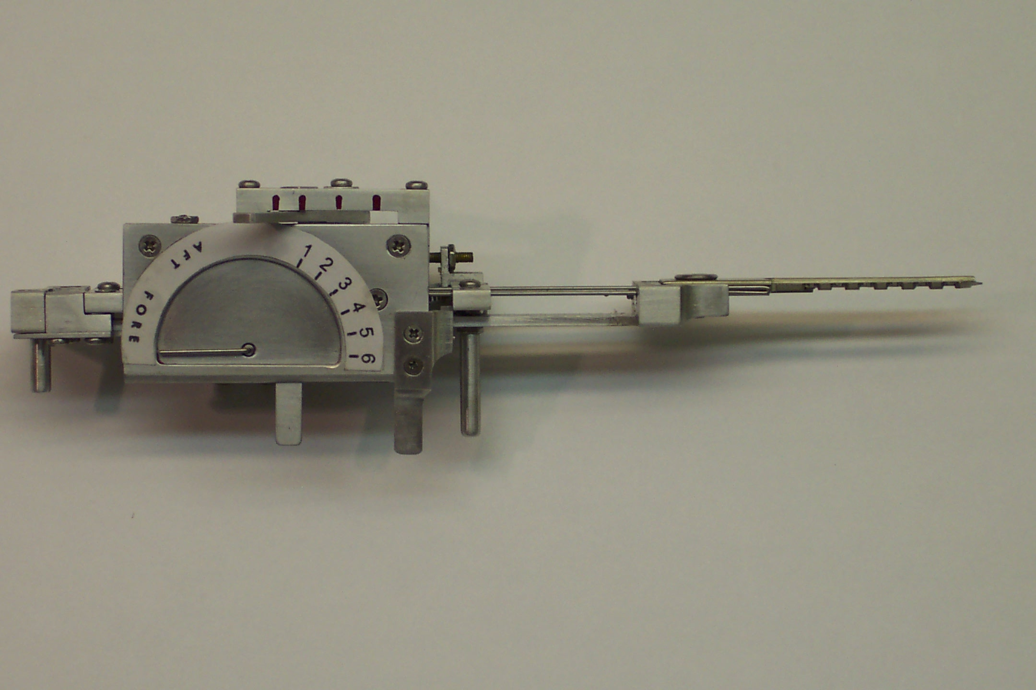
TOBIAS DECODER: Medeco decoder: by “Crackpot!”

Slide 28

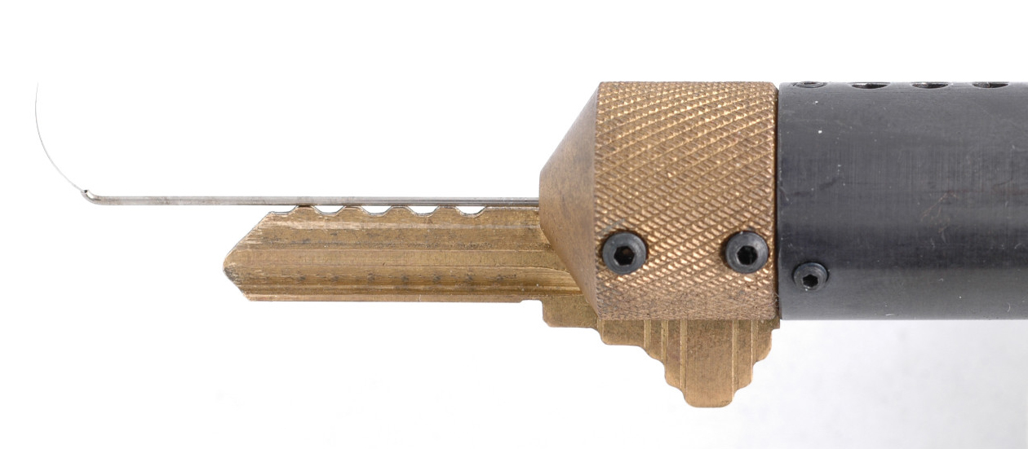
SOPHISTICATED DECODERS
John Falle: Wire Shim Decoder

Slide 29
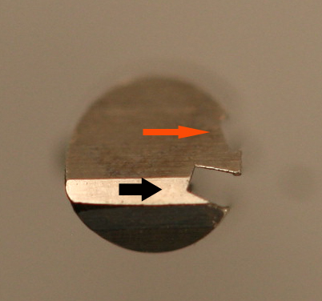
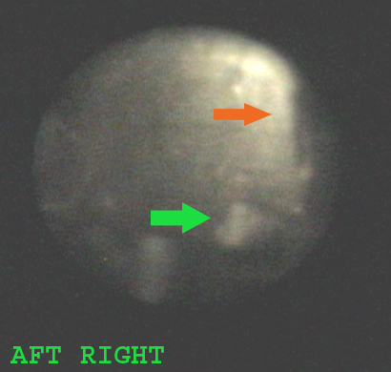
DECODE PIN ANGLES

Slide 30
FORCED ENTRY RESISTANCE
High security requirement

Slide 31
FORCED ENTRY ATTACKS: Deficiencies in standards
Many types of attacks defined
Do not contemplate mechanical bypass
Must examine weakest linkis
Do not cover “hybrid attacks”
Medeco deadbolt attacks
Medeco mortise attack

Slide 32
SIDEBAR: Bypass and Circumvention
Direct Access
Decoding attacks
Manipulation
Simulate the sidebar code (Medeco)
Use of a key (Primus and Assa
Indirect access
Medeco borescope and otoscope decode issues

Slide 33
SIDEBAR ATTACK: Physical Strength
Independent protection
Integrated with pin tumblers or other critical locking components
Compress plug
Defeat of sidebar as one security layer: result and failures
Anti-drill protection

Slide 34
FORCED ENTRY ATTACKS
Direct compromise of critical components
Medeco deadbolt 1 and 2 manipulate tailpiece
Hybrid attack: two different modes
Medeco reverse picking
Defeat of one security layer: result
Medeco Mortise and rim cylinders, defeat shear line

