Slide 1
KEY CONTROL:
MEDECO “VIRTUALLY RESISTANT” SECURITY
A Case Study in Real World
Security Vulnerabilities

Slide 2
HIGH SECURITY LOCKS
SPECIFY FOR FACILITY PROTECTION
  COVERT ENTRY
  FORCED ENTRY
  KEY CONTROL
MINIMUM SECURITY CRITERIA
  Minimum attack times
  Resistance to certain forms of entry
  UL 437 and BHMA/ANSI 156.30

Slide 3
COVERT ENTRY PROTECTION: The Theory
MINIMUM SECURITY CRITERIA IN UL 437 and BHMA/ANSI 156.30
PROTECT AGAINST CERTAIN FORMS OF COVERT ENTRY
ASSURE MINIMUM RESISTANCE TIMES TO OPEN

Slide 4
COVERT ENTRY OF MEDECO LOCKS: RESULT
BUMPING
  Modified change key
  Simulated key
PICKING
  With change key
  With code setting keys
EXTRAPOLATE TMK
DECODE BILEVEL SYSTEM TO COMPROMISE m3 SYSTEM

Slide 5
MEDECO INSECURITY:
Real World Threats - Covert
FOUR KEYS TO PICK AND BUMP PRE-12/07 LOCKS
SIXTEEN OR LESS KEYS FOR 2008 LOCKS
PICKING IN AS LITTLE AS 27 SECONDS
  Using any change key on same sidebar code
  With code setting keys
  Angle setting keys
  ARX pins

Slide 6
MEDECO INSECURITY:
Real World Threats - Covert
BUMPING
  With correct blank and sidebar code
  With simulated blank
  With or without ARX pins

Slide 7
MEDECO INSECURITY: Real World Threats - Keys
VIOLATION OF KIEY CONTROL and KEY SECURITY
  Compromise of entire facility
  Improper generation of keys

Slide 8
MEDECO INSECURITY:
Key Control Protective Measures
FACILITY RESTRICTIONS
  No paper clips
  No Copiers, scanners, cameras
  No scissors or X-Acto knives
  No plastic report covers
  No Shrinky-Dink plastic
  No printers
  No email or Fax connections to outside world

Slide 9
MEDECO INSECURITY:
Real World Threats - Keys
NO KEY CONTROL OR KEY SECURITY
All m3 and some Biaxial keyways
Keyways (restricted and proprietary)
M3 Step = no security
Copy keys
Produce any blank
Generate Top Level Master Key
Cut any key by code

Slide 10
MEDECO INSECURITY:
The Threat from Within
COMPROMISE OF KEY CONTROL + HYBRID ATTACK
  Mortise, Rim, Interchangeable cores
MEDECO KEY CONTROL v. CONVENTIONAL KEYS
  Conventional keys = 1 layer of security
  Medeco keys = 3 layers of security

Slide 11
MEDECO INSECURITY:
The Threat from Within
OBTAIN KEY DATA TO OPEN LOCKS BY HYBRID ATTACK
KEY CONTROL IS CIRCUMVENTED
BRIEF ACCESS TO A KEY FOR A TARGET LOCK
  Compromise of the lock or system
  By insiders
  By criminals outside of an organization

Slide 12
MEDECO INSECURITY: Key Control and Layers of Security
THREE LAYERS OF SECURITY
  Shear Line
  Sidebar
  Slider in m3
HYBRID ATTACK: NEUTRALIZE EACH LAYER OF SECURITY
  Shear line = Plastic key
  Sidebar and Slider = Torque on plug

Slide 13
MEDECO KEY CONTROL:
Appearance v. Reality
WHAT IS IT SUPPOSED TO MEAN?
ARE THE STANDARDS SUFFICIENT?
REAL WORLD VULNERABILITIES
[DO NOT DUPLICATE IMAGE]

Slide 14
KEY CONTROL: The Theory
PROTECTION OF BLANKS OR CUT KEYS FROM ACQUISITION OR USE:
  Unauthorized duplication
  Unauthorized replication
  Unauthorized simulation
    restricted keyways
    proprietary keyways
    sectional keyways

Slide 15
KEYS and KEY CONTROL
KEYS ARE THE EASIEST WAY TO OPEN LOCKS
  Change key or master key
  Duplicate correct bitting
  Bump keys
  Rights amplification: modify keys
PROTECTION OF KEYS
  Side bit milling: Primus and Assa
  Interactive elements: Mul-T-Lock
  Magnets: EVVA MCS

Slide 16
SECURITY THREAT:
Failure of Key Control: Duplicate
IMPROPER ACQUISITION OR USE OF KEYS BY EMPLOYEES OR CRIMINALS
Unauthorized access to facilities or areas
Bump keys
Use for rights amplification
Compromise master key systems

Slide 17
SECURITY THREAT:
Failure of Key Control: Replicate
HIGH SECURITY LOCKS AND KEYS
Designed to prevent replication
REPLICATION TECHNIQUES
EASY ENTRIE MILLING MACHINE
SILINCONE CASTING
PLASTIC AND EPOXY

Slide 18
SECURITY THREAT:
Failure of Key Control: Simulate
M3 KEYWAY
  Wider than Biaxial
  No paracentric keyway
COMPONENTS OF MEDECO KEYS
  Ward pattern and paracentric keyway
  Bitting
  M3 Slider
SECURITY THREAT
  Bypass wards in paracentric keyway
  Create new blanks

Slide 19
RESULT: Failure of Key Control
Restricted and proprietary keyways
M3 Slider: bypass with paper clip
Sabotage potential
Make keys to open your locks
Duplicate from codes or pictures
TMK extrapolation
Set the sidebar code

Slide 20
COMPROMISE THE SYSTEM: Obtaining the Critical Data
TECHNIQUES TO OBTAIN KEY DATA
Impressioning methods
Decoding: visual and Key Gauges
Photograph
Scan keys
Copy machine

Slide 21
KEY CONTROL:
Why Most Keys are Vulnerable
CONVENTIONAL LOCKS: Single Layer
  KEYWAY = KEY CONTROL
LEGAL PROTECTION DOES NOT PREVENT REAL WORLD ATTACKS
  KEYS = BITTING HEIGHT + KEYWAY
  Bypass the keyway
  Raise pins to shear line

Slide 22
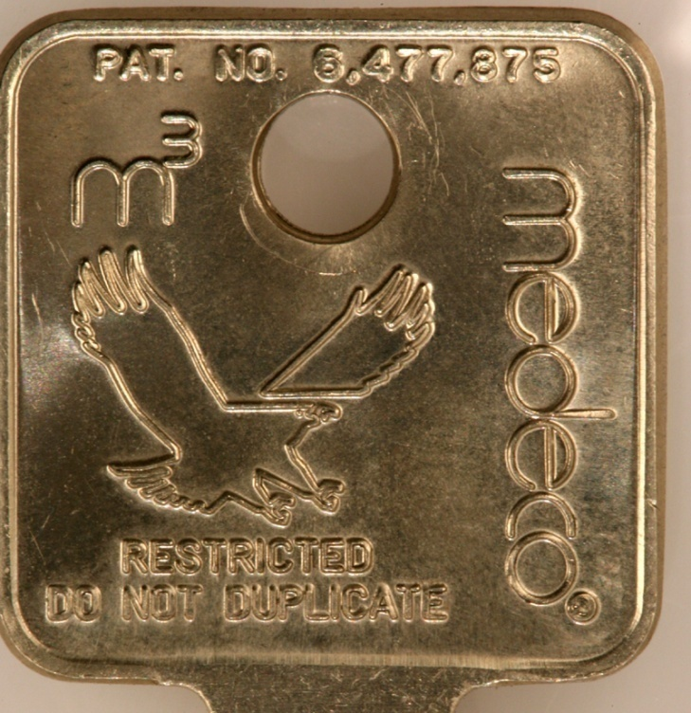
MEDECO KEY CONTROL: Virtually Impossible to Copy
[medeco quote from adv]

Slide 23
MEDECO KEY CONTROL:
The Problem
CIRCUMVENTING SECURITY LAYERS
  KEYWAYS CAN BE BYPASSED
  BLANKS CAN BE SIMULATED
  SIDEBAR CODES ARE SIMULATED
  SLIDER CAN BE BYPASSED
NO REAL LEGAL PROTECTION EXCEPT FOR M3 STEP

Slide 24
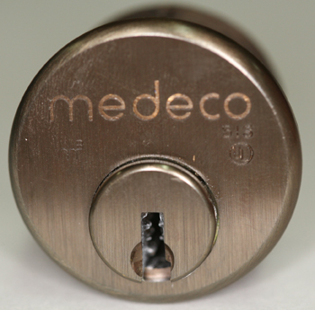
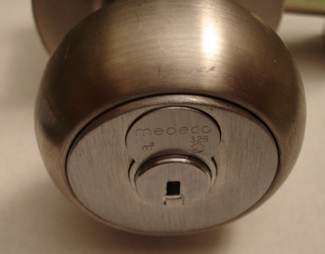
MORTISE, RIM, IC:
A Special Form of Attack
HYBRID ATTACK
Will damage the lock
Entry in ten seconds
Millions of Locks affected

Slide 25
“KEYMAIL”: The New Security Threat from Within
NEW AND DANGEROUS THREAT
THE NEW MULTI-FUNCTION COPIER
It scans, copies, prints, and allows the production of MEDECO keys
[medeco copier photo]

Slide 26
KEYMAIL: How It Works for Mortise, IC, and Rim Cylinders
ACCESS TO THE TARGET KEY
CAPTURE AN IMAGE
PRINT THE IMAGE
PRODUCE A KEY
OPEN THE LOCK

Slide 27
PLASTIC KEYS: PROCEDURE
OBTAIN IMAGE OF THE KEY
  Scan, copy, or photograph a Medeco key
  Email and print the image remotely
  Print 1:1 image on paper or plastic Shrinky Dink
  Trace onto plastic or cut out the key bitting
INSERT KEY INTO PLUG
  Neutralize three layers of security
  Open Mortise, Rim, IC cylinders

Slide 28
ACCESS TO TARGET KEY
BORROW BRIEFLY
AUTHORIZED POSSESSION
USE
COLLUSION WITH EMPLOYEE WHO HAS ACCESS TO A KEY

Slide 29
CAPTURE AN IMAGE
COPIER
TRACE THE KEY
CELL PHONE CAMERA
SCANNER

Slide 30
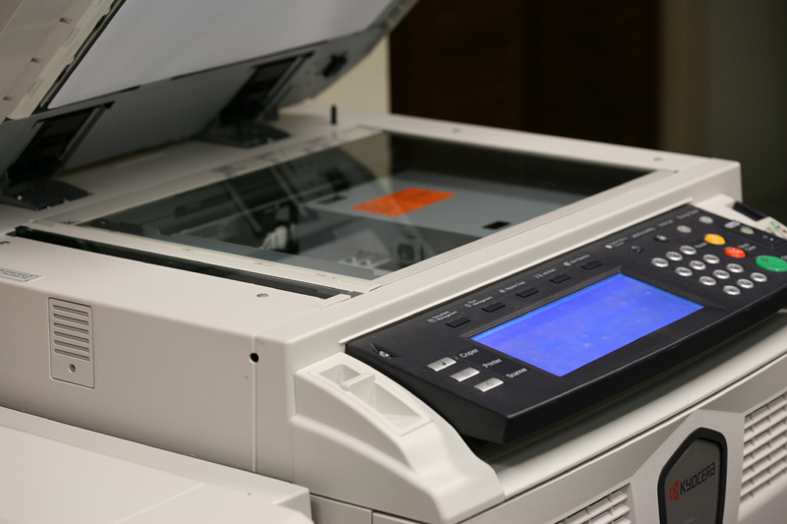
OBTAIN DATA - COPIER

Slide 31
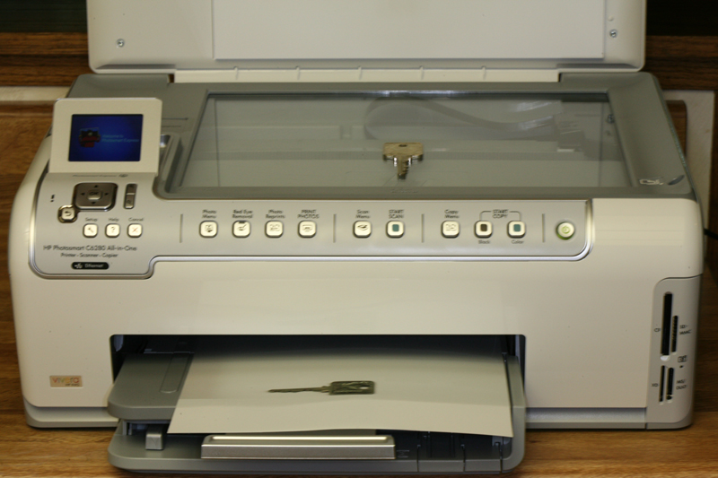
OBTAIN DATA
SCANNER

Slide 32
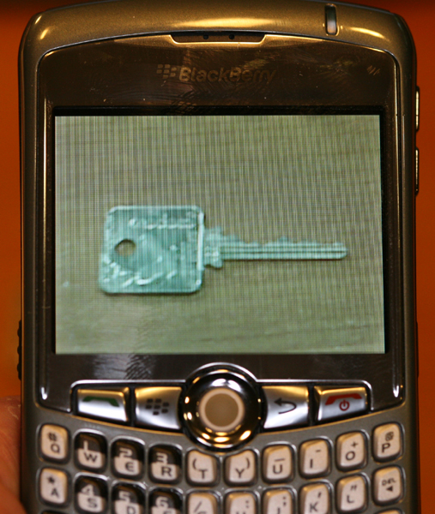
OBTAIN DATA
CELL PHONE

Slide 33
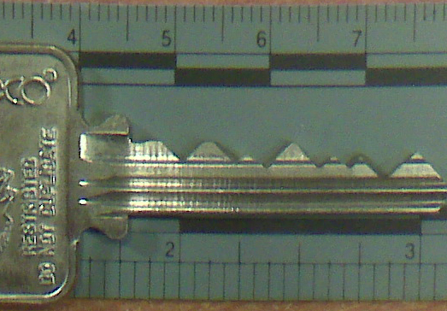
BLACKBERRY CURVE
CAPTURED IMAGE

Slide 34
RESULTING IMAGE
REPRODUCE THE IMAGE
  On Paper
  On plastic sheet
  On Adhesive Labels
  On Shrinky dinks® plastic
  On a piece of copper wire
  On a simulated metal key

Slide 35
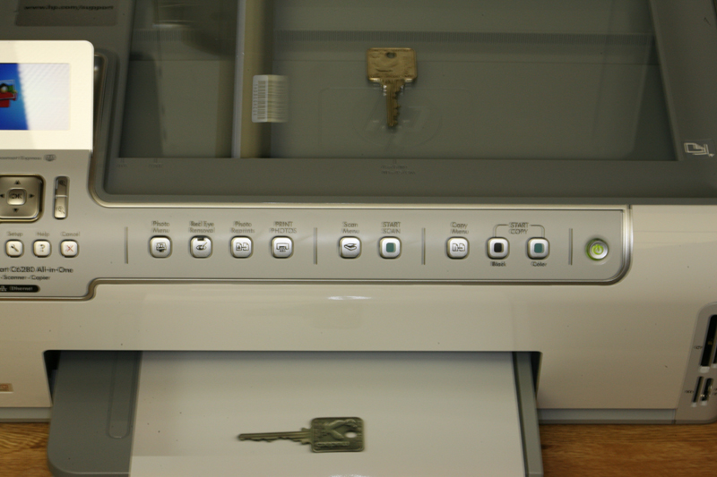
PRINT IMAGE
ON PLASTIC OR PAPER

Slide 36
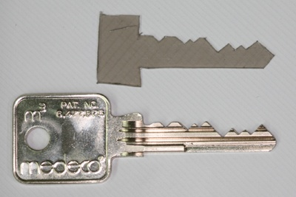
SET THE SHEAR LINE
PLASTIC KEY SETS SHEAR LINE

Slide 37
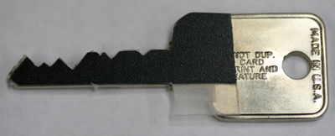

SET THE SHEAR LINE

Slide 38
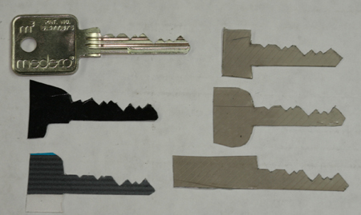
SET THE SHEAR LINE

Slide 39
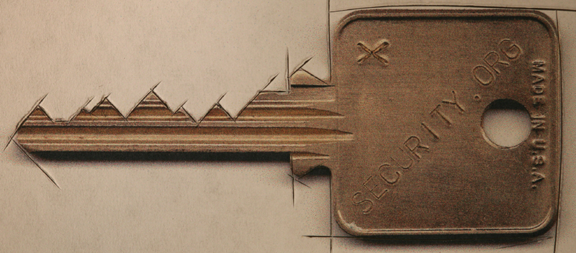
CUT A FACSIMILE OF KEY
KEY REQUIREMENTS
  Vertical bitting only
  No sidebar data
  No slider data

Slide 40
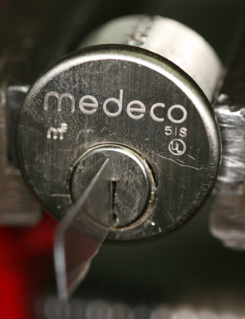
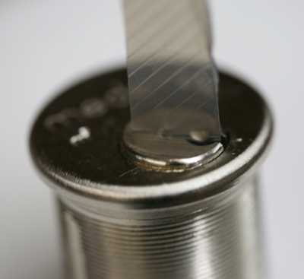
SET THE SHEAR LINE:
OPEN THE LOCK

Slide 41
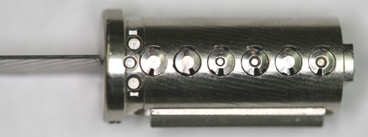
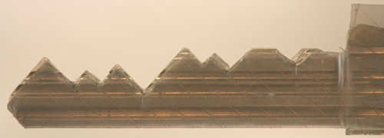
NEUTRALIZE SHEAR LINE

Slide 42
EASY ENTRIE:
SIMULATED KEY BLANKS

Slide 43
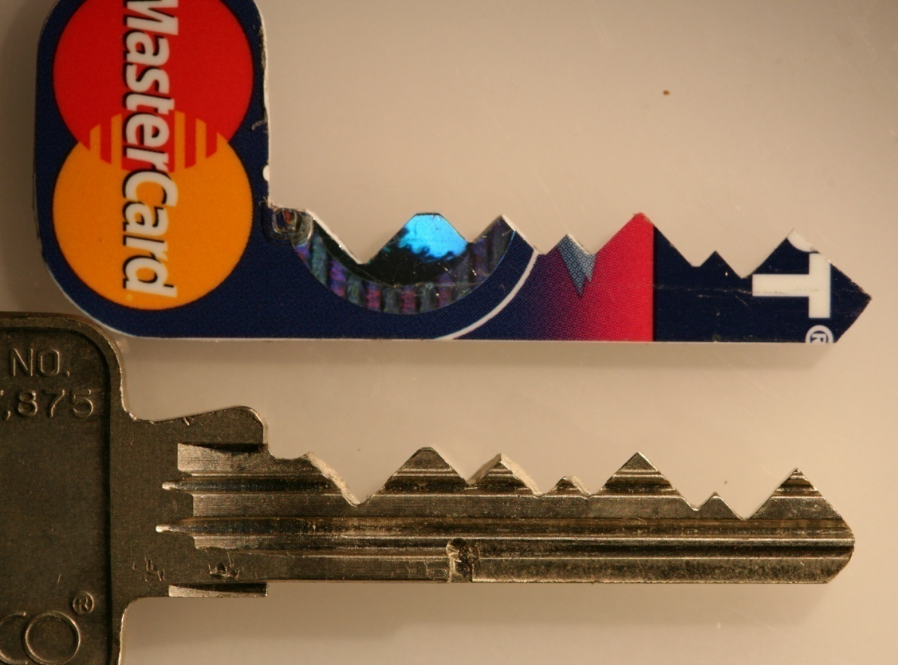
OPEN THE LOCK:
Replicate the Key in Plastic
MEDECO TAKES PLASTIC!

Slide 44
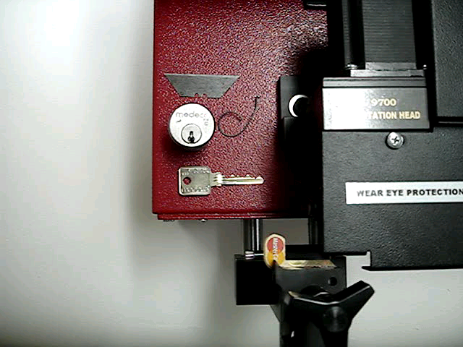
KEYS FROM CREDIT CARDS

Slide 45
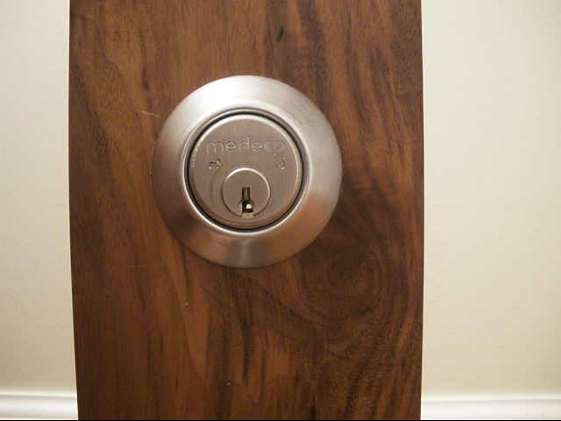
M3 PLASTIC KEYS:
OPEN THE LOCK

Slide 46
OPEN IN THIRTY SECONDS
© 2008 Marc Weber Tobias, Matt Fiddler
http://www.security.org
http://in.security.org
mwtobias@security.org
mjfiddler@security.org
tbluzmanis@security.org

