Slide 1
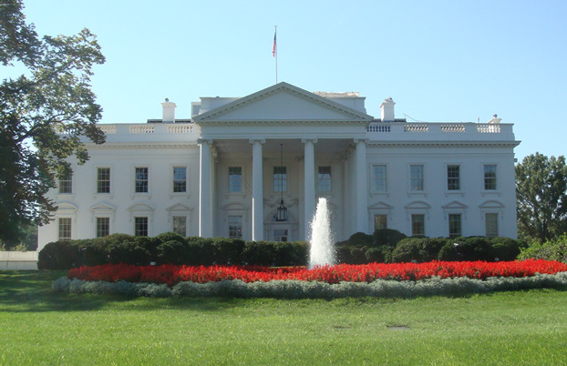
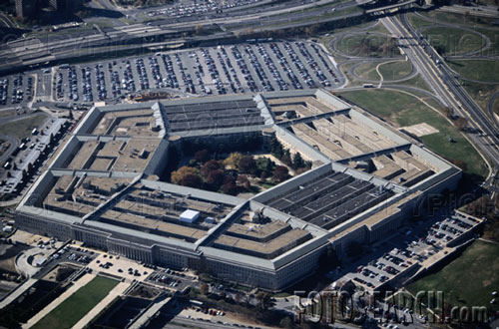
DESCONSTRUCTING LAYERS OF INSECURITY:
The Medeco Case Study
Cracking One of the Most Secure Locks in America
Lessons learned from embedded design deficiencies, a failure of imagination, a failure to connect the dots, and a belief in invincibility

Slide 2
MECHANICAL LOCKS
The First security barrier
Often the only security
Conventional or high security locks
Are they secure?
  Against what threat?
  Protection of what?
  Time and access?
  Must consider in context

Slide 3
SECURITY:
APPARENT OR ACTUAL
Most locks appear secure
Many are not
Conventional or high security rated
  UL 437
  BHMA/ANSI 156.30
Layers of security
Manufacturer may not know of insecurity
Manufacturer may not disclose defects

Slide 4
WHY IMPORTANT?
Detailed information for
  Security managers
  Risk managers
  IT directors
  Critical protection
  Security begins with locks

Slide 5
LOCKS:
MECHANICAL PUZZLES
More complex, more difficult to open
Greater complexity = vulnerabilities
All are apparently secure
Many design flaws never discovered
Manufacturers compromise on security
Manufacturing and R&D Cost v. Security

Slide 6
CONVENTIONAL v.
HIGH SECURITY LOCKS
CONVENTIONAL CYLINDERS
  Easy to pick and bump open
  No key control
  Limited forced entry resistance
HIGH SECURITY CYLINDERS
  UL and BHMA/ANSI Standards
  Higher quality and tolerances
  Resistance to Forced and Covert Entry
  Key control

Slide 7
LAYERS OF SECURITY
Independent and parallel
Each a separate point of failure
Add complexity to bypass
Does not equal more security
Conflicts possible
Many different types:
  Sliders
  Sidebars

Slide 8
LAYERS OF SECURITY AND BYPASS CAPABILITY
How many
Ability to exploit design feature?
Integrated
Separate
  Primus = 2 levels, independent, complex locking of secondary finger pins
  Assa = 2 levels, independent, simple locking, one level

Slide 9
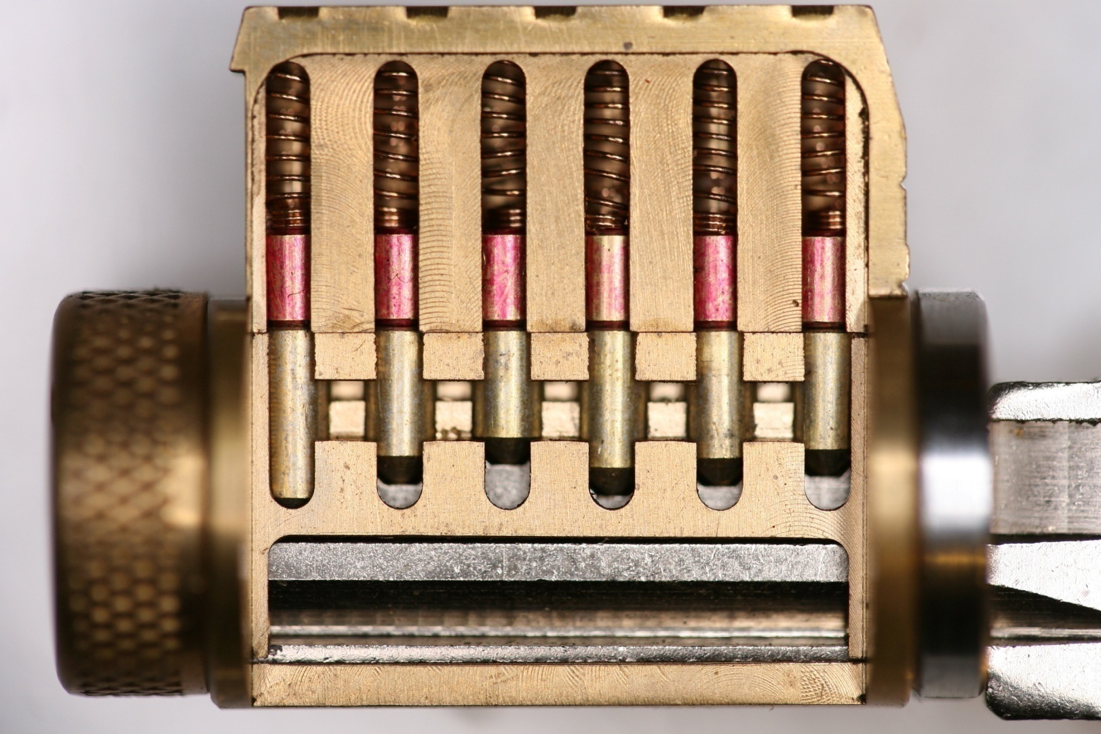
MODERN PIN TUMBLER

Slide 10
CONVENTIONAL LAYERS OF SECURITY = SHEAR LINE
Keyways and their design
sectional keyways
Check pins
Security pins, anti-bump pins
High tolerances
Key control: Everest and Medeco m3
Master key systems

Slide 11
HIGH SECURITY LOCKS: Why Important?
Protect Critical Infrastructure, high value targets
Stringent security requirements
High security Standards
Threat level is higher
Protect against Forced, Covert entry
Protect keys from compromise

Slide 12
HIGH SECURITY LOCKS: Critical Design Issues
Multiple security layers
More than one point of failure
Each security layer is independent
Security layers operate in parallel
Difficult to derive intelligence about a layer

Slide 13
HIGH SECURITY:
Three Design Factors
Resistance against forced entry
Resistance against covert and surreptitious entry
Key control and “key security”
Vulnerabilities for each requirement

Slide 14
STANDARDS REQUIREMENTS
UL and BHMA/ANSI STANDARDS
TIME is critical factor
  Ten or fifteen minutes
  Depends on security rating
Type of tools that can be used
Must resist picking and manipulation
Standards do not contemplate more sophisticated methods

Slide 15
ATTACK METHODOLOGY FOR HIGH SECURITY LOCKS
Assume and believe nothing
Ignore the experts
Think “out of the box”
Consider prior methods of attack
Always believe there is a vulnerability
WORK THE PROBLEM
  Consider all aspects and design parameters
  Do not exclude any solution

Slide 16
ATTACKS: Two Primary Rules
“The Key never unlocks the lock”
  Mechanical bypass
Alfred C. Hobbs: “If you can feel one component against the other, you can derive information and open the lock.”

Slide 17
MEDECO HISTORY
Dominant high security lock maker in U.S.
Owns 70+ Percent of U.S. high security market for commercial and government
Major government contracts
In UK, France, Europe, South America
Relied upon for highest security everywhere
Considered almost invincible by experts

Slide 18
MEDECO TIMELINE
1970 Original Lock introduced
1985 Biaxial, Second generation
2003 m3 Third generation
2006 Bumping introduced to America
  Medeco announces “Bump-Proof”
2007 Revised to “Virtually Bump-Proof”
2007 Revised to “Virtually Resistant”
2008 No public statements by Medeco

Slide 19
DECONSTRUCTING LAYERS OF SECURITY: Medeco Locks
Many lessons learned
Discovered serious security vulnerabilities
Applicable to residential, commercial, and government users
Serious potential liability issues
Resulted in a detailed book

Slide 20
WHY THE MEDECO CASE STUDY IS IMPORTANT
Insight into design of high security locks
Patents are no assurance of security
Appearance of security v. Real World
Undue reliance on Standards
Manufacturer knowledge and Representations
Methodology of attack
More secure lock designs

Slide 21
MEDECO MISTAKES
Failed to listen
Embedded design problems from beginning
Compounded problems with new designs with two new generations: Biaxial and m3
Failed to “connect the dots”
Failure of imagination
Lack of understanding of bypass techniques

Slide 22
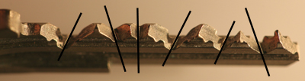
MEDECO TWISTING PINS:
3 Angles + 2 Positions

Slide 23
MEDECO LOCKS:
3 Independent Security Layers
Layer 1: PIN TUMBLERS to shear line
Layer 2: SIDEBAR: 3 angles x 2 positions
Layer 3: SLIDER – 26 positions
False Gates, ARX Pins,
High tolerance
TO OPEN:
  Lift the pins to shear line
  Rotate each pin individually
  Move the slider to correct position

Slide 24
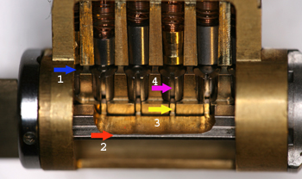
MEDECO BIAXIAL

Slide 25
SECURITY CONCEPTS: Sidebar IS Medeco Security
GM locks, 1935, Medeco re-invented
Heart of Medeco security and patents
Independent and parallel security layer
Integrated pin: lift and rotate to align
Sidebar blocks plug rotation
Pins block manipulation of pins for rotation to set angles

Slide 26
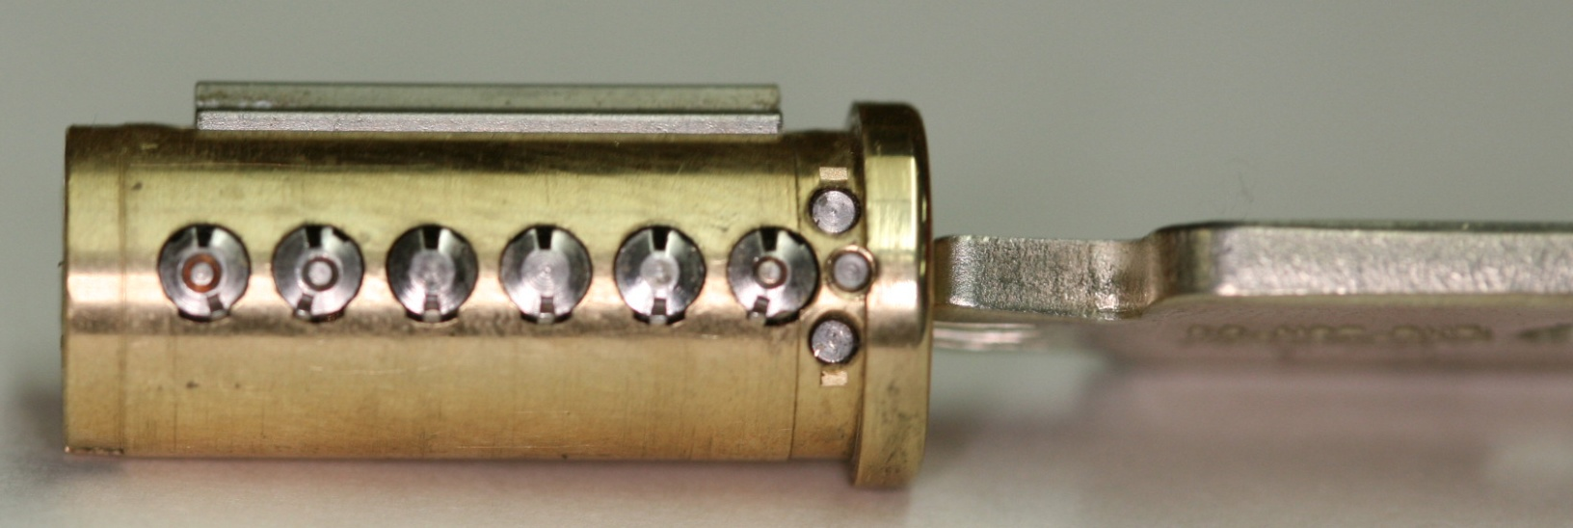
PLUG AND SIDEBAR:
All pins aligned

Slide 27
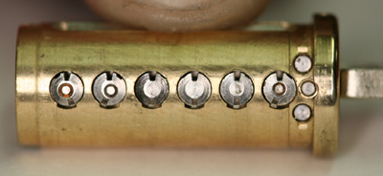
SIDEBAR RETRACTED

Slide 28
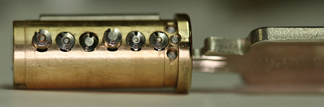
PLUG AND SIDEBAR: Locked

Slide 29
MEDECO CASE HISTORY
Exploited vulnerabilities
Reverse engineer sidebar codes
Analyze what constitutes security
Analyze critical tolerances
Analyze key control issues
Analyze design enhancements for new generations of locks: Biaxial and m3 and Bilevel

Slide 30
EXPLOIT DESIGN FEATURES AND SYSTEM PARAMETERS
Codes: design, progression
Key bitting design
Tolerances
Keying rules
  Medeco master and non-master key systems
Interaction of critical components and locking systems: Sidebar leg and gates
Keyway and plug design
M3 design: wider keyway

Slide 31
MEDECO RESEARCH:
Results of Project
Covert and surreptitious entry in as little as 30 seconds: standard requires 10-15 minutes
Forced entry: four techniques, 30 seconds, affect millions of locks
Complete compromise of key control
  Duplication, replication, simulation of keys
  Creation of bump keys and code setting keys
  Creation of top level master keys

Slide 32
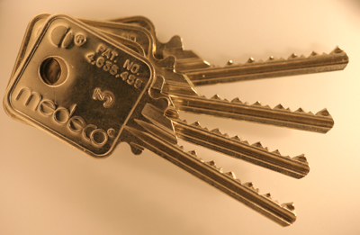
4 KEYS TO THE KINGDOM

Slide 33
RESULTS OF PROJECT: Bumping
Reliably bump open Biaxial and m3 locks
Produce bump keys on Medeco blanks and simulated blanks
Known sidebar code
Unknown sidebar code

Slide 34
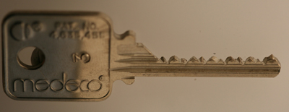
MEDECO BUMP KEY

Slide 35

REAL WORLD ATTACK: Bumping a Medeco Lock

Slide 36
RESULTS OF PROJECT:
Key Control and Key Security
Total compromise of key control and key security, vital to high security locks
  Duplicate, replicate, simulate keys for all m3 and some Biaxial keyways
    Restricted keyways, proprietary keyways
    Government and large facilities affected
  Attack master key systems
  Produce bump keys
  Produce code setting keys

Slide 37
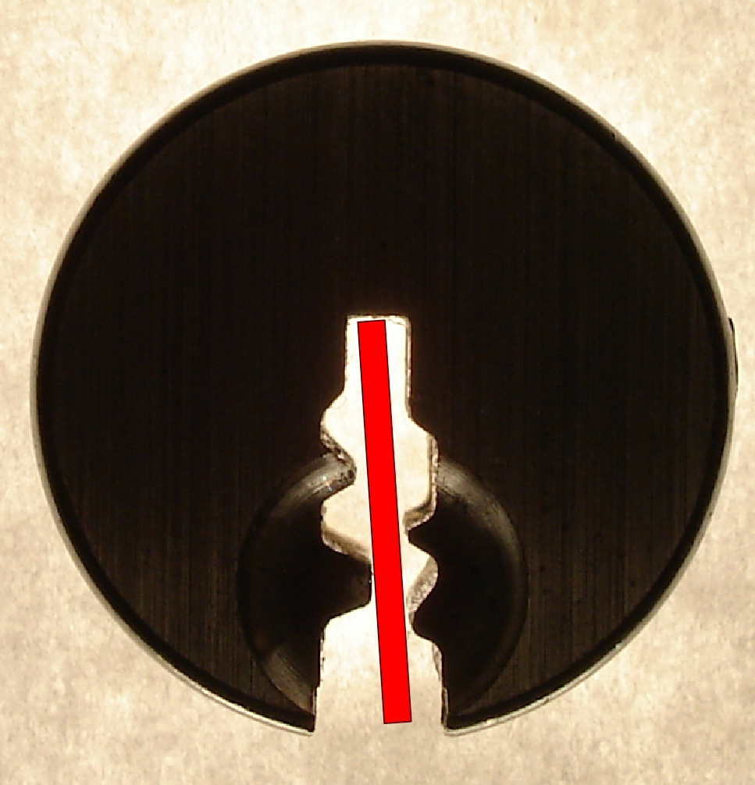
SIMULATED BLANKS: Any m3 and Many Biaxial Locks

Slide 38
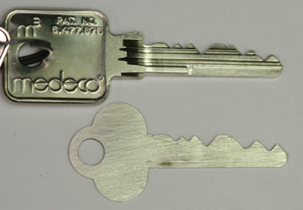
SIMULATED BLANKS

Slide 39
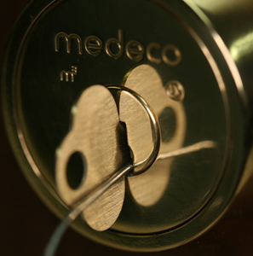
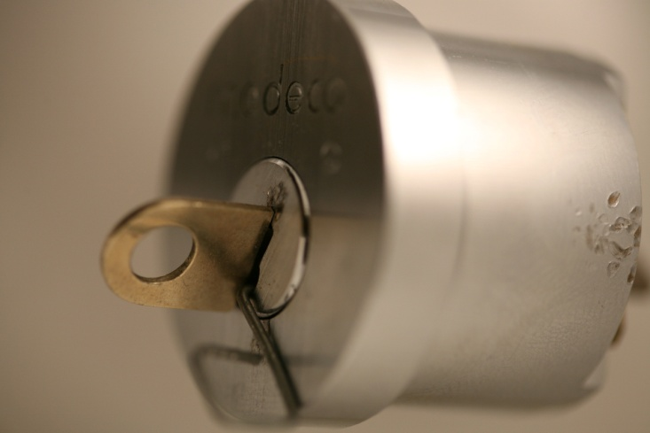
M3 SLIDER:
Bypass with a Paper clip

Slide 40
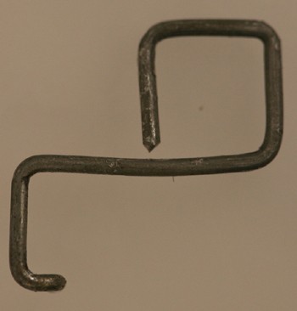
SECURITY OF m3:
High Tech Wire!

Slide 41
RESULTS OF PROJECT: Picking
Pick the locks in as little as 30 seconds
Standard picks, not high tech tools
Use of another key in the system to set the sidebar code
Pick all pins or individual pins
Neutralize the sidebar as security layer

Slide 42
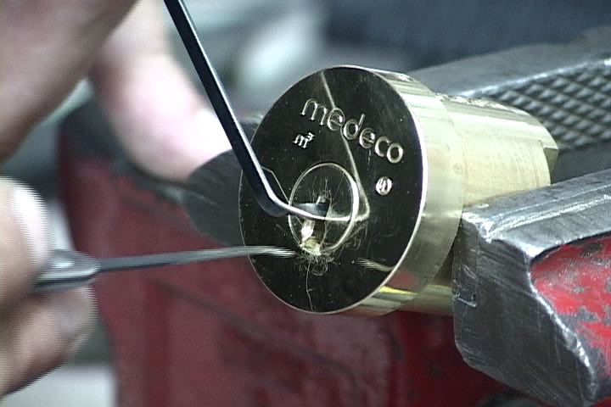
PICKING A MEDECO LOCK

Slide 43
RESULTS OF PROJECT: Decode Top Level Master Key
Determine the sidebar code in special system where multiple sidebar codes are employed to protect one or more locks
Decode the TMK
OWN the system

Slide 44
RESULTS OF PROJECT: Forced Entry Techniques
Deadbolt attacks on all three versions
  Deadbolt 1 and 2: 30 seconds
  Deadbolt 3: New hybrid technique of reverse picking
Mortise and rim cylinders
  Prior intelligence + simulated key
Interchangeable core locks

Slide 45
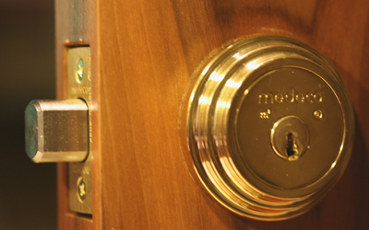
DEADBOLT ATTACK

Slide 46

DEADBOLT BYPASS: 2$ Screwdriver + $.25 materials

Slide 47
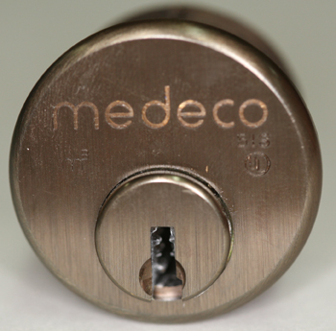
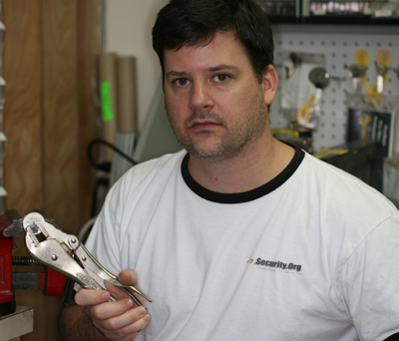
MORTISE CYLINDER

Slide 48
LESSONS TO BE LEARNED
Patents do not assure security
Apparent security v. actual security
40 years of invincibility means nothing
New methods of attack
Corporate arrogance and misrepresentation
“If it wasn’t invented here” mentality
All mechanical locks have vulnerabilities

Slide 49
RESPONSIBLE DISCLOSURE
Medeco announced their locks were bump-proof
  Medeco learned they were not
Medeco was shown how their locks could be picked with four keys
Medeco was shown how their key control could be compromised
Medeco knew their deadbolts could be opened in seconds

Slide 50
IRRESPONSIBLE
NON-DISCLOSURE?
Should they have advised their customers when they believed their locks could be compromised?
Should they have warned their dealers regarding their deadbolt issue before they fixed it?
Do they have an affirmative duty to disclose vulnerabilities that could affect their customers?

Slide 51
RESPONSIBLE DISCLSOURE BY A MANUFACTURER?
Should a lock manufacturer disclose vulnerabilities to the public
Should they promote Security by Obscurity
Does the public have a right to know
  There are security vulnerabilities
  The details of those vulnerabilities
  How much of a risk

Slide 52
HIGH SECURITY LOCK MANUFACTURERS:
Special Duties to Customers?
Nature of product
What is at risk
Disclosure to customer v. educating criminals: Which is more important?
Does the dealer and customer need to know
Liability for non-disclosure?

Slide 53
OPEN IN THIRTY SECONDS: Cracking one of the most secure locks in America
© 2008 Marc Weber Tobias and
Tobias Bluzmanis
www.security.org
mwtobias@security.org

