Slide 1
MEDECO “VIRTUALLY RESISTANT” SECURITY
A Case Study in Real World
Security Vulnerabilities and Liability

Slide 2
LOCKS AND LIABILITY: WHY IMPORTANT
PROTECTION OF ASSETS, INFORMATION, PEOPLE
PREVENT LOSSES
UNAUTHORIZED ACCESS
STATUTORY REQUIREMENTS
STANDARDS: MINIMAL PROTECTION
BYPASS OF LOCKS
ELECTRONIC ACCESS CONTROL

Slide 3
MEDECO: One of the Most Secure Locks in America?
FORTY YEARS: THE LEADER
FIRST LINE OF PROTECTION
CRITICAL INFRASTRUCTURE
LEGAL REQUIREMENTS
HIGHEST SECURITY RATINGS
UL 437 and BHMA/ANSI 156.30

Slide 4
MEDECO CASE STUDY: WHY IMPORTANT
CONCEPT OF SECURITY
Medeco locks are good, but not for everybody
STANDARDS DO NOT PROTECT YOU
CORPORATE ARROGANCE
Medeco cannot open their own locks
“Nobody else understands their locks”
CAMPAIGN OF DISINFORMATION
Misrepresentations, obfuscation, and misstatements

Slide 5
MEDECO: LESSONS LEARNED
PATENTS DO NOT MEAN ANYTHING
STANDARDS: LIMITED VALUE
SOME MANUFACTURERS WILL NOT TELL THE TRUTH OR DO NOT KNOW
KEY CONTROL: THE MYTH
SECURITY OF MECHANICAL LOCKS
ELECTRONIC ACCESS CONTROL SECURITY ISSUES

Slide 6
LOCK BUMPING: WHERE IT ALL STARTED
AUGUST 2006: JENNALYNN
Bumps a Kwikset pin tumbler lock
AUGUST 2007: JENNALYNN
Bumps a Medeco Biaxial lock
JUNE, 2008: OPEN IN THIRTY SECONDS
AUGUST, 2008: JENNALYNN
Bumps a Medeco with ARX pins

Slide 7
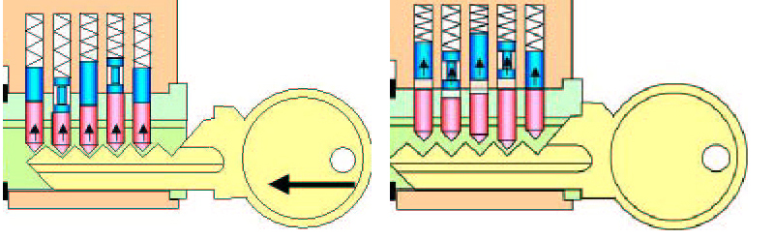
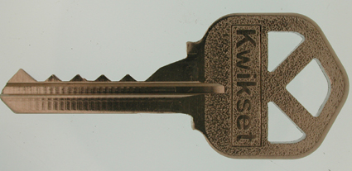
LOCK BUMPING THEORY

Slide 8
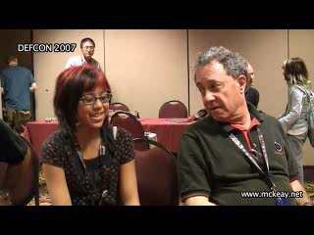
JENNALYNN, AGE 11: OPENS KWIKSET

Slide 9
LOCK BUMPING: 2006 A SERIOUS THREAT
INTRODUCED LOCK BUMPING
JennaLynn opens a Kwikset
KNOWN TECHNIQUE: 1925
Refined in 2004 in Europe
ALOA: NOT A PROBLEM
MEDECO: BUMP-PROOF LOCKS
POSTAL INSPECTION SERVICE
CONVENTIONAL LOCKS AFFECTED

Slide 10
WHY BUMPING IMPORTANT
EXPOSED VULNERABILITY TO 95% OF PIN TUMBLER LOCKS
PUBLIC AWARENESS
LEGAL NOTICE AND LIABILITY
HIGH SECRITY LOCKS
Manufacturers said locks were secure
Our locks are bump-proof
Assa Abloy Companies: “Smoke and mirrors”

Slide 11
BUMPING AND SECURITY
NEED TO UNDERSTAND PROBLEM
PROPERLY ASSESS SECURITY
RESULTED IN BYPASS OF HIGH SECURITY LOCKS
MEDECO, MUL-T-LOCK, ASSA, OTHERS
LEGAL LIABILITIES AND STATUTORY MANDATES FOR SECURITY

Slide 12
WHAT IS HIGH SECURITY: QUESTIONS TO ASK
DO I HAVE HIGH SECURITY LOCKS
DO I NEED HIGH SECURITY LOCKS
CAN HIGH SECURITY LOCKS BE COMPROMISED
WHAT CONSTITUTES A THREAT AND HOW DO LOCKS PROTECT MY FACILITY
WILL ELECTRONIC ACCESS CONTROL BE SUFFICIENT

Slide 13
HIGH SECURITY LOCKS: A REVIEW
SPECIFY FOR FACILITY PROTECTION
COVERT ENTRY
FORCED ENTRY
KEY CONTROL
MINIMUM SECURITY CRITERIA
MINIMUM ATTACK TIMES
RESISTANCE TO CERTAIN FORMS OF ENTRY
UL 437 and BHMA/ANSI 156.30

Slide 14
COVERT ENTRY PROTECTION: The Theory
MINIMUM SECURITY CRITERIA IN UL 437 and BHMA/ANSI 156.30
PROTECT AGAINST CERTAIN FORMS OF COVERT ENTRY
ASSURE MINIMUM RESISTANCE TIMES TO OPEN

Slide 15
COVERT ENTRY OF MEDECO LOCKS: RESULT
BUMPING
Modified change key
Simulated key
PICKING
With change key
With code setting keys
EXTRAPOLATE TMK
DECODE BILEVEL SYSTEM TO COMPROMISE m3 SYSTEM

Slide 16
MEDECO INSECURITY: Real World Threats - Covert
FOUR KEYS TO PICK AND BUMP PRE-12/07 LOCKS
SIXTEEN OR LESS KEYS FOR 2008 LOCKS
PICKING IN AS LITTLE AS 27 SECONDS
Using any change key on same sidebar code
With code setting keys
Angle setting keys
ARX pins

Slide 17
MEDECO INSECURITY: Real World Threats - Covert
BUMPING
With correct blank and sidebar code
With simulated blank
With or without ARX pins

Slide 18
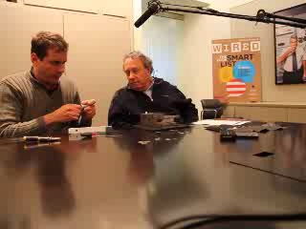
BUMPING MEDECO LOCKS

Slide 19
FORCED ENTRY PROTECTION: Theory
LOCKS ARE SECURE AGAINST FORCED METHODS OF ATTACK
MINIMUM TIMES SPECIFIED IN UL 437 and BHMA/ANSI 156.30
ATTACK RESISTANCE: 5 MINUTES

Slide 20
MEDECO INSECURITY: Real World Threats – Forced
DEADBOLT Pre-12/2007
Thirty seconds
Complete circumvention of security
Simple tools, easy to accomplish
DEADBOLT 2008
Reverse picking attack
MORTISE, RIM, ICORE
Hybrid attack, compromise of key control

Slide 21
MEDECO INSECURITY: Real World Threats - Keys
VIOLATION OF KEY CONTROL and KEY SECURITY
Compromise of entire facility
Improper generation of keys
Compromise of Top Level Master Key

Slide 22
MEDECO INSECURITY: The Threat from Within
COMPROMISE OF KEY CONTROL + HYBRID ATTACK
Mortise, Rim, Interchangeable cores
MEDECO KEY CONTROL v. CONVENTIONAL KEYS
Conventional keys = 1 layer of security
Medeco keys = 3 layers of security
Electronic Access Control issues: two levels of security

Slide 23
MEDECO INSECURITY: The Threat from Within
OBTAIN KEY DATA TO OPEN LOCKS BY HYBRID ATTACK
KEY CONTROL IS CIRCUMVENTED
BRIEF ACCESS TO A KEY FOR A TARGET LOCK
Compromise of the lock or system
By insiders
By criminals outside of an organization

Slide 24
MEDECO KEY CONTROL: Appearance v. Reality
WHAT IS IT SUPPOSED TO MEAN?
ARE THE STANDARDS SUFFICIENT?
REAL WORLD VULNERABILITIES
IS ELECTRONIC ACCESS CONTROL ANY MORE SECURE?

Slide 25
KEY CONTROL: The Theory
PROTECTION OF BLANKS OR CUT KEYS FROM ACQUISITION OR USE:
Unauthorized duplication
Unauthorized replication
Unauthorized simulation
restricted keyways
proprietary keyways
sectional keyways

Slide 26
KEYS and KEY CONTROL
KEYS ARE THE EASIEST WAY TO OPEN LOCKS
Change key or master key
Duplicate correct bitting
Bump keys
Rights amplification: modify keys
PROTECTION OF KEYS
Side bit milling: Primus and Assa
Interactive elements: Mul-T-Lock
Magnets: EVVA MCS

Slide 27
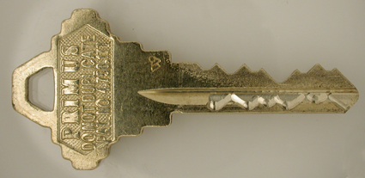
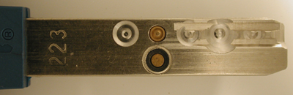
PROTECTION OF KEYS

Slide 28
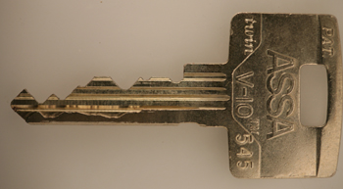
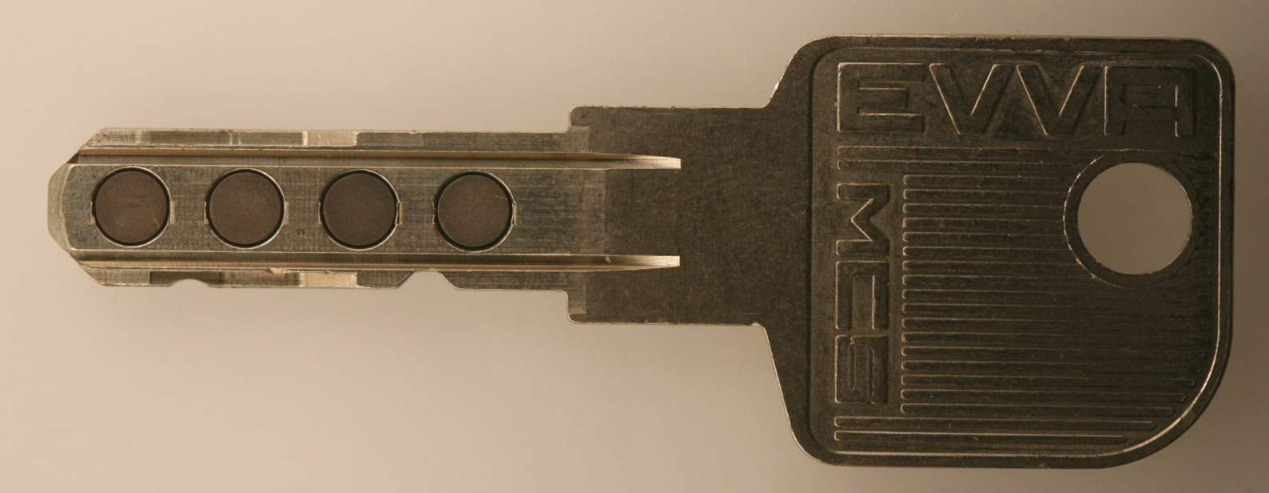
PROTECTION OF KEYS

Slide 29
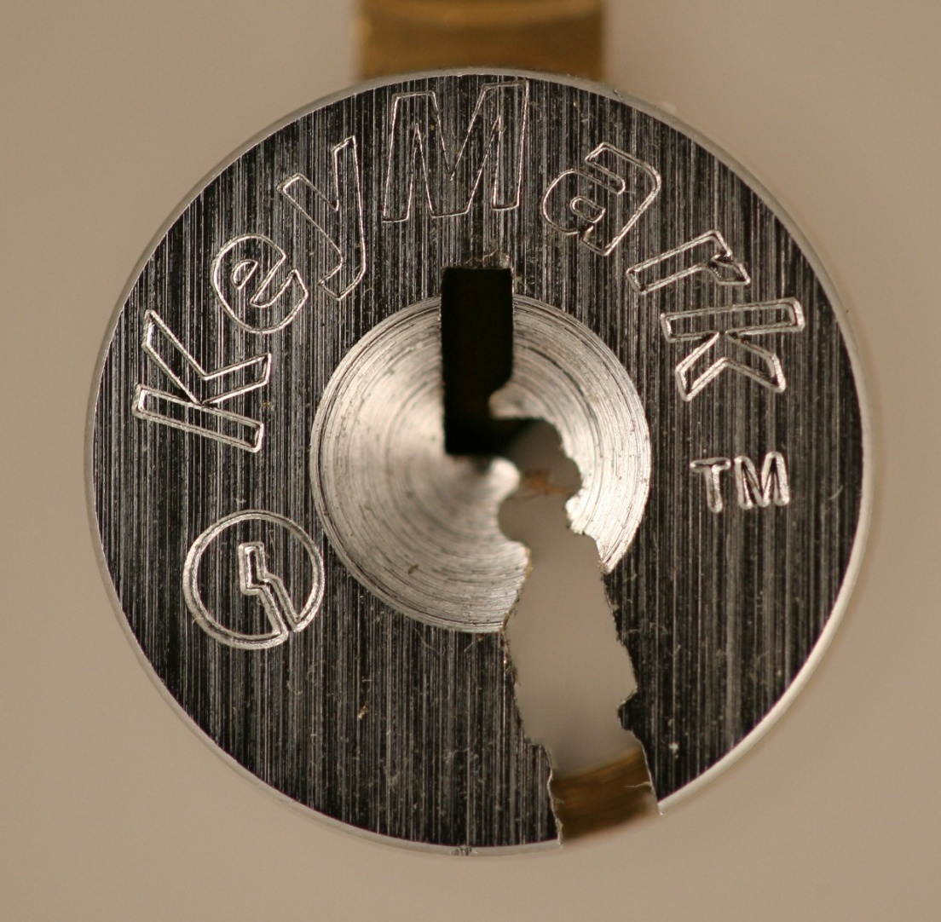
MEDECO KEYMARK: ABSOLUTE KEY CONTROL!

Slide 30
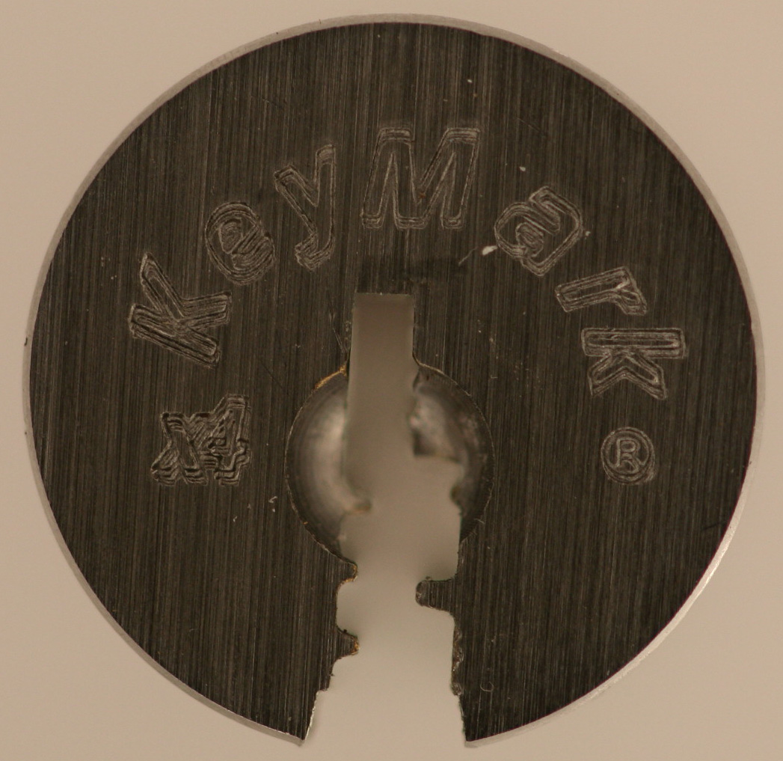
MEDECO KEYMARK X4

Slide 31
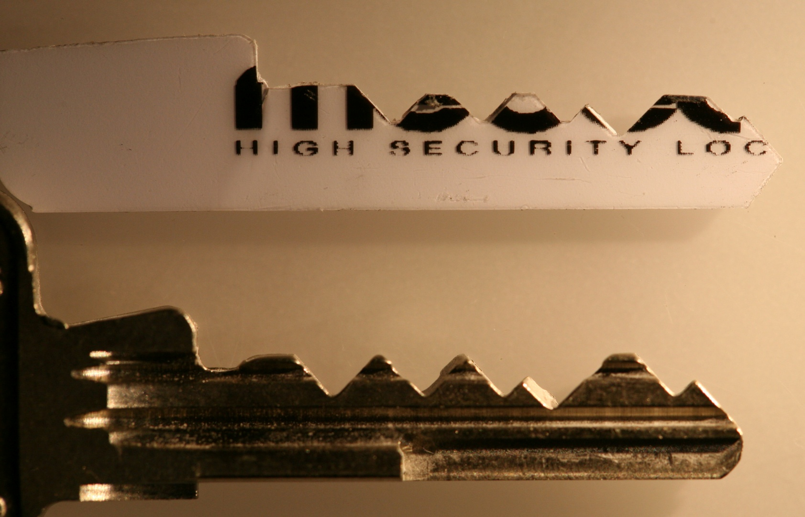
KEYMARK TAKES PLASTIC

Slide 32
SECURITY THREAT: Failure of Key Control: Duplicate
IMPROPER ACQUISITION OR USE OF KEYS BY EMPLOYEES OR CRIMINALS
Unauthorized access to facilities or areas
Bump keys
Use for rights amplification
Compromise master key systems

Slide 33
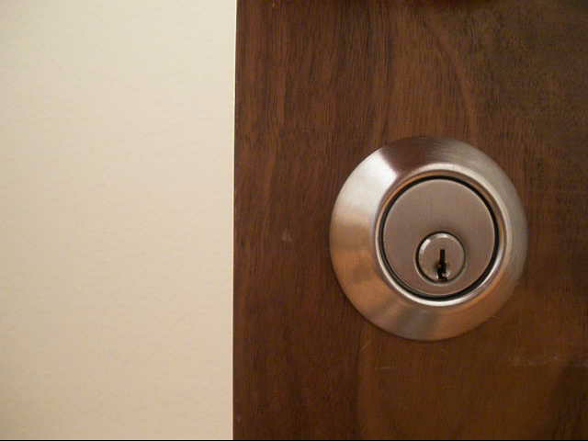
KWIKSET: CONVENTIONAL LOCKS AND KEYS

Slide 34
SECURITY THREAT: Failure of Key Control: Replicate
HIGH SECURITY LOCKS AND KEYS
Designed to prevent replication
REPLICATION TECHNIQUES
EASY ENTRIE MILLING MACHINE
SILINCONE CASTING
PLASTIC AND EPOXY

Slide 35
SECURITY THREAT: Failure of Key Control: Simulate
M3 KEYWAY
Wider than Biaxial
No paracentric keyway
COMPONENTS OF MEDECO KEYS
Ward pattern and paracentric keyway
Bitting
M3 Slider
SECURITY THREAT
Bypass wards in paracentric keyway
Create new blanks

Slide 36
RESULT: Failure of Key Control
Restricted and proprietary keyways
M3 Slider: bypass with paper clip
Sabotage potential
Make keys to open your locks
Duplicate from codes or pictures
TMK extrapolation
Set the sidebar code

Slide 37
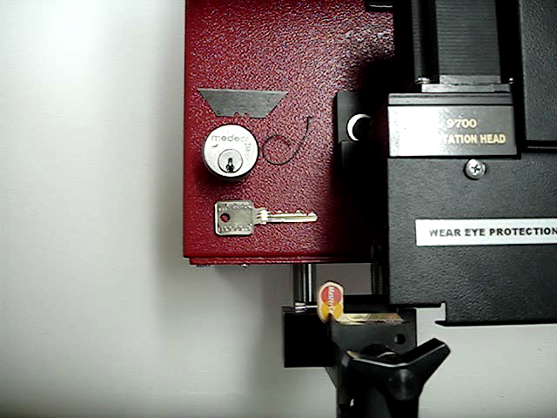
DUPLICATING MEDECO

Slide 38
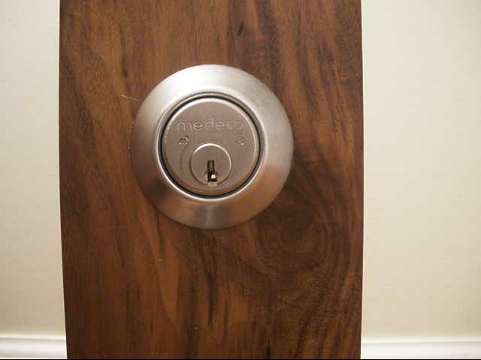
KEYS AND FORCED ENTRY

Slide 39
COMPROMISE THE SYSTEM: Obtaining the Critical Data
TECHNIQUES TO OBTAIN KEY DATA
Impressioning methods
Decoding: visual and Key Gauges
Photograph
Scan keys
Copy machine

Slide 40
KEY CONTROL: Why Most Keys are Vulnerable
CONVENTIONAL LOCKS: Single Layer
KEYWAY = KEY CONTROL
LEGAL PROTECTION DOES NOT PREVENT REAL WORLD ATTACKS
KEYS = BITTING HEIGHT + KEYWAY
Bypass the keyway
Raise pins to shear line

Slide 41
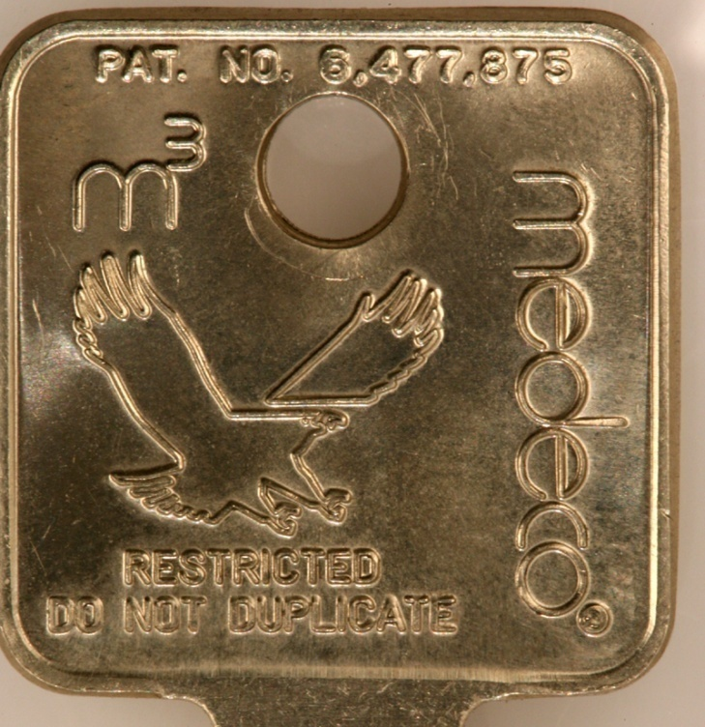
MEDECO KEY CONTROL: Virtually Impossible to Copy
“If there is no key control, then it does not matter what security enhancements are in the lock”

Slide 42
MEDECO KEY CONTROL: The Problem
CIRCUMVENTING SECURITY LAYERS
KEYWAYS CAN BE BYPASSED
BLANKS CAN BE SIMULATED
SIDEBAR CODES ARE SIMULATED
SLIDER CAN BE BYPASSED
NO REAL LEGAL PROTECTION EXCEPT FOR M3 STEP

Slide 43
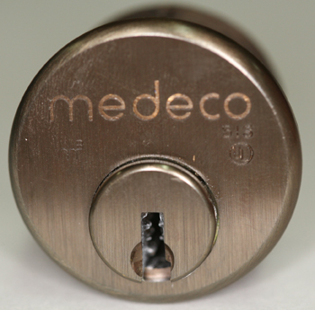
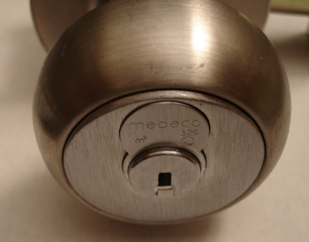
MORTISE, RIM, IC: A Special Form of Attack
HYBRID ATTACK
Will damage the lock
Entry in ten seconds
Millions of Locks affected

Slide 44
“KEYMAIL”: The New Security Threat from Within
NEW AND DANGEROUS THREAT
THE NEW MULTI-FUNCTION COPIER
It scans, copies, prints, and allows the production of MEDECO keys

Slide 45
KEYMAIL: How It Works for Mortise, IC, and Rim Cylinders
ACCESS TO THE TARGET KEY
CAPTURE AN IMAGE
PRINT THE IMAGE
PRODUCE A KEY
OPEN THE LOCK

Slide 46
PLASTIC KEYS: PROCEDURE
OBTAIN IMAGE OF THE KEY
Scan, copy, or photograph a Medeco key
Email and print the image remotely
Print 1:1 image on paper or plastic Shrinky Dink
Trace onto plastic or cut out the key bitting
INSERT KEY INTO PLUG
Neutralize three layers of security
Open Mortise, Rim, IC cylinders

Slide 47
ACCESS TO TARGET KEY
BORROW BRIEFLY
AUTHORIZED POSSESSION
USE
COLLUSION WITH EMPLOYEE WHO HAS ACCESS TO A KEY

Slide 48
CAPTURE AN IMAGE
COPIER
TRACE THE KEY
CELL PHONE CAMERA
SCANNER

Slide 49
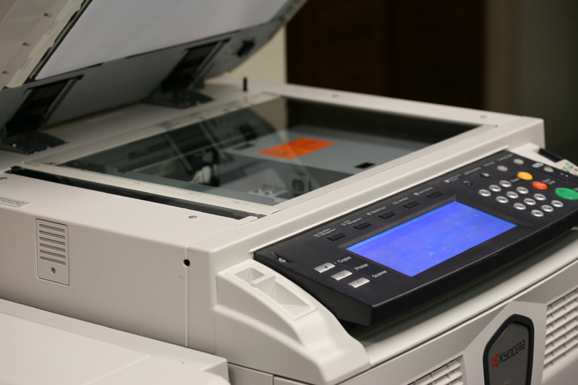
OBTAIN DATA - COPIER

Slide 50
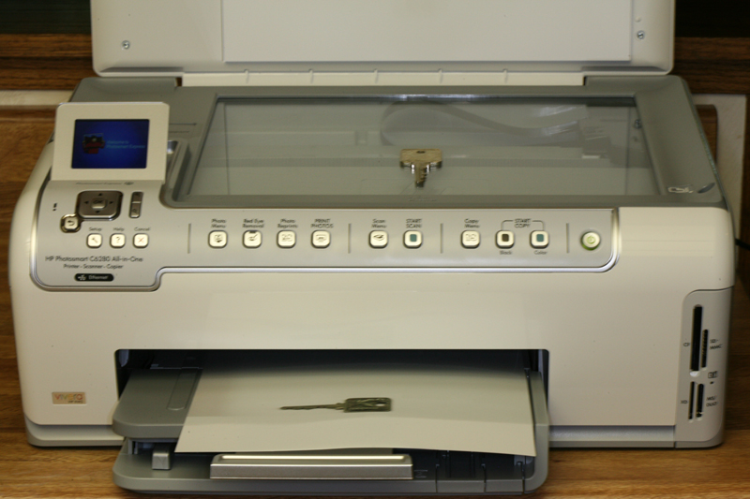
OBTAIN DATA
SCANNER

Slide 51
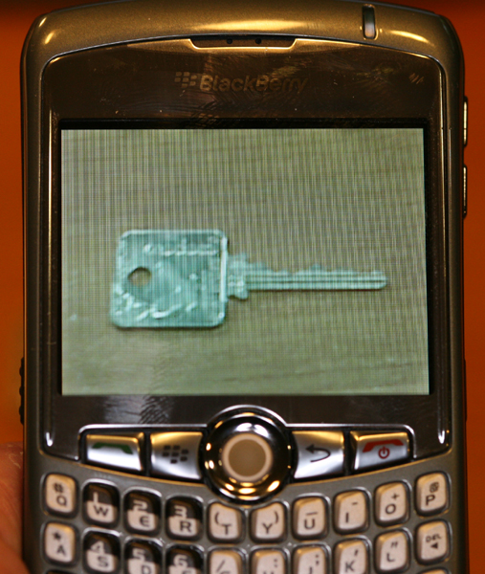
OBTAIN DATA
CELL PHONE

Slide 52
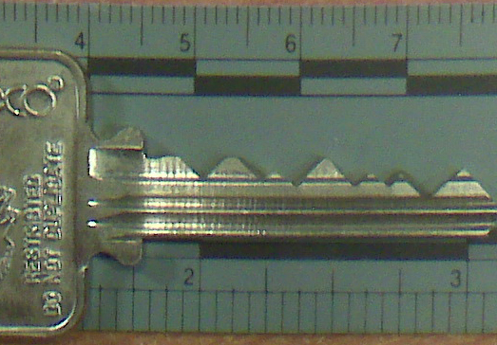
BLACKBERRY CURVE
CAPTURED IMAGE

Slide 53
RESULTING IMAGE
REPRODUCE THE IMAGE
On Paper
On plastic sheet
On Adhesive Labels
On Shrinky dinks® plastic
On a piece of copper wire
On a simulated metal key

Slide 54
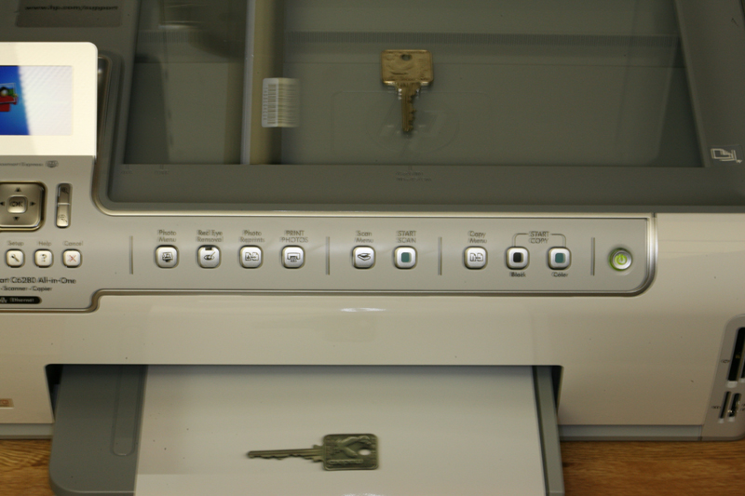
PRINT IMAGE ON PLASTIC OR PAPER

Slide 55
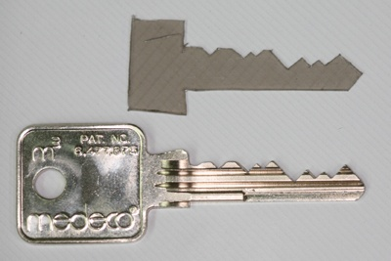
SET THE SHEAR LINE
PLASTIC KEY SETS SHEAR LINE

Slide 56
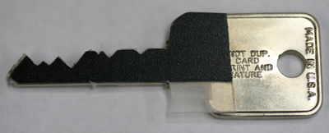

SET THE SHEAR LINE

Slide 57
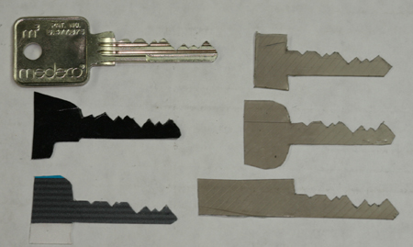
SET THE SHEAR LINE

Slide 58
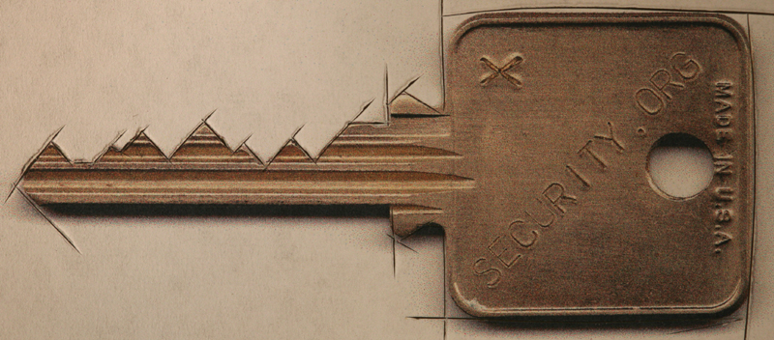
CUT A FACSIMILE OF KEY
KEY REQUIREMENTS
Vertical bitting only
No sidebar data
No slider data

Slide 59
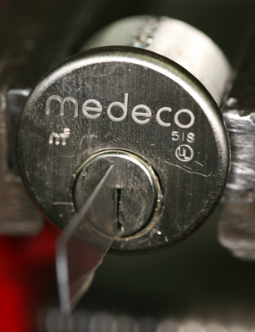
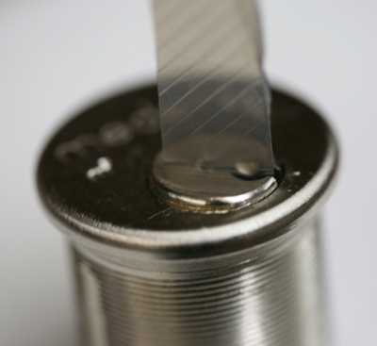
SET THE SHEAR LINE: OPEN THE LOCK

Slide 60
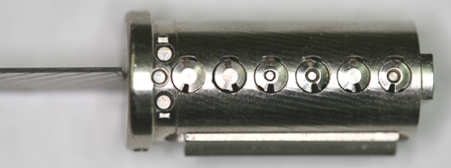
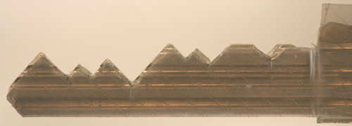
NEUTRALIZE SHEAR LINE

Slide 61
HIGH SECURITY LOCK MANUFACTURERS
LEGAL RESPONSIBILITY
ETHICAL RESPONSIBILITY
NOTIFY OF VULNERABILITIES
PROPER PRODUCT DESIGNS
FIX PROBLEMS

Slide 62
LOCKS, LIES, AND VIDEOTAPE: MEDECO CASE STUDY
LOCK BUMPING: WHERE IT BEGAN
MEDECO CASE STUDY
Medeco security: “Our locks are bump-proof, virtually bump-proof, and Virtually Resistant”
We Never claimed our Locks were bump-proof!
Our deadbolts are secure, no problem!
We have spent hundreds of hours and cannot replicate any of the Tobias attacks!

Slide 63
MEDECO BUMPING CLAIM: “We never said it: Others did!”
WHAT IS THE TRUTH?
August 4, 2006 press release: “Bump-proof”
2007 - Retroactively changed the language: “Virtually Bump-proof”
The Medeco Problem: www.archive.org
TV, Advertising, DVD, Medeco website
The Smoking Gun: August 12, 2006

Slide 64
WE NEVER SAID OUR LOCKS WERE BUMP-PROOF
AUGUST 15, 2006
U.S. Patent and Trademark Office filing by Medeco Security Locks, Inc. lawyer G. Franklin Rothwell, Application 78952460
Word mark: BUMP PROOF
Abandoned: February 9,2007

Slide 65
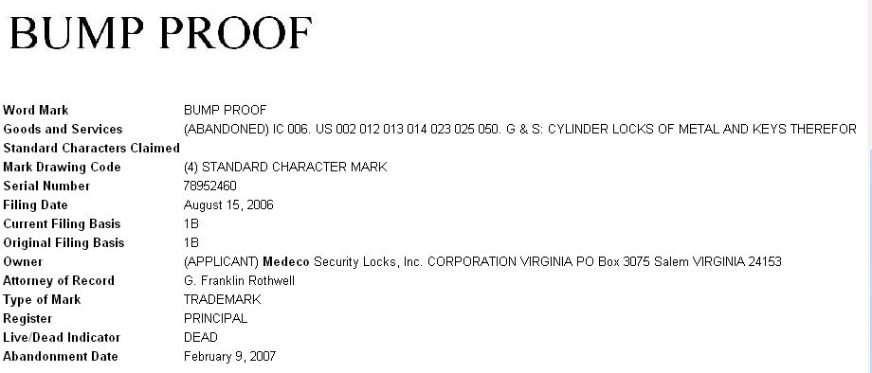
BUMP PROOF: USPTO FILING FOR THE WORD MARK

Slide 66
ABOUT CLAIMS OF PICKING MEDECO LOCKS
NOBODY HAS PROVED THEY CAN PICK OUR LOCKS IN 40 YEARS
False demonstrations, special locks
They are lying
We cannot replicate anything
THE REAL PROBLEM
They cannot open their own locks
Failure of imagination

Slide 67
RESPONSIBLE DISCLOSURE BY LOCK MANUFACTURERS
KNOWLEDGE OF VULNERABILITY
Known or suspected
Make responsible notifications
Let users and dealers assess risks
Duty to tell the truth
Duty to fix the problem

Slide 68
VULNERABILITIES: Full Disclosure Required
SECURITY BY OBSCURITY
It does not work with Internet
It is the User’s security
They have a right to assess their own risks
Criminals already have information
Disclosure: benefits outweigh risks
Liability for failure to disclose

Slide 69
LESSONS LEARNED
THE MEDECO CASE
Nothing is impossible
Corporate arrogance does not work
HIGH SECURITY LOCK MAKERS
Engineering, Security, Integrity
Duty to tell the truth

Slide 70
OPEN IN THIRTY SECONDS
© 2008 Marc Weber Tobias, Matt Fiddler
http://www.security.org
http://in.security.org
mwtobias@security.org
mjfiddler@security.org
tbluzmanis@security.org

