Slide 1
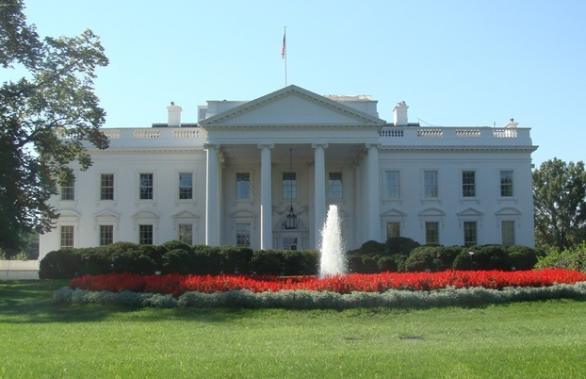
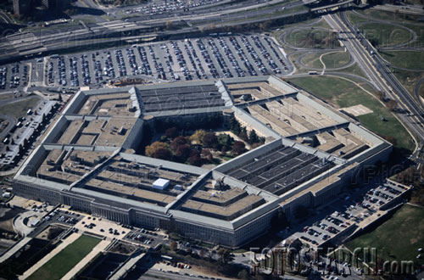
MEDECO CASE STUDY
Cracking One of the Most Secure Locks in America
Lessons learned from embedded design deficiencies, a failure of imagination, and a failure to connect the dots, and a belief in invincibility

Slide 2
MEDECO PRESENTATION
HIGH SECURITY LOCKS
  Attack methodology
MEDECO LOCKS
  High security: Why secure?
  Sidebar IS security
  Case history
  ID Vulnerabilities
  Codes

Slide 3
MEDECO PRESENTATION
HIGH SECURITY REQUIREMENTS
  Key control
  Covert and Surreptitious entry
  Forced entry
RESULTS OF RESEARCH PROJECT

Slide 4
ATTACK METHODOLOGY FOR HIGH SECURITY LOCKS
Assume and believe nothing
Ignore the experts
Think “out of the box” and “inside the lock”
Consider prior methods of attack
Always believe there is a vulnerability
WORK THE PROBLEM
  Consider all aspects and design parameters
  Do not exclude any solution

Slide 5
HIGH SECURITY LOCKS: Critical Design Issues
Multiple security layers
More than one point of failure
Each security layer is independent
Security layers operate in parallel
Difficult to derive intelligence about a layer

Slide 6
HIGH SECURITY:
Three Critical Design Factors
Resistance against forced entry
Resistance against covert and surreptitious entry
Key control and “key security”
Vulnerabilities for each requirement

Slide 7
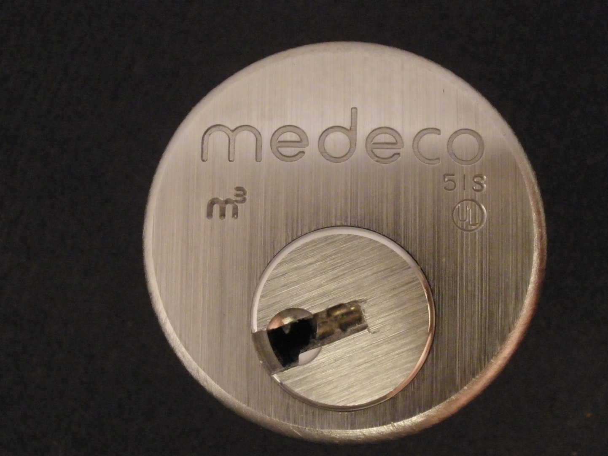
MEDECO HIGH SECURITY

Slide 8
MEDECO HIGH SECURITY:
What it means
UL, BHMA/ANSI, Vd.S Certified
High level of protection against attack
Picking: 10-15 minute resistance
No bumping
Forced Entry: 5 minutes, minimum
Key control
  Protect restricted and proprietary keyways
  Stop duplication, replication, simulation of keys

Slide 9
MEDECO LOCKS:
Why are they Secure?
2 shear lines and sidebar for Biaxial
3 independent security layers: m3
Pins = 3 rotation angles, 6 permutations
Physical pin manipulation difficult
False gates and mushroom pins
ARX special anti-pick pins
High tolerance

Slide 10
MEDECO LOCKS:
Why are they Secure?
2 shear lines and sidebar for Biaxial
3 independent security layers: m3
Pins = 3 rotation angles, 6 permutations
Physical pin manipulation difficult
False gates and mushroom pins
ARX special anti-pick pins
High tolerance

Slide 11
MEDECO LOCKS:
3 Independent Security Layers
Layer 1: PIN TUMBLERS to shear line
Layer 2: SIDEBAR: 3 angles x 2 positions
Layer 3: SLIDER – 26 positions
TO OPEN:
  Lift the pins to shear line
  Rotate each pin individually
  Move the slider to correct position

Slide 12
HIGH SECURITY LOCKS: Why Important?
Protect Critical Infrastructure, high value targets
Stringent security requirements
High security Standards
Threat level is higher
Protect against Forced, Covert entry
Protect keys from compromise

Slide 13
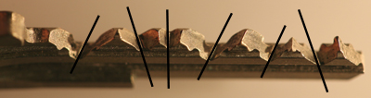
MEDECO TWISTING PINS:
3 Angles + 2 Positions

Slide 14
SECURITY CONCEPTS: Sidebar IS Medeco Security
GM locks, 1935, Medeco re-invented
Heart of Medeco security and patents
Independent and parallel security layer
Integrated pin: lift and rotate to align
Sidebar blocks plug rotation
Pins block manipulation of pins for rotation to set angles

Slide 15
STORY OF LOCKS, LIES, and HIGH INSECURITY
Dominant high security lock maker
40 year history of security
Many expert attempts to crack with limited success, complicated tools
Misstatements and disinformation
18 month research project results:
Total compromise of security

Slide 16
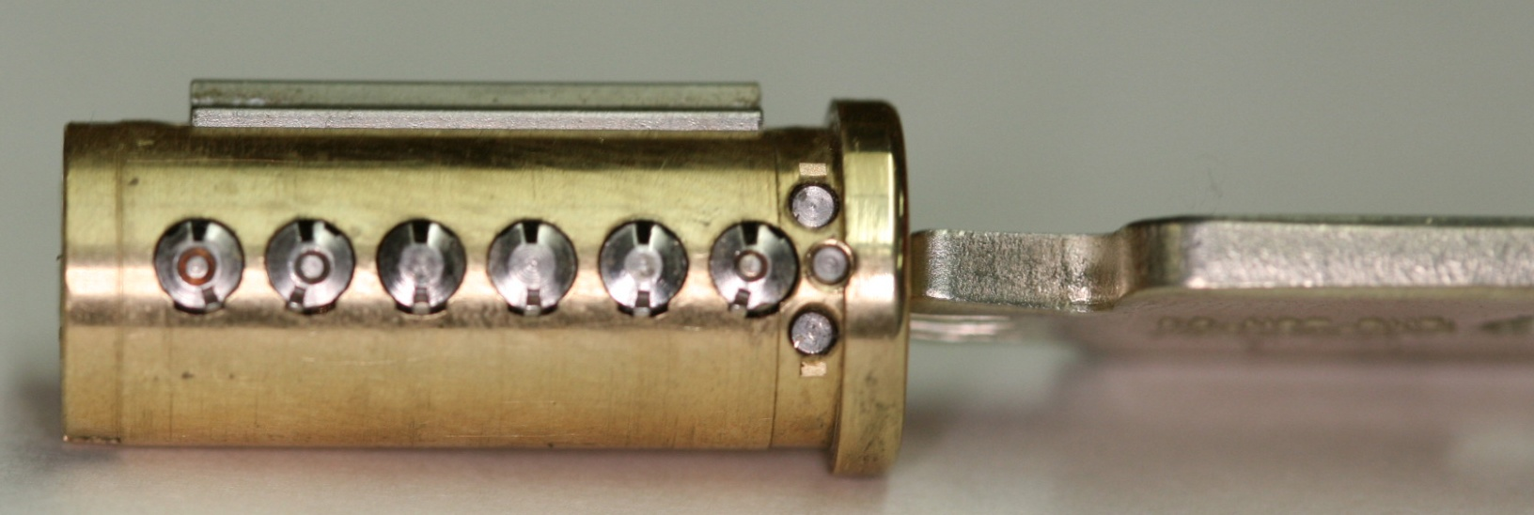
PLUG AND SIDEBAR:
All pins aligned

Slide 17
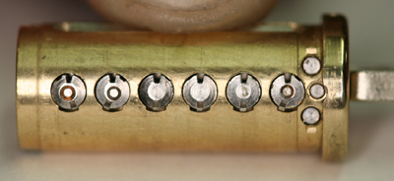
SIDEBAR RETRACTED

Slide 18
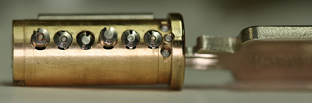
PLUG AND SIDEBAR: Locked

Slide 19
MEDECO CASE HISTORY
Exploited vulnerabilities
Reverse engineer sidebar codes
Analyze what constitutes security
Analyze critical tolerances
Analyze key control issues
Analyze design enhancements for new generations of locks: Biaxial and m3 and Bilevel

Slide 20
DESIGN = VULNERABILITIES
Basic design: sidebar legs + gates
  How they work: leg + gate interface
  Tolerance of gates
Biaxial code designation
Biaxial pin design: aft position decoding
M3 slider: geometry
M3 keyway design
Deadbolt design

Slide 21
MEDECO HISTORY
Dominant high security lock maker in U.S.
Owns 70+ Percent of U.S. high security market for commercial and government
Major government contracts
In UK, France, Europe, South America
Relied upon for highest security everywhere
Considered almost invincible by experts

Slide 22
CRACKING MEDECO LOCKS: Exploit Design Features and System Parameters
Codes: design, progression
Key bitting design: double-cutting
Keying rules: Extrapolation of the TMK
  Medeco master and non-master key systems
Tolerances: 20 degree rotation
  Sidebar leg – true gate tolerance

Slide 23
CRACKING MEDECO LOCKS: Exploit Design Features and System Parameters
Interaction of critical components and locking systems: Sidebar leg – gate
Keyway and plug design
Slider design and geometry
Wider keyway

Slide 24
MEDECO CODEBOOK:
At the heart of security
All locksmiths worldwide must use
All non-master keyed systems
New codes developed for Biaxial in 1983
Chinese firewall: MK and Non-MK
Codebook defines all sidebar codes
December, 2007: Add 2500 codes

Slide 25
WHY THE MEDECO CASE STUDY IS IMPORTANT
Insight into design of high security locks
Patents are no assurance of security
Appearance of security v. Real World
Undue reliance on Standards
Manufacturer knowledge and Representations
Methodology of attack
More secure lock designs

Slide 26
CONVENTIONAL v.
HIGH SECURITY LOCKS
CONVENTIONAL CYLINDERS
  Easy to pick and bump open
  No key control
  Limited forced entry resistance
HIGH SECURITY CYLINDERS
  UL and BHMA/ANSI Standards
  Higher quality and tolerances
  Resistance to Forced and Covert Entry
  Key control

Slide 27
QUESTIONS: BYPASS AND REVERSE ENGINEERING
Weakest link in lock to bypass (Medeco)
What locks the lock?
What locking elements lock and in what order. Is there a primary element to bypass?
Result if one layer fails: Can others be compromised?
What intelligence needed to open the lock?
Can Intelligence be simulated?

Slide 28
SYSTEM BYPASS: More Questions
How strong is the sidebar(s) against forced attack
Is the sidebar the only locking system?
What if defeat one of two sidebars or security layers?
Bitting design: spring biased?
Ability to manipulate each pin or slider to set its code?

Slide 29
ATTACKS: Two Primary Rules
“The Key never unlocks the lock”
  Mechanical bypass
Alfred C. Hobbs: “If you can feel one component against the other, you can derive information and open the lock.”

Slide 30
METHODS OF ATTACK: High Security Locks
Picking and manipulation of components
Impressioning
Bumping
Vibration and shock
Shim wire decoding (Bluzmanis and Falle)
Borescope and Otoscope decoding
Direct or indirect measurement of critical locking components

Slide 31
ADDITIONAL METHODS OF ATTACK
Split key, use sidebar portion to set code
Simulate sidebar code
Use of key to probe depths and extrapolate
Rights amplification of key

Slide 32
KEY CONTROL
High Security Requirement

Slide 33
KEY CONTROL and
“KEY SECURITY”
Duplicate
Replicate
Simulate
“Key control” and “Key Security” may not be synonymous!

Slide 34
KEY SECURITY: A Concept
Key control = physical control of keys
  Prevent manufacture and access to blanks
  Control generation of keys by code
  Patent protection
Key security = Compromise of keys
  Duplication
  Replication
  Simulation

Slide 35
KEYS: Analyze
Critical Elements
Length = number of pins/sliders/disks
Height of blade = depth increments = differs
Thickness of blade = keyway design
Paracentric design
Keyway modification to accommodate other security elements
  Finger pins
  Sliders

Slide 36
MEDECO KEY CONTROL: Critical Issues
MEDECO: Simulation of code or key components
  Bitting for particular lock
  Sidebar code
Security of locks = key control and key security
  All bypass techniques simulate actions of key
  Easiest way to open a lock is with the key

Slide 37
MEDECO KEY CONTROL
Bypass all m3 keyways
  Simulate blanks
  Some Biaxial keyways
Set shear line
  Plastic keys
Hybrid attacks
  Mortise, Rim, IC

Slide 38
KEY CONTROL and “KEY SECURITY” ISSUES
Most keys are passive: align = open
Simulate components of key
Replicate critical components
Duplicate critical components
Require interactive element for security
  MUL-T-LOCK element
  MCS magnets

Slide 39
KEY CONTROL:
Design Issues
Bitting design
Bitting and sidebar issues and conflicts and limitations in differs
Ability to decode one or more keys to break system
Consider critical elements of the key: require to insure cannot be replicated
Hybrid attacks using keys
  Medeco mortise cylinder example

Slide 40
DUPLICATION AND REPLICATION OF KEYS
Key machine
Milling machine: Easy Entrie
Clay and Silicone casting
Key simulation: Medeco
Rights amplification
Alter similar keys

Slide 41
COVERT and FORCED ENTRY RESISTANCE
High Security Requirement

Slide 42
CMOE: Covert Methods of Entry
Picking
  Set the sidebar code
  Code setting keys
  Any change key
Bumping
Decoding
  Otoscope
  Borescope

Slide 43
STANDARDS REQUIREMENTS
UL and BHMA/ANSI STANDARDS
TIME is critical factor
  Ten or fifteen minutes
  Depends on security rating
Type of tools that can be used
Must resist picking and manipulation
Standards do not contemplate more sophisticated methods

Slide 44
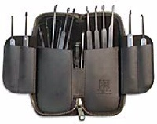
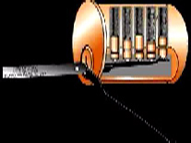
MEDECO:
CONVENTIONAL PICKING

Slide 45
PICKING MEDECO LOCKS
Change key
Code setting key
  Set the code and pick or bmp the lock
Original blanks
Simulated blanks

Slide 46
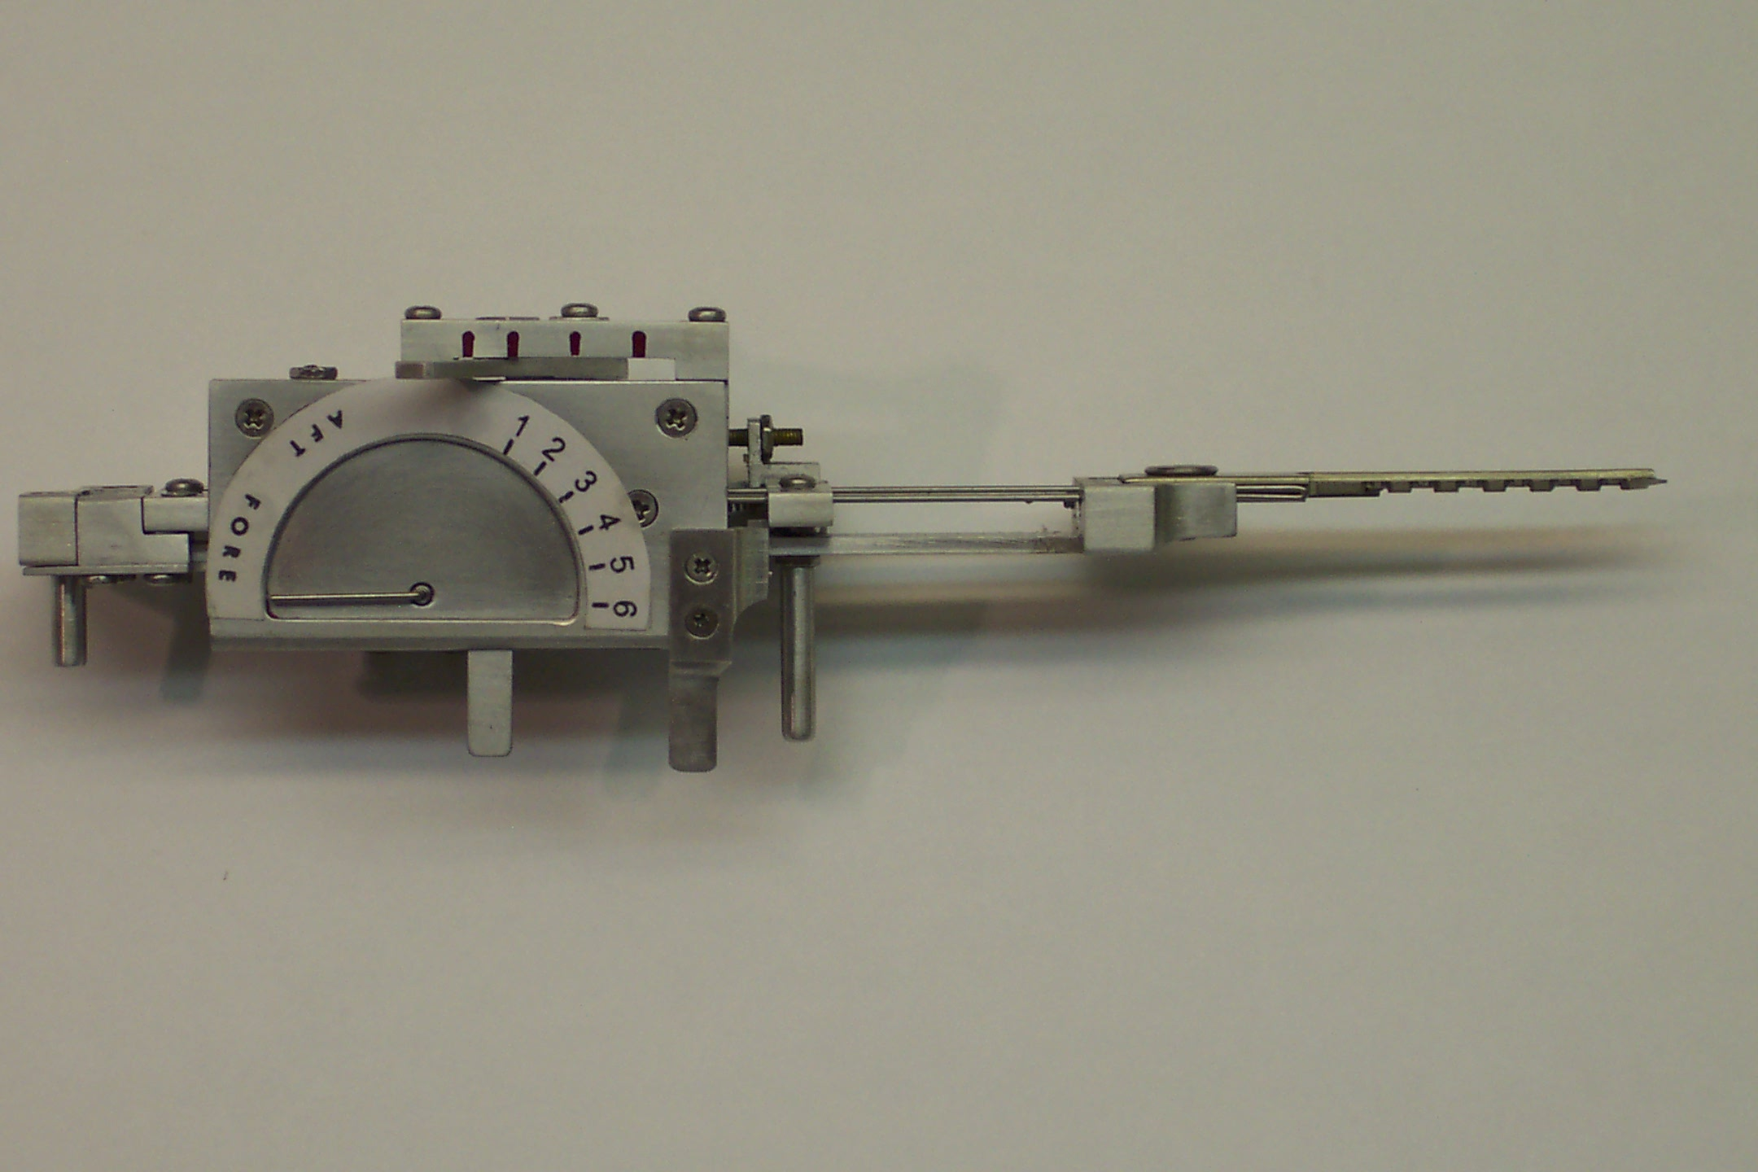
TOBIAS DECODER:
Medeco decoder: by “Crackpot!”

Slide 47

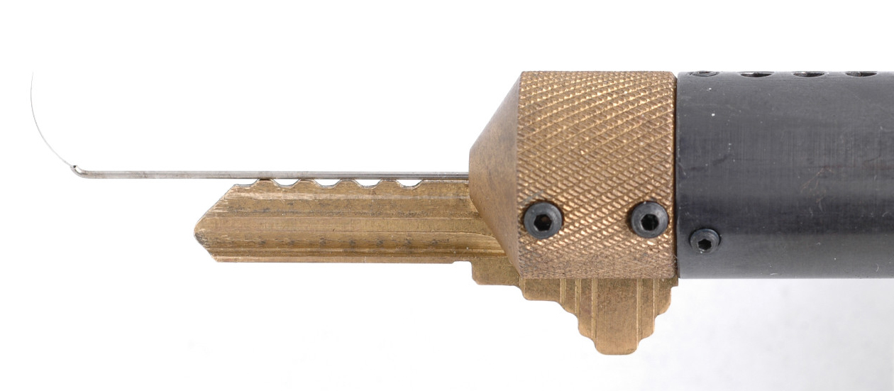
SOPHISTICATED DECODERS
John Falle: Wire Shim Decoder

Slide 48
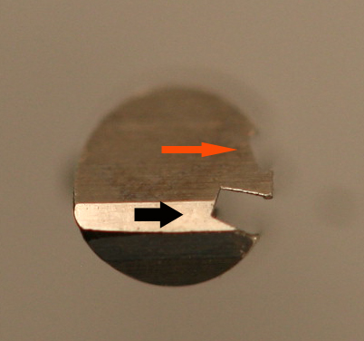
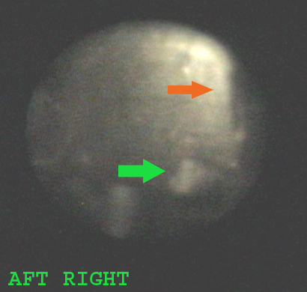
AFT PINS: Decode Angles for Biaxial, m3, and Bilevel

Slide 49
FORCED ENTRY RESISTANCE
High Security Requirement

Slide 50
FORCED ENTRY ATTACKS: Deficiencies in standards
Many types of attacks defined
Do not contemplate mechanical bypass
Must examine weakest linkis
Do not cover “hybrid attacks”
  Medeco deadbolt attacks
  Medeco mortise attack

Slide 51
SIDEBAR:
Bypass and Circumvention
Direct Access
  Decoding attacks
  Manipulation
  Simulate the sidebar code (Medeco)
  Use of a key (Primus and Assa
Indirect access
  Medeco borescope and otoscope decode issues

Slide 52
SIDEBAR ATTACK: Physical Strength
Independent protection
Integrated with pin tumblers or other critical locking components
Compress plug
Defeat of sidebar as one security layer: result and failures
Anti-drill protection

Slide 53
FORCED ENTRY ATTACKS
Direct compromise of critical components
  Medeco deadbolt 1 and 2 manipulate tailpiece
Hybrid attack: two different modes
  Medeco reverse picking
Defeat of one security layer: result
  Medeco Mortise and rim cylinders, defeat shear line

Slide 54
MEDECO HIGH SECURITY:
Lessons to be learned
What constitutes security
Lessons for design engineers
Appearance v. reality

Slide 55
MEDECO MISTAKES
Failed to listen
Embedded design problems from beginning
Compounded problems with new designs with two new generations: Biaxial and m3
Failed to “connect the dots”
Failure of imagination
Lack of understanding of bypass techniques

Slide 56
MEDECO TIMELINE
1970 Original Lock introduced
1985 Biaxial, Second generation
2003 m3 Third generation
2006 Bumping introduced to America
  Medeco announces “Bump-Proof”
2007 Revised to “Virtually Bump-Proof”
2007 Revised to “Virtually Resistant”
2008 No public statements by Medeco

Slide 57
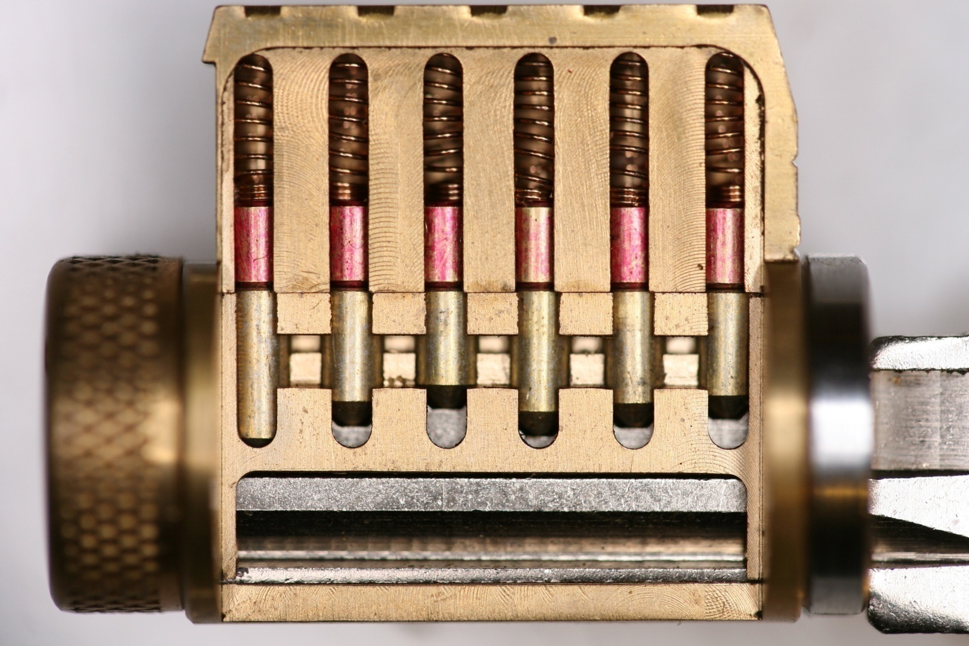
MODERN PIN TUMBLER

Slide 58
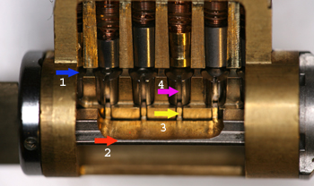
MEDECO BIAXIAL

Slide 59
SIDEBAR AS A GENERIC SECURITY CONCEPT
Block rotation of the plug
One or two sidebars
Primary or secondary locking
Only shear line or secondary
Integrated or separate systems
  Assa, Primus , MT5, MCS= split
  Medeco and 3KS = integrated
Direct or indirect relationship and access by key bitting

Slide 60
MEDECO RESEARCH:
Results of Project
Covert and surreptitious entry in as little as 30 seconds: standard requires 10-15 minutes
Forced entry: four techniques, 30 seconds, affect millions of locks
Complete compromise of key control
  Duplication, replication, simulation of keys
  Creation of bump keys and code setting keys
  Creation of top level master keys

Slide 61
RESULTS OF PROJECT: Bumping
Reliably bump open Biaxial and m3 locks
Produce bump keys on Medeco blanks and simulated blanks
Known sidebar code
Unknown sidebar code

Slide 62
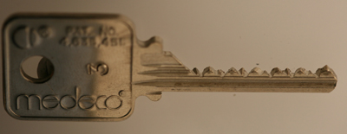
MEDECO BUMP KEY

Slide 63
RESULTS OF PROJECT:
Key Control and Key Security
Total compromise of key control and key security, vital to high security locks
  Duplicate, replicate, simulate keys for all m3 and some Biaxial keyways
    Restricted keyways, proprietary keyways
    Government and large facilities affected
  Attack master key systems
  Produce bump keys
  Produce code setting keys

Slide 64
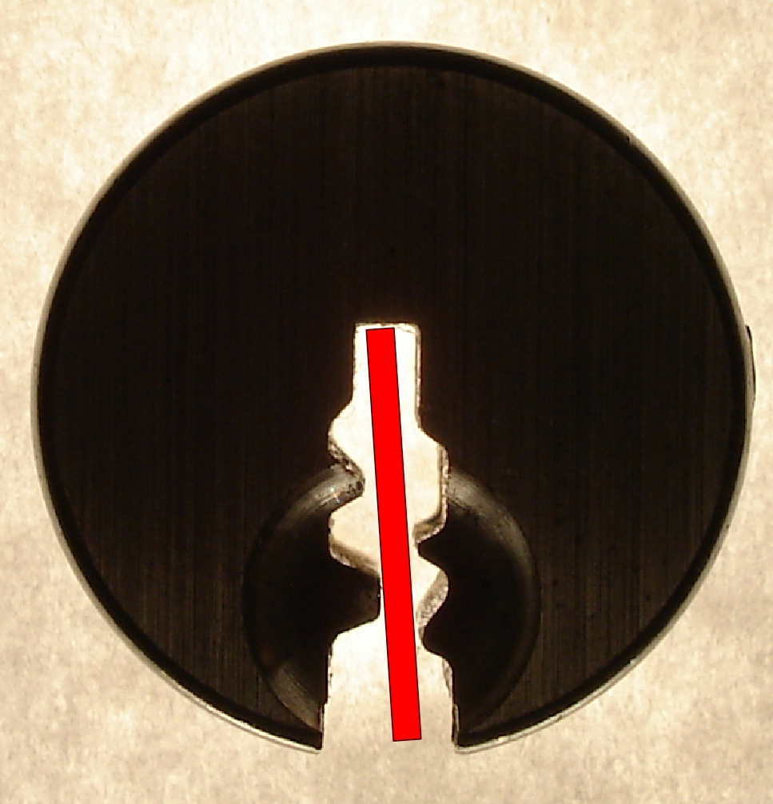
SIMULATED BLANKS: Any m3 and Many Biaxial Locks

Slide 65
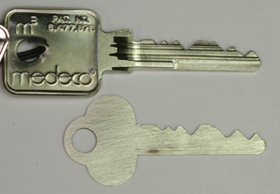
SIMULATED BLANKS

Slide 66
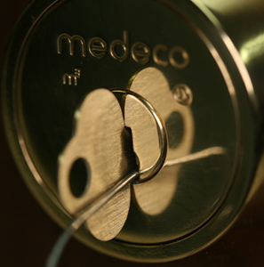
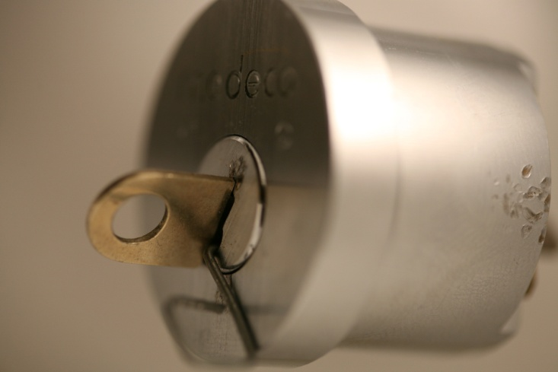
M3 SLIDER:
Bypass with a Paper clip

Slide 67
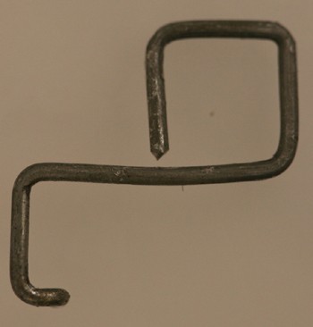
SECURITY OF m3:
High Tech Wire!

Slide 68
RESULTS OF PROJECT: Picking
Pick the locks in as little as 30 seconds
Standard picks, not high tech tools
Use of another key in the system to set the sidebar code
Pick all pins or individual pins
Neutralize the sidebar as security layer

Slide 69
RESULTS OF PROJECT: Forced Entry Techniques
Deadbolt attacks on all three versions
  Deadbolt 1 and 2: 30 seconds
  Deadbolt 3: New hybrid technique of reverse picking
Mortise and rim cylinders
  Prior intelligence + simulated key
Interchangeable core locks

Slide 70
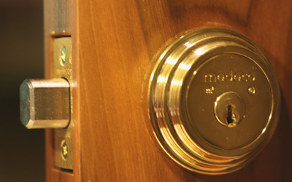
DEADBOLT ATTACK

Slide 71

DEADBOLT BYPASS: 2$ Screwdriver + $.25 materials

Slide 72
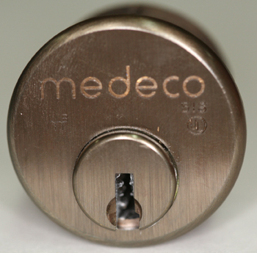
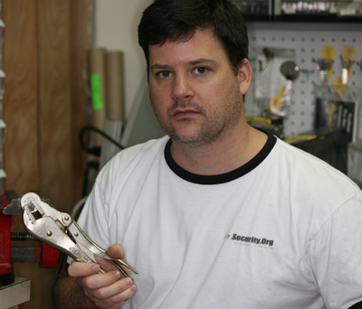
MORTISE CYLINDER

Slide 73
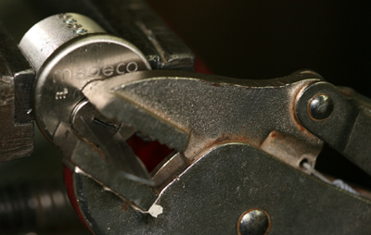
MORTISE ATTACK

Slide 74
MORTISE ATTACK
Copy machine
Scanner
Cell phone camera
Plastic sheets: Shrinky Dink
X-acto knife

Slide 75
CONNECTING THE DOTS
CRITICAL FAILURES
Original → Biaxial
  pin design
  code assignment
Biaxial -→ m3 design
  M3 slider geometry = .040” offset
  Key simulation
  .007” keyway widening

Slide 76
MORE DOTS!
FORCED ENTRY
Original Deadbolt design
Fatal design flaw: 30 seconds bypass
Later deadbolt designs: new attacks
Mortise and rim cylinders
Inherent design problem: .065” plug

Slide 77
MORE DOTS: BILEVEL LOCK
2007 Bilevel locks introduced
Integrate low and high security to compete
Flawed design, will affect system security when integrated into high security system
Borescope decoding of aft pins to compromise security of entire system

Slide 78
CONNECTING THE DOTS:
The Results
Biaxial Code assignment: Reverse Engineer for all non-master key systems
Gate tolerance: 4 keys to open
NEW CONCEPT: Code Setting keys
Sidebar leg-gate interface: NEW CONCEPT: Setting sidebar code
M3 Wider keyway: Simulated blanks
Slider design: paper clip offset

Slide 79
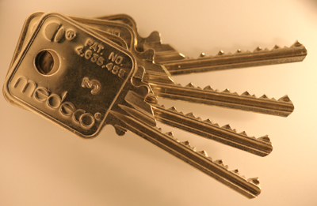
CODE SETTING KEYS:
Four Keys to the Kingdom

Slide 80
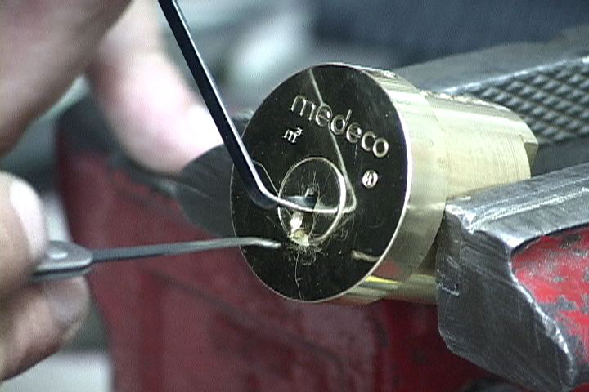
OPEN IN THIRTY SECONDS
Setting the Sidebar Code
Conventional pick tools

Slide 81
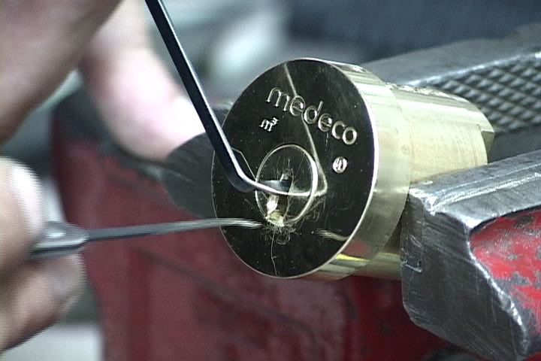
PICKING A MEDECO LOCK

Slide 82
LESSONS TO BE LEARNED
Patents do not assure security
Apparent security v. actual security
40 years of invincibility means nothing
New methods of attack
Corporate arrogance and misrepresentation
“If it wasn’t invented here” mentality
All mechanical locks have vulnerabilities

Slide 83
RESULTS OF PROJECT: Decode Top Level Master Key
Determine the sidebar code in special system where multiple sidebar codes are employed to protect one or more locks
Decode the TMK
OWN the system

Slide 84

REAL WORLD ATTACK: Bumping a Medeco Lock

Slide 85
OPEN IN THIRTY SECONDS: Cracking one of the most secure locks in America
© 2008 Marc Weber Tobias and
Tobias Bluzmanis
www.security.org
mwtobias@security.org

