Slide 1
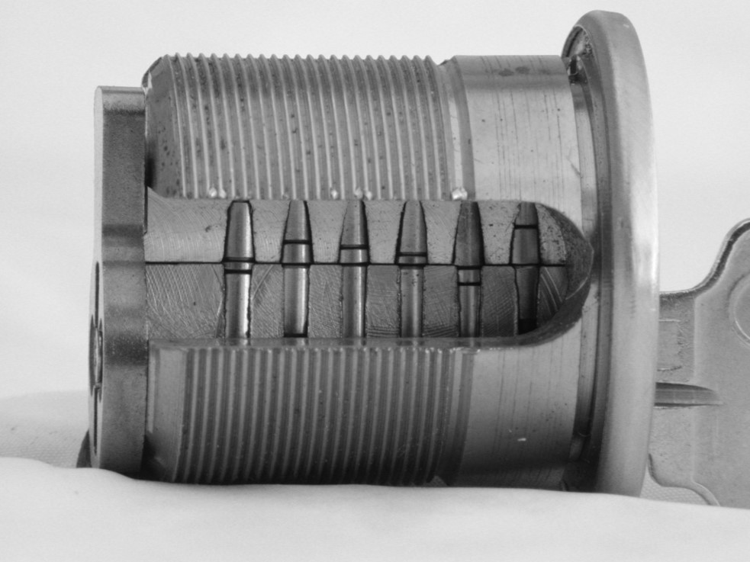
MASTER KEY SYSTEMS DATA:
Security, Protection, Liability
SECURITY GUIDELINES FOR MANUFACTURERS, LOCKSMITHS, AND END-USERS
GOAL: Protection of master key system data from
Unauthorized access, use, or compromise

Slide 2
MECHANICAL LOCKS
AND MASTER KEY SYSTEMS:
First line of defense in large and small facilities
Conventional and High Security locks
Systems designed by Manufacturers or Locksmiths
Installed and maintained by locksmiths or end-users
Security vulnerabilities
  PHYSICAL SECURITY AND CONTROL ISSUES OF ASSETS
  DATA SECURITY ISSUES
  LIABILITY ISSUES

Slide 3
MASTER KEY SYSTEMS:
The high value target
Master keys and data are vulnerable
Industry has not addressed MKS security issues
Hackers and thieves and terrorists will target
Global access can be obtained
No audit trails
Duplication and replication of keys possible
Lack of control of a facility if compromised
Systems cannot be easily changed

Slide 4
MKS COMPROMISE: RESULTS
Protection of physical facilities
Protection of people, assets, information
Access to all areas
Access to critical areas and facilities
Breach of security by criminals and terrorists
New techniques: can make compromise easier, especially 3D technology

Slide 5
COST OF A BREACH OF SECURITY
Total rekey of a system
Legal liability for damages by locksmith or manufacturer
Criminal liability for failure to meet laws
Cancellation of contracts
Bad publicity
Loss of certification

Slide 6
INDUSTRY STANDARDS
AND GUIDELINES
NO REAL STANDARDS FOR HANDLING MASTER KEY SYSTEM DATA
Additional security measures will be required by:
  Manufacturers
  Regulators
  Locksmiths
  End-user customers
  Public

Slide 7
WHY IMPORTANT?
No consistency in rules protecting information and physical inventory
Often easy to compromise MK systems through lack of controls at all levels
MK systems provide the “keys to the kingdom”
Public and facilities and assets can be at risk if a system is compromised
Serious liability and security issues
  Legal requirements
  Contractual requirements
  Certification issues
  Protection of people, facilities, assets, information

Slide 8
INDUSTRY MUST DEVELOP GUIDELINES AND STANDARDS
IF THE LOCK MANUFACTURERS AND SECURITY INDUSTRY DO NOT DEVELOP AND FOLLOW GUIDELINES, THEN FORMAL RULES WILL FOLLOW
  Legal requirements
  Regulatory rules
  Privacy laws
  Audits
  End-users will demand accountability
  General Data Protection Regulation 2018: Personal data at present

Slide 9
PROTECTION OF SYSTEMS
AGAINST COMPROMISE
POTENTIAL VULNERABILITIES
  Key codes, keying lists for facilities
  Remote and local computer access
  Restricted key blanks
  Who is authorized to obtain keys
  Ordering new cylinders
  Products in transit and shipment diversion
  Inventory control
  Audit systems for data, blanks, key machines

Slide 10
THE CRITICAL PLAYERS
MANUFACTURERS
LOCKSMITHS
END-USERS
LOCKSMITHS ARE THE MOST IMPORTANT
  They are the gatekeeper
  They are the most vulnerable to attack
  Most are least equipped to deal with security issues

Slide 11
LOCKSMITHS:
WHY MOST IMPORTANT
Planning and ordering systems, or defining the system locally
Responsible for receiving cylinders and keys
Installation
Keying, rekeying, adding to systems
Cutting keys
Storage of key blanks
Maintain keying charts and data

Slide 12
LOCKSMITH SECURITY and MKS
Does it exist?
Can compromise an entire system
They have all the critical information
They have key blanks
Responsible to verify credentials for restricted systems
Ability to produce keys
Ability to order new keys

Slide 13
INDUSTRY SECURITY GUIDELINES
MUST ADDRESS CRITICAL ISSUES
  Access to data and storage
  Control and protection of information and inventory
  Physical control of all elements that can compromise a system
  SECURITY CONCERNS
  PRIVACY ISSUES AND LEGISLATION
  REGULATORY ENFORCEMENT WILL FOLLOW
  COMPLY WITH CURRENT AND FUTURE USER SECURITY REQUIREMENTS

Slide 14
INDUSTRY GUIDELINES
MUST ADDRESS
Risk management and facilities security will require security audits
  Manufacturer controls
  Locksmith internal controls and procedures
  End-user controls and procedures
  GOAL: THE PROTECTION OF
  End-user facilities, assets, information
  Locksmiths
  Public

Slide 15
LOCKSMITH SECURITY AND MKS
Required Elements
Physical components: locks and keys
System information: keying charts, code data
Direct access to manufacturer via data links
Computers and storage of information
Mobile service vans for support and their security
Interact with customers to produce restricted keys by authorized credentials

Slide 16
MANUFACTURERS AND LOCKSMITHS MUST TAKE LEAD
IF THE INDUSTRY DOES NOT MOVE TO PROTECT ITSELF, REGULATORS WILL
All manufactures will be involved
Locksmith organizations must promote to protect the industry and customers
Address protection of all elements
  Design of systems
  Implementation and installation of MKS
  Support of systems

Slide 17
EVERYONE INVOLVED IN MKS
Responsibility for Security
Of the process: Design, Protection of information, Implementation
Of the result, and continued maintenance
Legal liability
Protect end-user system and facility
Insure integrity of entire system

Slide 18
MASTER KEY SECURITY ENCOMPASSES
INFORMATION ABOUT:
  Facilities
  Key codes and data
  System architecture
  Locks and keys
  Employees that work on systems
  Manufacturers: ordering, coding, inventory, identification of customers, shipment, re-ordering of blanks and locks

Slide 19
LIABILITY AND SECURITY ISSUES:
Complex Issues
DATA SECURITY: storage, access, transmission, deletion, updating
PHYSICAL SECURITY: Locksmith, inventory, locks, keys, data, databases
EMPLOYEE VETTING: Background, criminal history, access levels, audits, defining responsibility

Slide 20
UNDERSTAND SECURITY ISSUES
AND RISKS
STORAGE AND DATA ACCESS
ORDERING NEW SYSTEMS VIA LINKS: EMAIL, FAX, INTERNET AND COMMUNICATION SECURITY
WEB SITE DESIGN
AUTHORIZATION LEVELS TO ORDER
CUSTOMER DATA
USE AND CONTROL OF TEST KEYS
USE OF OEM PARTS PER CONTRACTS

Slide 21
PERSONNEL VETTING
CRIMINAL HISTORY AND FINGERPRINT CHECK
LICENSURE
CREDIT HISTORY
WORK HISTORY
DRIVING RECORDS
NON-DISCLOSURE AGREEMENTS
TRADE SECRET AGREEMENTS
BONDING

Slide 22
MORE SECURITY GUIDELINES
COMPUTER SYSTEMS, ENCRYPTION
SECURE DATA LINKS
SECURE WEBSITES, EMAIL, PASSWORDS
AUDIT TRAILS
REMOTE ACCESS SECURITY
THEFT OF COMPUTERS

Slide 23
LOCKSMITH PHYSICAL SECURITY
SECURE PHYSICAL FACILITY
ALARM SYSTREMS TO CENTRAL STATION AND CELLULAR
HIGH SECURITY LOCKS
SECURE SAFE OR VAULT FOR STORAGE
COMPUTER BACKUPS
DEFINE WHAT PII IS RETAINED AND HOW
SMART CARD OR DONGLE SECURITY FOR COMPUTERS
LOCKSMITH SERVICE VAN SECURITY

Slide 24
RISKS AND SECURITY GUIDELINES
BY LOCKSMITH
INFORMATION SECURITY
HUMAN RESOURCE SECURITY: VETTING
ASSET MANAGEMENT
MEDIA HANDLING CONTROLS
ACCESS CONTROL TO INFORMATION: FACILITIES, NETWORK ACCESS, AUTHORITY LEVELS, AUDITS, ACCESS RIGHTS, CRYPTO

Slide 25
LOCKSMITH PHYSICAL CONTROLS
SECURE AREAS: UNAUTHORIZED ACCESS, DAMAGE, SECURE ENTRY CONTROLS
PHYSICAL PROTECTION AGAINST: NATURAL DISASTERS, MALICIOUS ATTACKS, ACCIDENTS
DELIVERY AND LOADING AREAS
WORKING IN SECURE AREAS
EQUIPMENT PROTECTION

Slide 26
RESPONSE TO SECURITY INCIDENTS
QUICK, EFFECTIVE, ORDERLY
REPORT AS REQUIRED
REPORT SUSPECTED WEAKNESSES
DOCUMENTED PROCEDURES

Slide 27
COMPLIANCE
Legal and contractual requirements
Applicable legislation
Intellectual Property rights
Protection of records
Privacy and Protection of PII
Use of crypto controls Independent review

Slide 28
QUESTIONS AND INPUT
Are guidelines needed?
Would guidelines be helpful and accepted?
Do you think MKS data needs to be protected?
How do you protect your systems?
What suggestions do you have?
Should the lock manufacturers or Locksmiths organizations develop standards
Do you understand the potential liability involved?

Slide 29
MASTER KEY SYSTEM SECURITY
© 2017 Marc Weber Tobias and Tobias Bluzmanis, Investigative Law Offices and Security Laboratories
mwtobias@security.org

