Slide 1
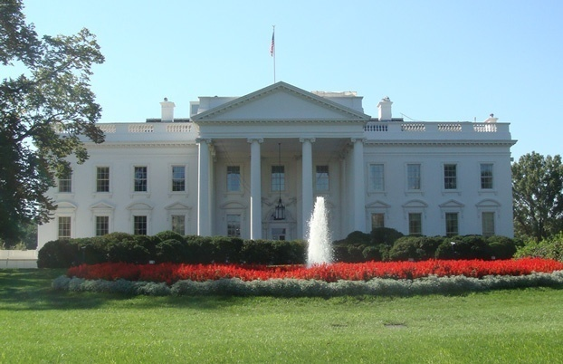
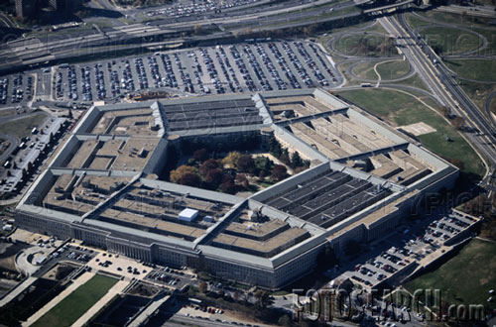
MEDECO CASE STUDY
Cracking One of the Most Secure Locks in America
Lessons learned from embedded design deficiencies, a failure of imagination, and a failure to connect the dots, and a belief in invincibility

Slide 2
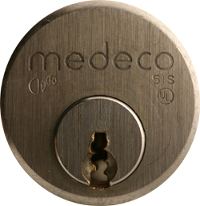
MEDECO HIGH SECURITY

Slide 3
PART I: BACKGROUND
WHO AND WHAT IS MEDECO
WHY WE DID IT
STANDARDS AND WHAT THEY MEAN FOR HIGH SECURITY LOCKS
LAYERS OF SECURITY
COMPROMISE OF EACH LAYER
RESULTS

Slide 4
MEDECO HIGH SECURITY:
What it means
UL, BHMA/ANSI, Vd.S Certified
High level of protection against attack
Picking: 10-15 minute resistance
No bumping
Forced Entry: 5 minutes, minimum
Key control
  Protect restricted and proprietary keyways
  Stop duplication, replication, simulation of keys

Slide 5
STORY OF LOCKS, LIES, and HIGH INSECURITY
Dominant high security lock maker
40 year history of security
Many expert attempts to crack with limited success, complicated tools
Misstatements and disinformation
18 month research project results:
Total compromise of security

Slide 6
HIGH SECURITY LOCKS: Why Important?
Protect Critical Infrastructure, high value targets
Stringent security requirements
High security Standards
Threat level is higher
Protect against Forced, Covert entry
Protect keys from compromise

Slide 7
MEDECO HISTORY
Dominant high security lock maker in U.S.
Owns 70+ Percent of U.S. high security market for commercial and government
Major government contracts
In UK, France, Europe, South America
Relied upon for highest security everywhere
Considered almost invincible by experts

Slide 8
WHY THE MEDECO CASE STUDY IS IMPORTANT
Insight into design of high security locks
Patents are no assurance of security
Appearance of security v. Real World
Undue reliance on Standards
Manufacturer knowledge and Representations
Methodology of attack
More secure lock designs

Slide 9
ATTACK METHODOLOGY FOR HIGH SECURITY LOCKS
Assume and believe nothing
Ignore the experts
Think “out of the box”
Consider prior methods of attack
Always believe there is a vulnerability
WORK THE PROBLEM
  Consider all aspects and design parameters
  Do not exclude any solution

Slide 10
HIGH SECURITY LOCKS: Critical Design Issues
Multiple security layers
More than one point of failure
Each security layer is independent
Security layers operate in parallel
Difficult to derive intelligence about a layer

Slide 11
HIGH SECURITY:
Three Critical Design Factors
Resistance against forced entry
Resistance against covert and surreptitious entry
Key control and “key security”
  Vulnerabilities for each requirement

Slide 12
QUESTIONS: BYPASS AND REVERSE ENGINEERING
Weakest link in lock to bypass (Medeco)
What locks the lock?
What locking elements lock and in what order. Is there a primary element to bypass?
Result if one layer fails: Can others be compromised?
What intelligence needed to open the lock?
Can Intelligence be simulated?

Slide 13
ATTACKS: Two Primary Rules
“The Key never unlocks the lock”
  Mechanical bypass
Alfred C. Hobbs: “If you can feel one component against the other, you can derive information and open the lock.”

Slide 14
KEY CONTROL
High security requirement

Slide 15
KEY CONTROL and “KEY SECURITY”
Duplicate
Replicate
Simulate
“Key control” and “Key Security” may not be synonymous!

Slide 16
KEY SECURITY: A Concept
Key control = physical control of keys
Prevent manufacture and access to blanks
Control generation of keys by code
Patent protection
Key security = compromise of keys
  Duplication
  Replication
  Simulation

Slide 17
KEYS: CRITICAL ELEMENTS
Length = number of pins/sliders/disks
Height of blade = depth increments = differs
Thickness of blade = keyway design
Paracentric design
Keyway modification to accommodate other security elements
  Finger pins
  Sliders

Slide 18
KEY CONTROL: Critical issues
Simulation of code or key components
Security of locks = key control and key security
  All bypass techniques simulate actions of key
  Easiest way to open a lock is with the key

Slide 19
KEY CONTROL:
Design Issues
Bitting design
Bitting and sidebar issues and conflicts and limitations in differs
Ability to decode one or more keys to break system
Consider critical elements of the key: require to insure cannot be replicated
Hybrid attacks using keys
  Medeco mortise cylinder example

Slide 20
DUPLICATION AND REPLICATION OF KEYS
Key machine
Milling machine: Easy Entrie
Clay and Silicone casting
Key simulation: Medeco
Rights amplification
Alter similar keys

Slide 21
COVERT and FORCED ENTRY RESISTANCE
High security requirement

Slide 22
STANDARDS REQUIREMENTS
UL and BHMA/ANSI STANDARDS
TIME is critical factor
  Ten or fifteen minutes
  Depends on security rating
Type of tools that can be used
Must resist picking and manipulation
Standards do not contemplate more sophisticated methods

Slide 23
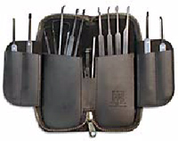
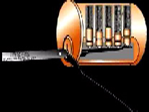
CONVENTIONAL PICKING

Slide 24
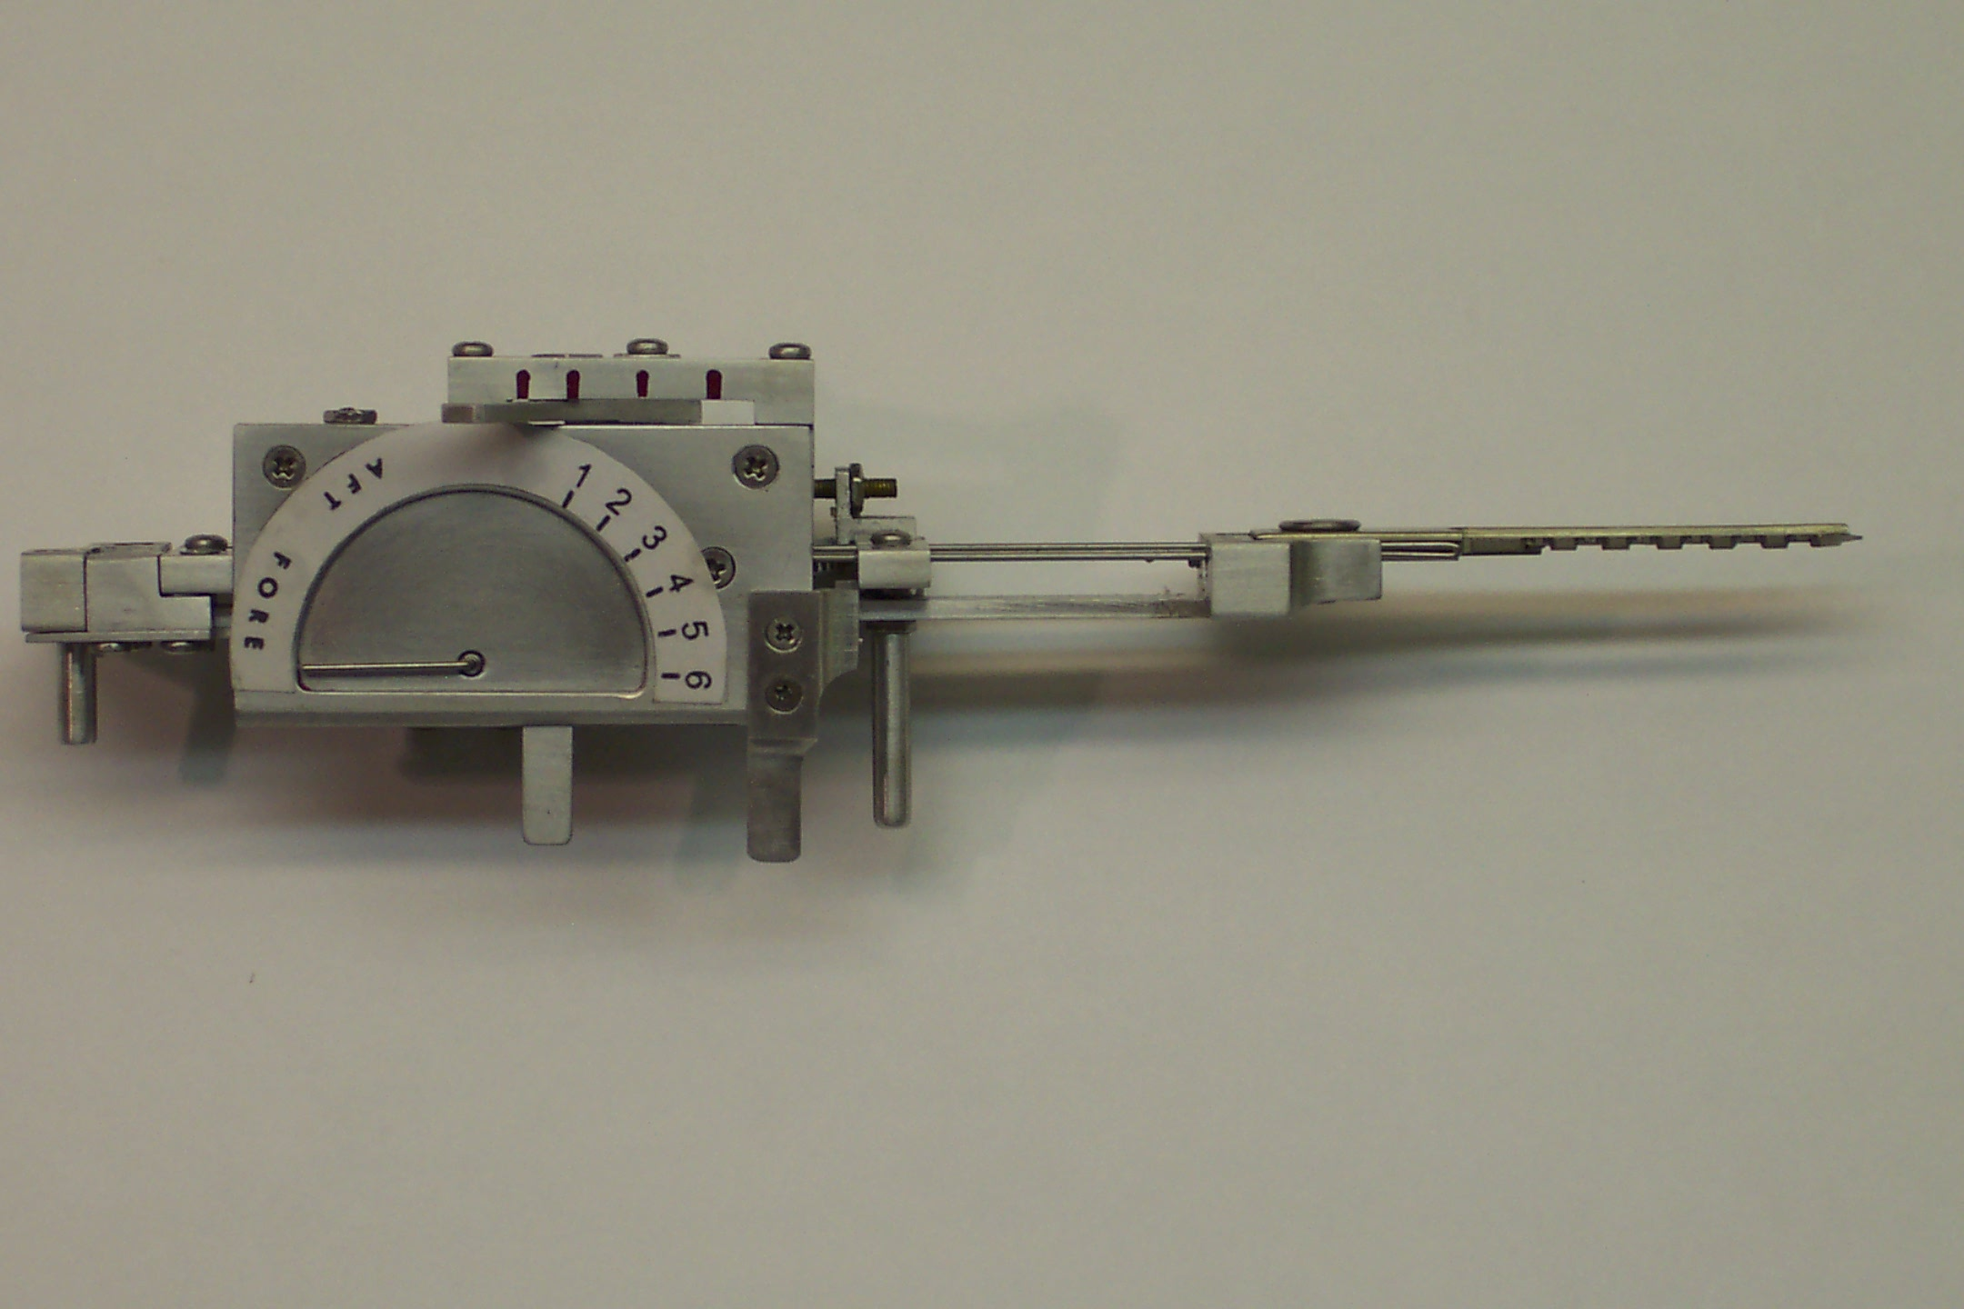
TOBIAS DECODER:
Medeco decoder: by “Crackpot!”

Slide 25

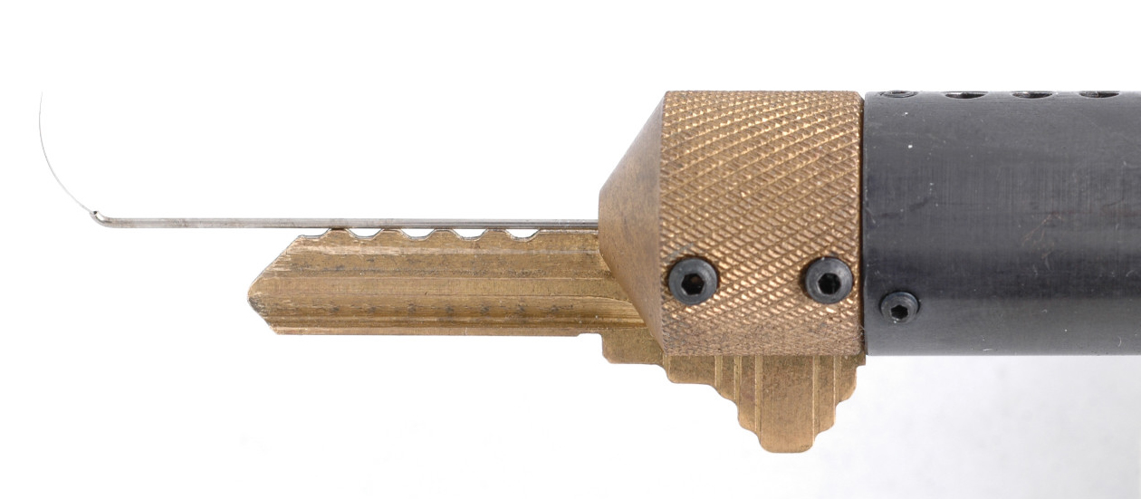
SOPHISTICATED DECODERS
John Falle: Wire Shim Decoder

Slide 26
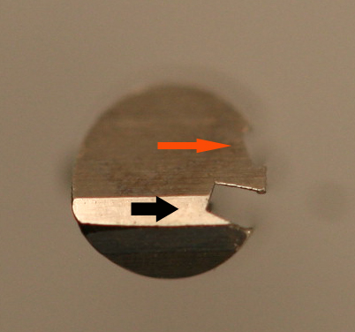
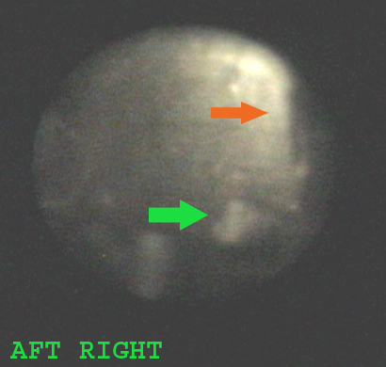
DECODE PIN ANGLES

Slide 27
FORCED ENTRY RESISTANCE
High security requirement

Slide 28
FORCED ENTRY ATTACKS: Deficiencies in standards
Many types of attacks defined
Do not contemplate mechanical bypass
Must examine weakest links
Do not cover “hybrid attacks”
  Medeco deadbolt attacks
  Medeco mortise attack

Slide 29
FORCED ENTRY ATTACKS
Direct compromise of critical components
  Medeco deadbolt 1 and 2 manipulate tailpiece
Hybrid attack: two different modes
  Medeco reverse picking
Defeat of one security layer: result
  Medeco Mortise and rim cylinders, defeat shear line

Slide 30
SIDEBAR:
Bypass and Circumvention
Direct Access
  Decoding attacks
  Manipulation
  Simulate the sidebar code (Medeco)
  Use of a key (Primus and Assa
Indirect access
  Medeco borescope and otoscope decode issues

Slide 31
SIDEBAR ATTACK:
Physical Strength
Independent protection
Integrated with pin tumblers or other critical locking components
Compress plug
Defeat of sidebar as one security layer: result and failures
Anti-drill protection

Slide 32
MEDECO HIGH SECURITY:
Lessons to be learned
What constitutes security
Lessons for design engineers
Appearance v. reality

Slide 33
MEDECO CASE HISTORY
Exploited vulnerabilities
Reverse engineer sidebar codes
Analyze what constitutes security
Analyze critical tolerances
Analyze key control issues
Analyze design enhancements for new generations of locks: Biaxial and m3 and Bilevel

Slide 34
MEDECO MISTAKES
Failed to listen
Embedded design problems from beginning
Compounded problems with new designs with two new generations: Biaxial and m3
Failed to “connect the dots”
Failure of imagination
Lack of understanding of bypass techniques

Slide 35
DESIGN = VULNERABILITIES
Basic design: sidebar legs + gates
  How they work: leg + gate interface
  Tolerance of gates
Biaxial code designation
Biaxial pin design: aft position decoding
M3 slider: geometry
M3 keyway design
Deadbolt design

Slide 36
MEDECO DESIGN:
Exploit design vulnerabilities
EXPLOIT BEST DESIGN FEATURES
Sidebar leg – true gate channel
Code assignment: Biaxial 1985
Gate – sidebar leg tolerance
M3 design 2003
  Widen keyway .007”
  Slider geometry, .040” offset

Slide 37
MEDECO DESIGNS:
More vulnerabilities
Biaxial pin design: fore and aft positions
Borescope decode of aft angles
Introduction of Bilevel in 2006
Compromise by decoding

Slide 38
MEDECO TIMELINE
1970 Original Lock introduced
1985 Biaxial, Second generation
2003 m3 Third generation
2006 Bumping introduced to America
  Medeco announces “Bump-Proof”
2007 Revised to “Virtually Bump-Proof”
2007 Revised to “Virtually Resistant”
2008 No public statements by Medeco

Slide 39
MEDECO LOCKS:
Why are they Secure?
2 shear lines and sidebar for Biaxial
3 independent security layers: m3
Pins = 3 rotation angles, 6 permutations
Physical pin manipulation difficult
False gates and mushroom pins
ARX special anti-pick pins
High tolerance

Slide 40
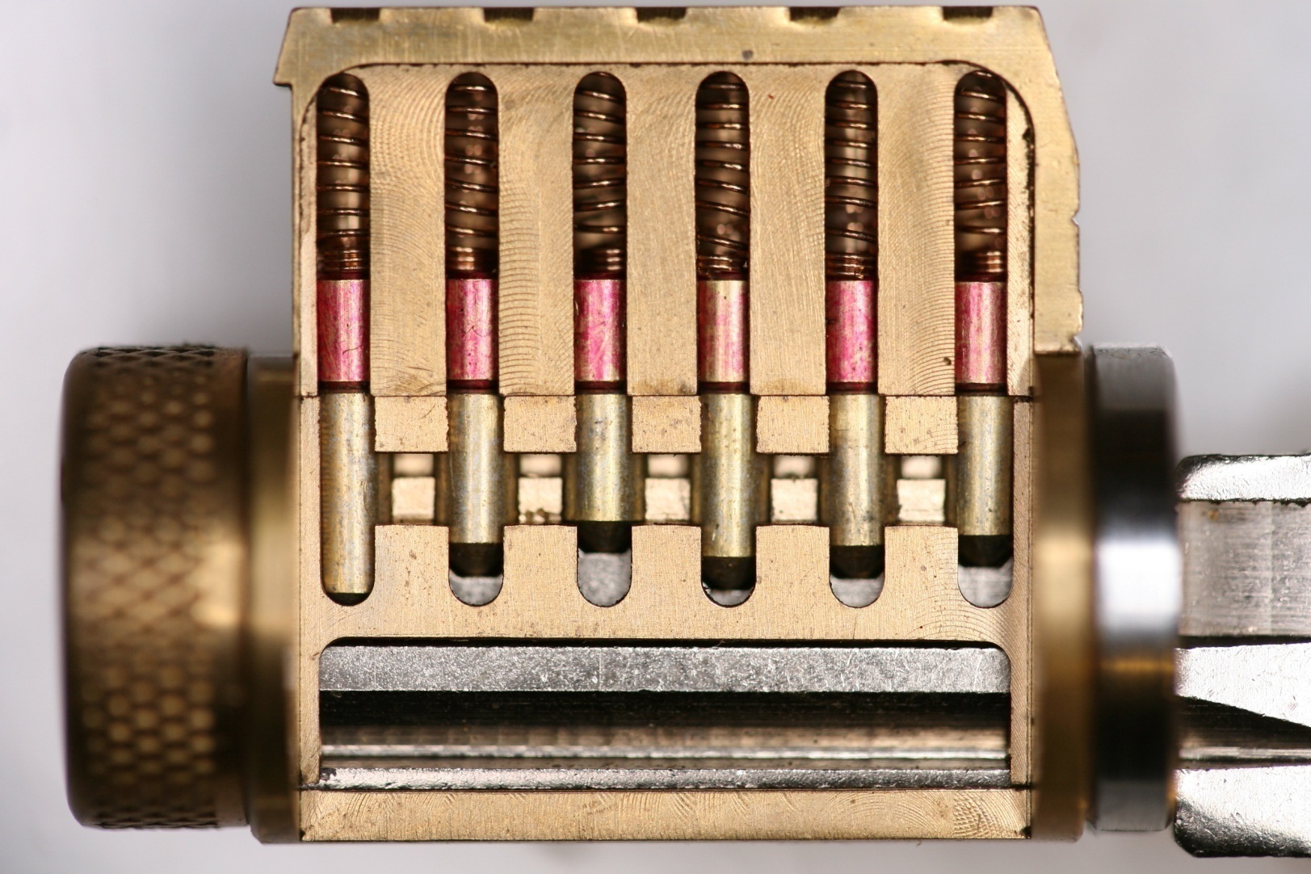
MODERN PIN TUMBLER

Slide 41
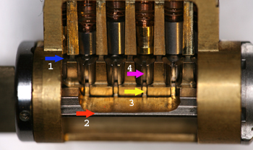
MEDECO BIAXIAL

Slide 42
MEDECO LOCKS:
3 Independent Security Layers
Layer 1: PIN TUMBLERS to shear line
Layer 2: SIDEBAR: 3 angles x 2 positions
Layer 3: SLIDER – 26 positions
TO OPEN:
  Lift the pins to shear line
  Rotate each pin individually
  Move the slider to correct position

Slide 43
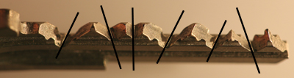
MEDECO TWISTING PINS:
3 Angles + 2 Positions

Slide 44
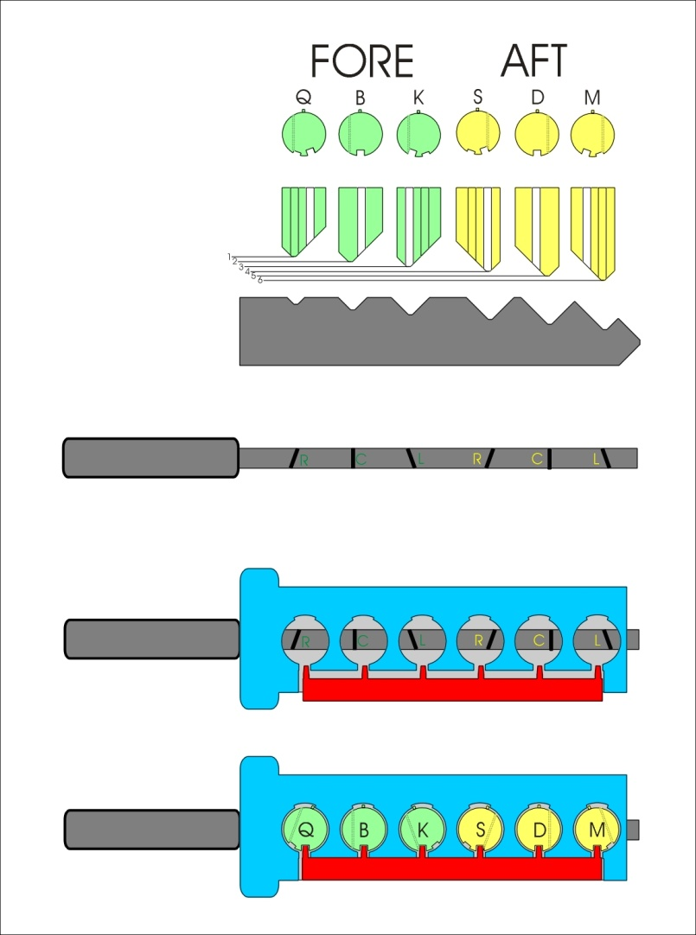
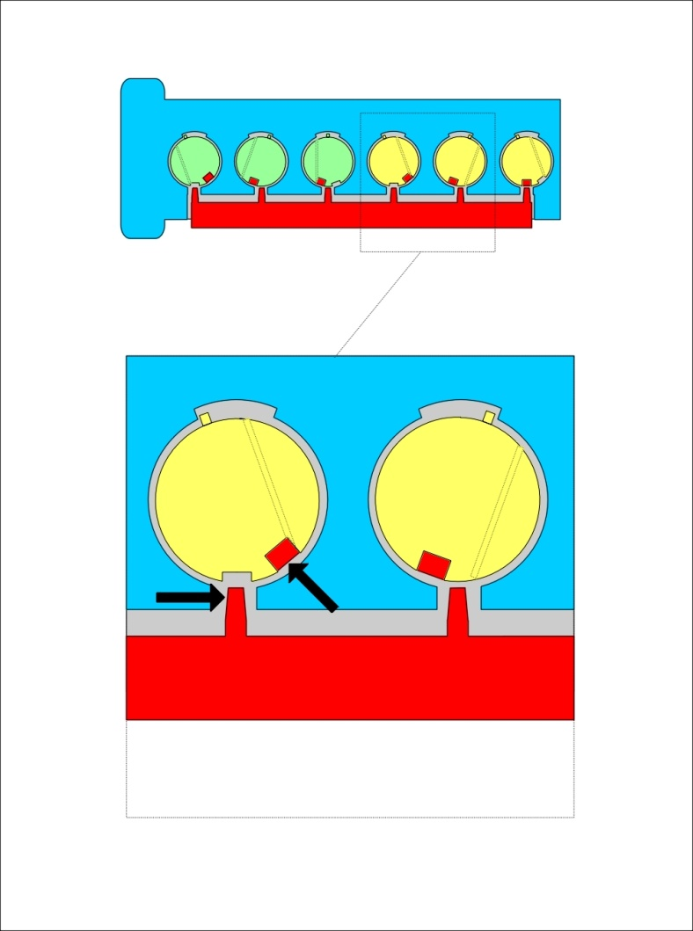
MEDECO ROTATING TUMBLER

Slide 45
SIDEBAR AS A GENERIC SECURITY CONCEPT
Block rotation of the plug
One or two sidebars
Primary or secondary locking
Only shear line or secondary
Integrated or separate systems
  Assa, Primus , MT5, MCS= split
  Medeco and 3KS = integrated
Direct or indirect relationship and access by key bitting

Slide 46
SIDEBAR LOCKING:
How does it work
One or two sidebars
Interaction during plug rotation
Direct or indirect block plug rotation
Sidebar works in which modes
  Rotate left or right
  Pull or push
Can sidebar be neutralized: i.e. Medeco
  Setting sidebar code
  Pull plug forward, not turn

Slide 47
SECURITY CONCEPTS: Sidebar IS Medeco Security
GM locks, 1935, Medeco re-invented
Heart of Medeco security and patents
Independent and parallel security layer
Integrated pin: lift and rotate to align
Sidebar blocks plug rotation
Pins block manipulation of pins for rotation to set angles

Slide 48
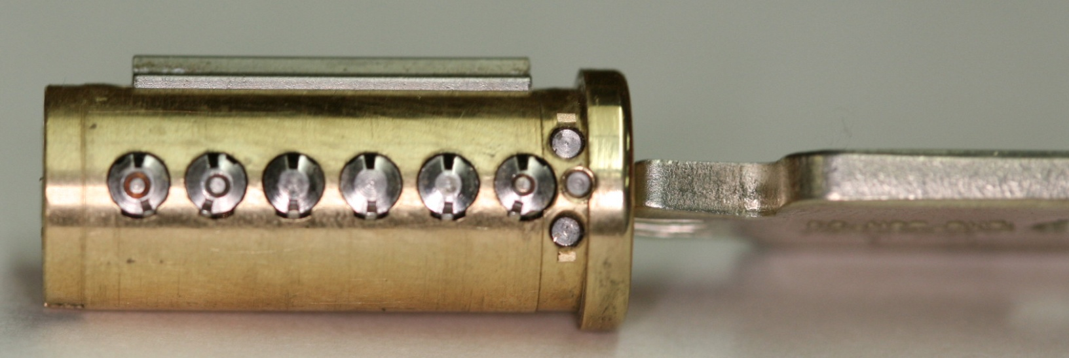
PLUG AND SIDEBAR:
All pins aligned

Slide 49
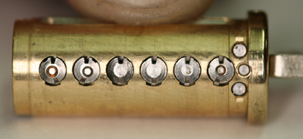
SIDEBAR RETRACTED

Slide 50
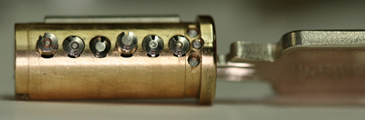
PLUG AND SIDEBAR: Locked

Slide 51
MEDECO CODEBOOK:
At the heart of security
All locksmiths worldwide must use
All non-master keyed systems
New codes developed for Biaxial in 1983
Chinese firewall: MK and Non-MK
Codebook defines all sidebar codes

Slide 52
FAILURE TO CONNECT THE DOTS: DESTROY SECURITY
CRITICAL FAILURES
Original → Biaxial
  pin design
  code assignment
Biaxial -→ m3 design
  M3 slider geometry = .040” offset
  Key simulation
  .007” keyway widening

Slide 53
MORE DOTS!
FORCED ENTRY
Original Deadbolt design
Fatal design flaw: 30 seconds bypass
Later deadbolt designs: new attacks
Mortise and rim cylinders
Inherent design problem: .065” plug

Slide 54
CONNECTING THE DOTS:
The Results
Biaxial Code assignment: Reverse Engineer for all non-master key systems
Gate tolerance: 4 keys to open
NEW CONCEPT: Code Setting keys
Sidebar leg-gate interface: NEW CONCEPT: Setting sidebar code
M3 Wider keyway: Simulated blanks
Slider design: paper clip offset

Slide 55
LESSONS TO BE LEARNED
Patents do not assure security
Apparent security v. actual security
40 years of invincibility means nothing
New methods of attack
Corporate arrogance and misrepresentation
“If it wasn’t invented here” mentality
All mechanical locks have vulnerabilities

Slide 56
PART II:
OPENING MEDECO LOCKS
PRODUCING KEYS
SIDEBAR CODES: KNOWN OR UNKNOWN
BUMPING
PICKING
FORCED ENTRY

Slide 57
TWO NEW CONCEPTS
SETTING THE SIDEBAR CODE
CODE SETTING KEYS

Slide 58
SETTING THE SIDEBAR CODE
SIDEBAR CODE MUST BE SET FOR BUMPING AND PICKING
SIDEBAR CODE: COMPOSITE ANGLES
USE CHANGE KEY TO SET
USE CODE SETTING KEYS TO SET
WHY IMPORTANT?

Slide 59
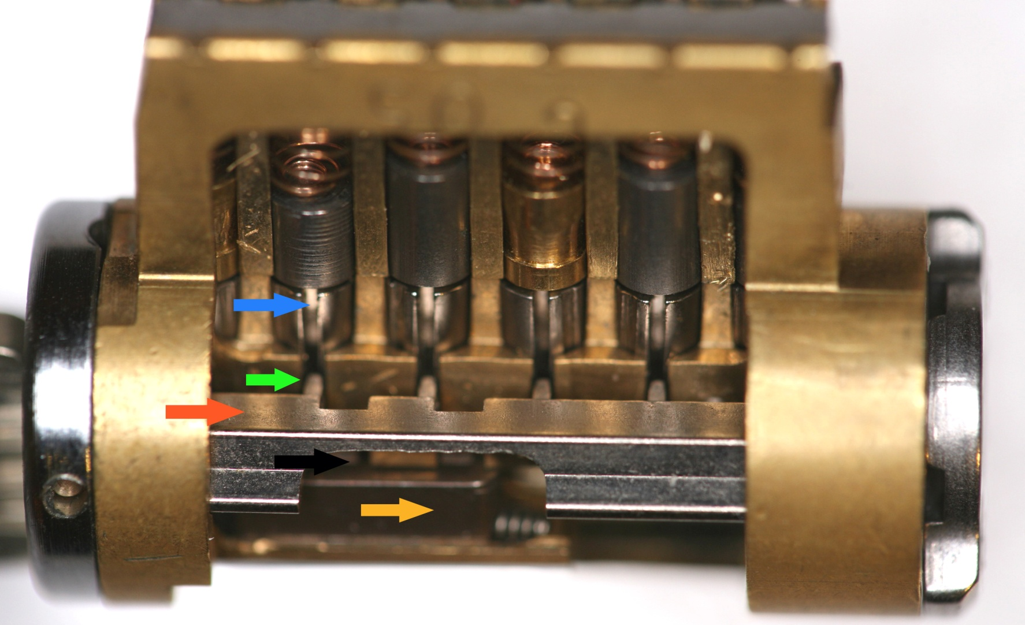
SIDEBAR CODE

Slide 60
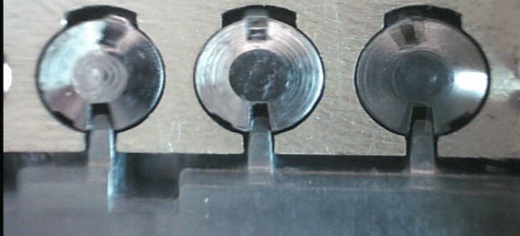
LEG-GATE TOLERANCE

Slide 61

SETTING THE CODE:
BASIC DESIGN FLAW

Slide 62
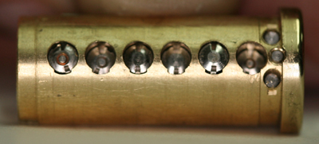
LEGS OF SIDEBAR TO GATE CHANNEL

Slide 63
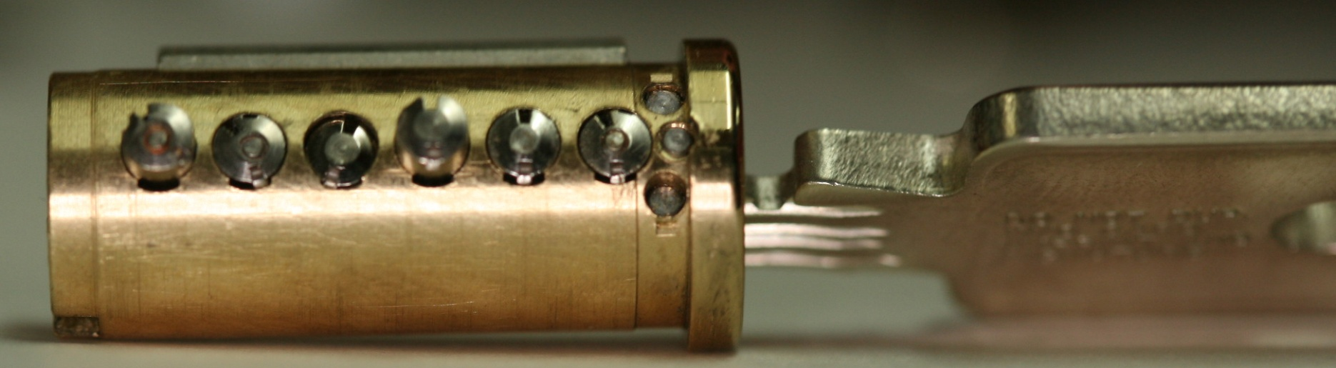
NO PRESSURE APPLIED

Slide 64
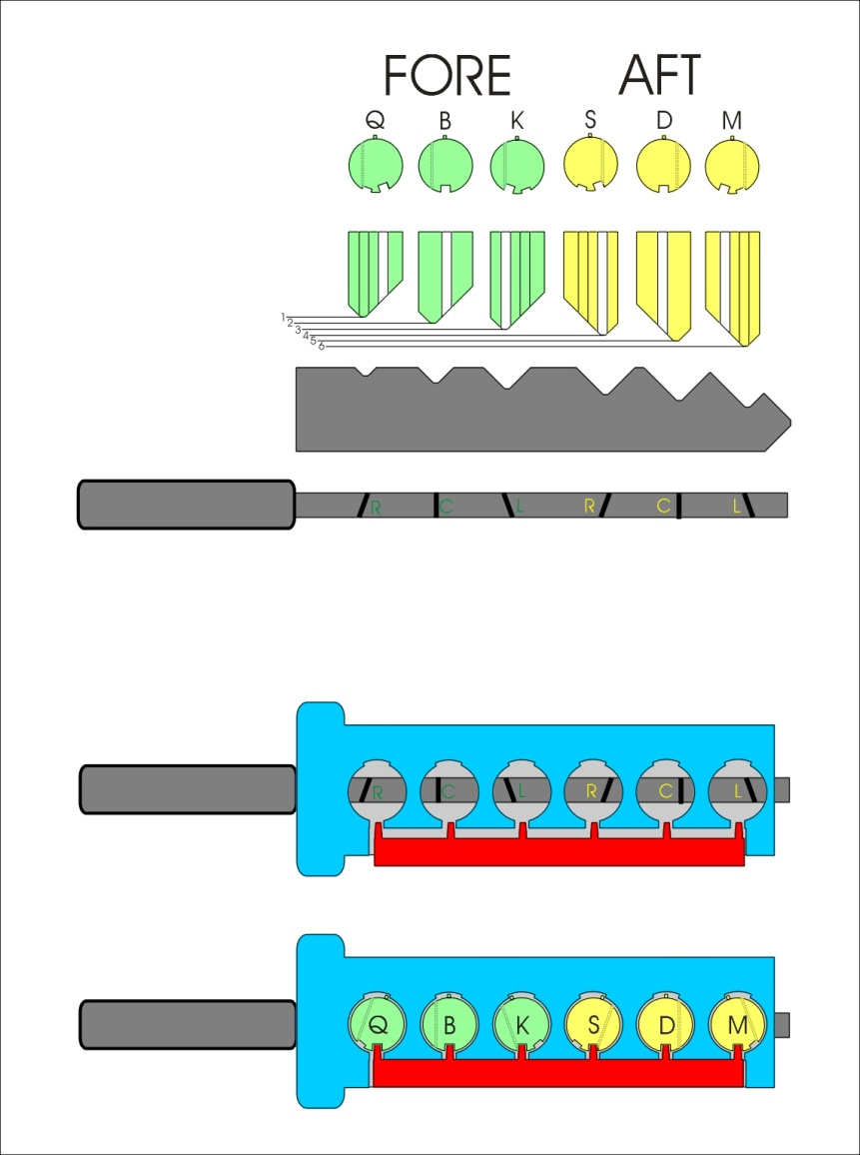
USING LEGS OF SIDEBAR

Slide 65
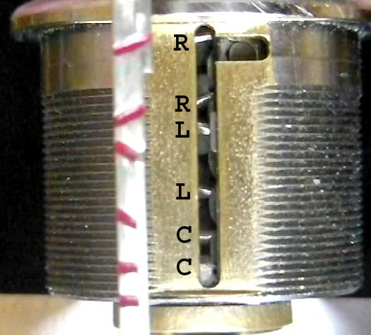
SIDEBAR CODE IS SET

Slide 66
CODES AND CODE SETTING KEYS
MEDECO SECURITY IS ABOUT THE SIDEBAR CODE
MUST SET THE PROPER CODE TO OPEN THE LOCK
KNOWN SIDEBAR CODE OR SIMULATE IT

Slide 67
KEY CODES:
Vertical Bitting and Sidebar
Vertical bitting = 6 depths .025” increments
Sidebar Pins: 3 angles, 2 positions = 6 permutations
 | ORIGINAL | FORE | AFT
Left | L | K | M
Center | C | B | D
Right | R | Q | S

Slide 68
SIMULATING SIDEBAR CODES
GENERATION -2 CODES: HOW DERIVED: 729 CODE ALLOCATION
CODE DATA BASE ANALYSIS
EXPLOIT TOLERANCES
DERIVE FOUR KEYS
DECEMBER, 2007 + 2500 CODES

Slide 69
CODE SETTING KEYS
CHANGE KEY WITH CORRECT CODE
CODE SETTING KEYS WITH SIMULATED CODES
ON FACTORY BLANKS
ON SIMULATED BLANKS

Slide 70
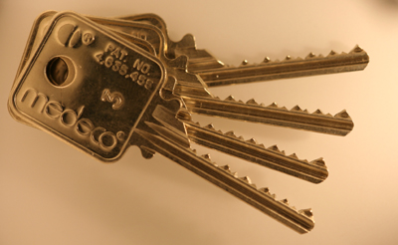
FOUR KEYS = 46,656 CODES

Slide 71

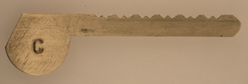
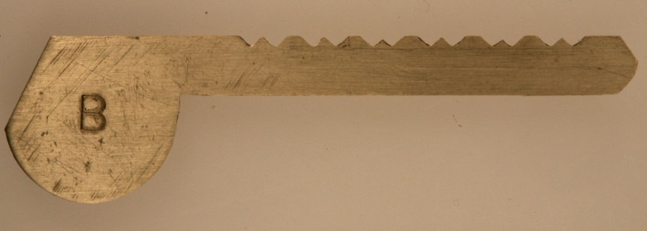
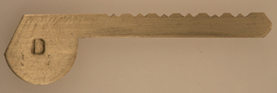
CODE SETTING KEYS

Slide 72
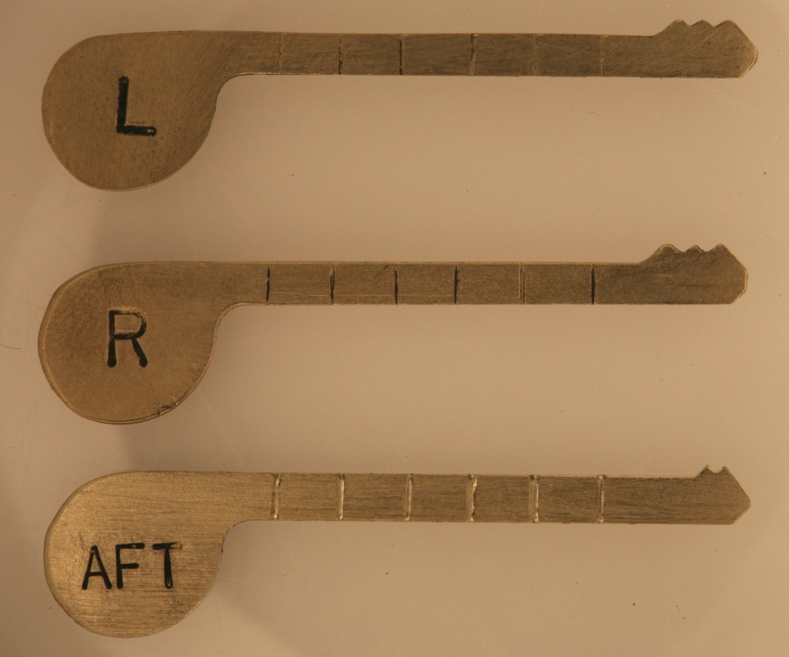
ANGLE SETTING KEYS

Slide 73
46,656 CODES = 4 KEYS
6 PINS, 2 POSITIONS, 3 ANGLES
3⁶ COMBINATINS = 729
  Right, Center, Left Angles
20° ANGLES R-C-L
  10° tolerance = 2 angles (L-C and R-C)
3 ANGLES = 2 SIMULATED ANGLES
REPEATING CODE PATTERNS

Slide 74
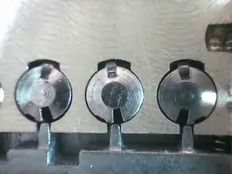
10° TOLERANCE FOR GATES

Slide 75
CODE SETTING KEYS +
SETTING SIDEBAR CODE
BUMP AND PICK ALL M3 and BIAXIAL
FOUR KEYS: ALL NON-MASTER KEY SYSTEMS PRIOR TO 12/2007
SIXTEEN KEYS: ALL NON-MASTER KEY CYLINDERS
CHANGE KEY: SET CODE FOR ALL LOCKS

Slide 76
PROCEDURE: SET THE CODE
INSERT CHANGE KEY OR CODE SETTING KEY
TORQUE COUNTER-CLOCKWISE
REMOVE KEY, SET CODE
RELEASE TENSION
CONVENTIONAL PICKING

Slide 77
CODE SETTING KEYS AND KEY CONTROL ISSUE
NO PARACENTRIC KEYWAY IN m3
WILL NOT MEET BHMA/ANSI 156.30
MUST BE ABLE TO PRODUCE CODE SETTING KEYS FOR ALL KEYWAYS
MEDECO HAS NO KEY SECURITY

Slide 78
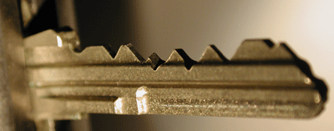
M3 KEY AND SIDE STEP

Slide 79
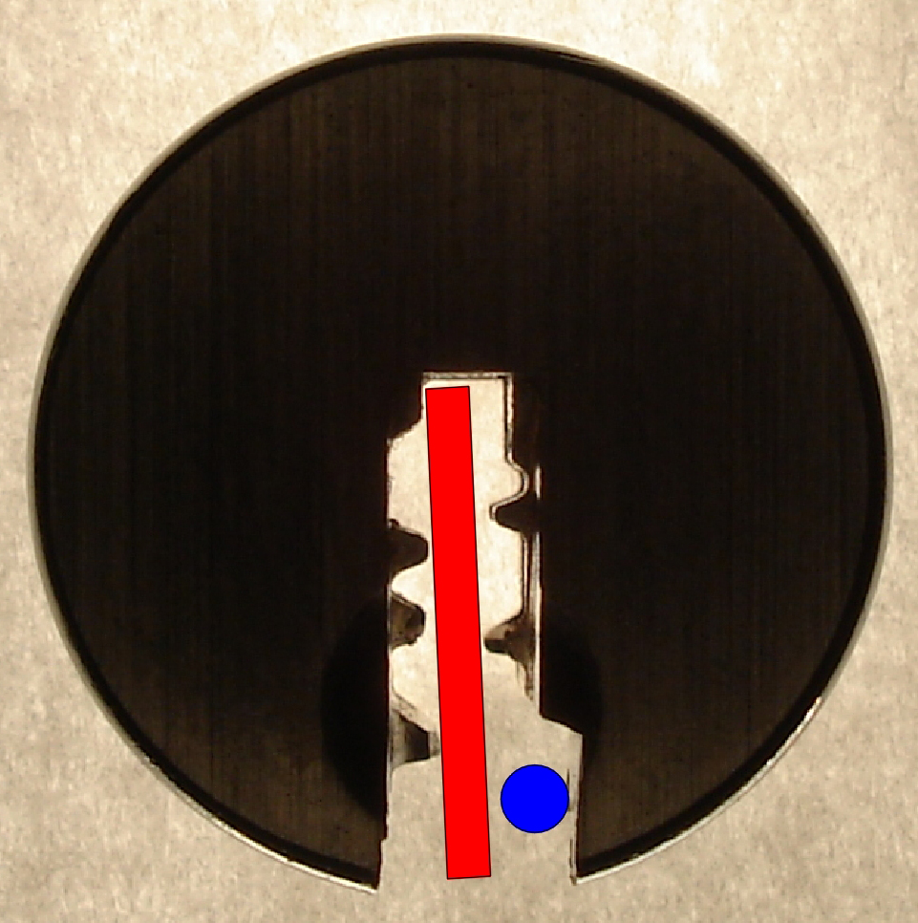
PARACENTRIC KEYWAY

Slide 80
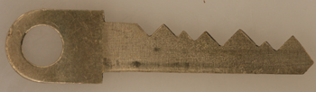
SIMULATED KEYS

Slide 81
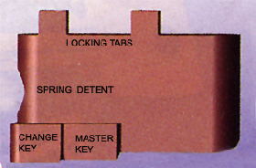
SLIDER DESIGN

Slide 82
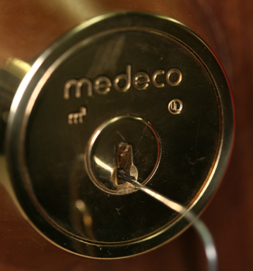
SET THE SLIDER

Slide 83
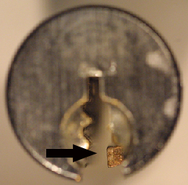
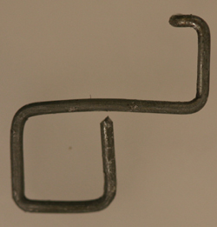
.040” OFFSET OF SLIDER

Slide 84
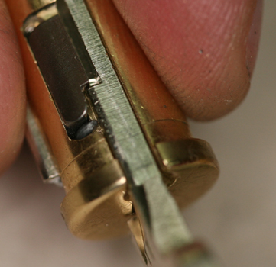
SLIDER OFFSET

Slide 85
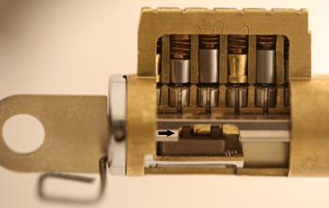
SLIDER OPERATION

Slide 86
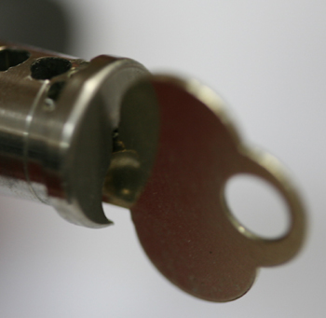
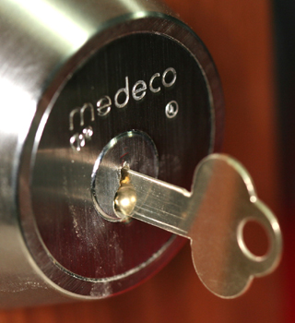
KEYWAY MODIFICATION

Slide 87
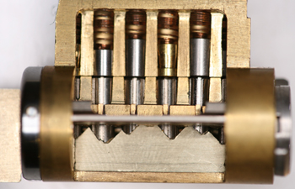
SIMULATED KEY

Slide 88
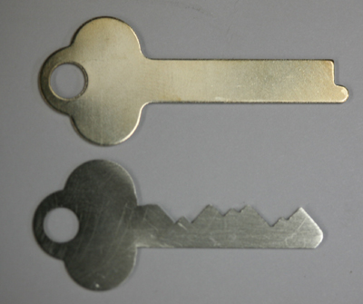
SIMULATED METAL KEY

Slide 89
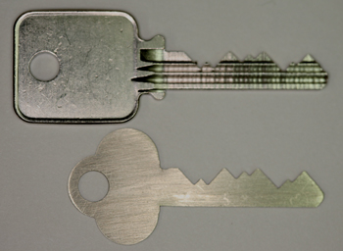
SIMULATED KEY

Slide 90
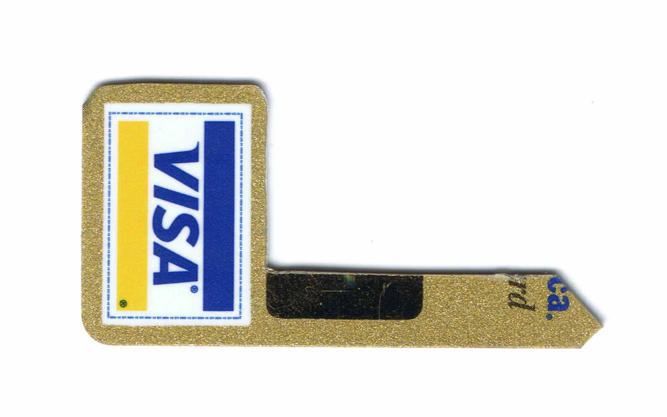
MEDECO TAKES PLASTIC

Slide 91
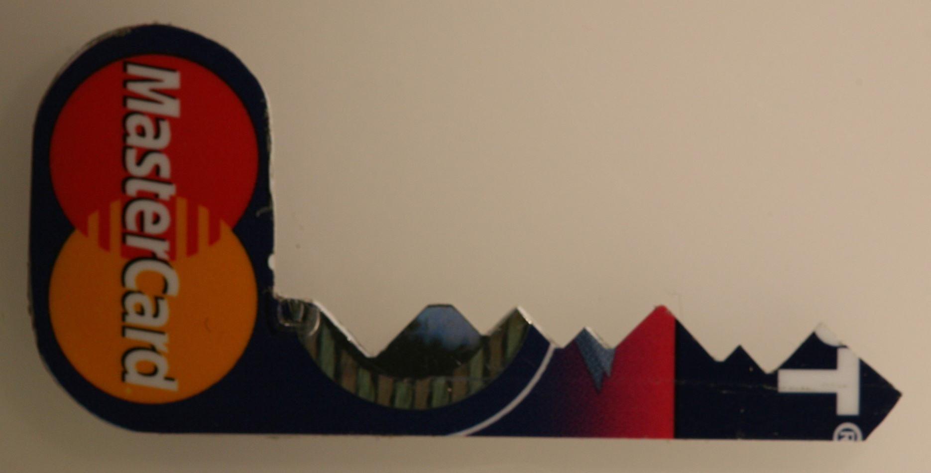
PRICELESS!

Slide 92
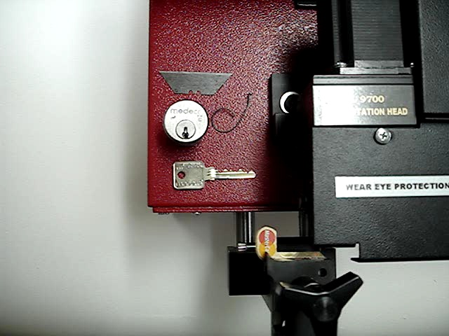
NO KEY CONTROL

Slide 93
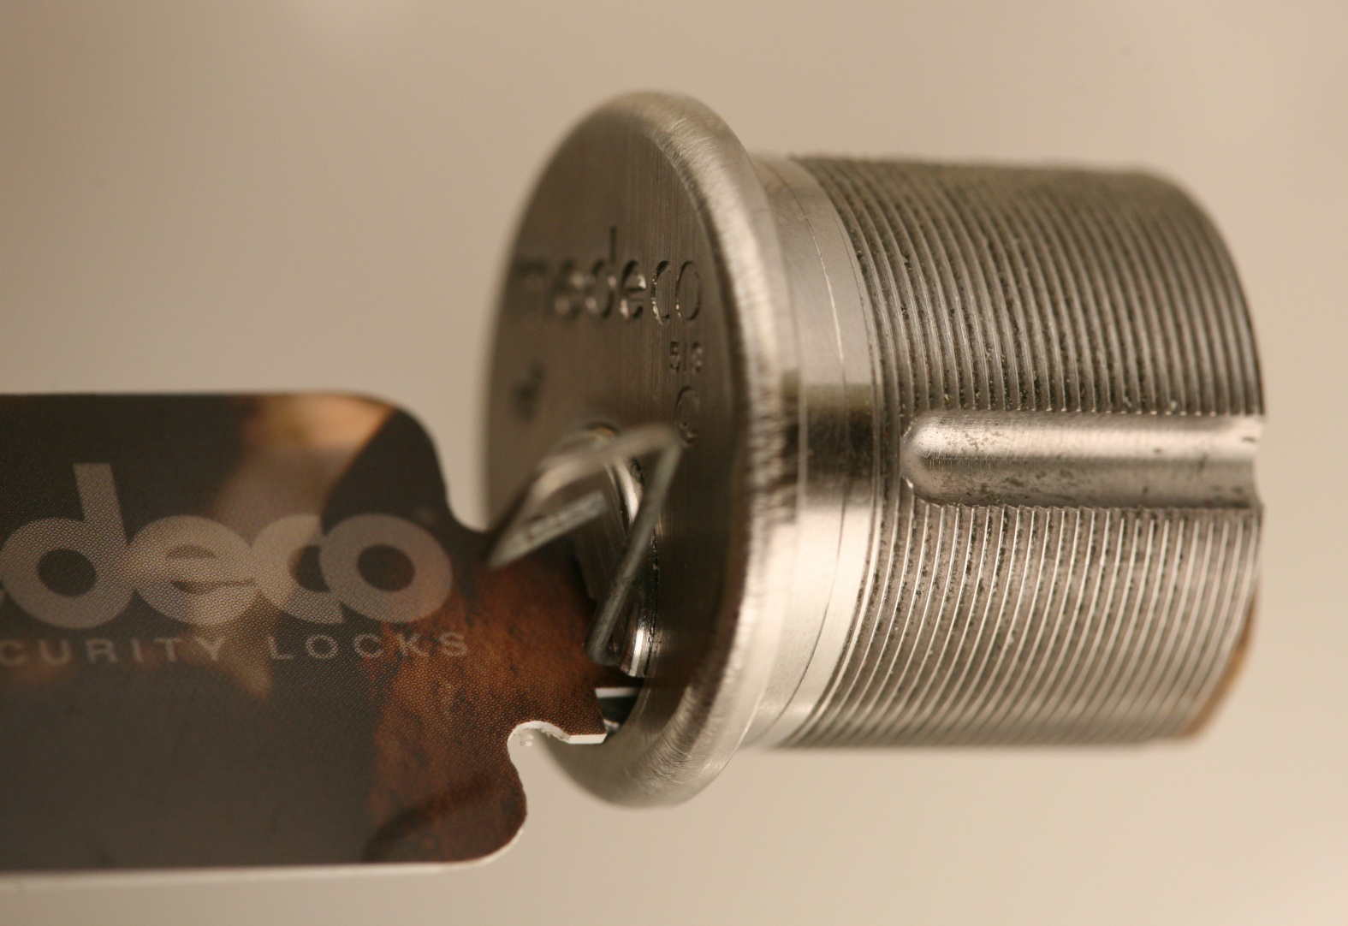
MEDECO KEY CARD

Slide 94
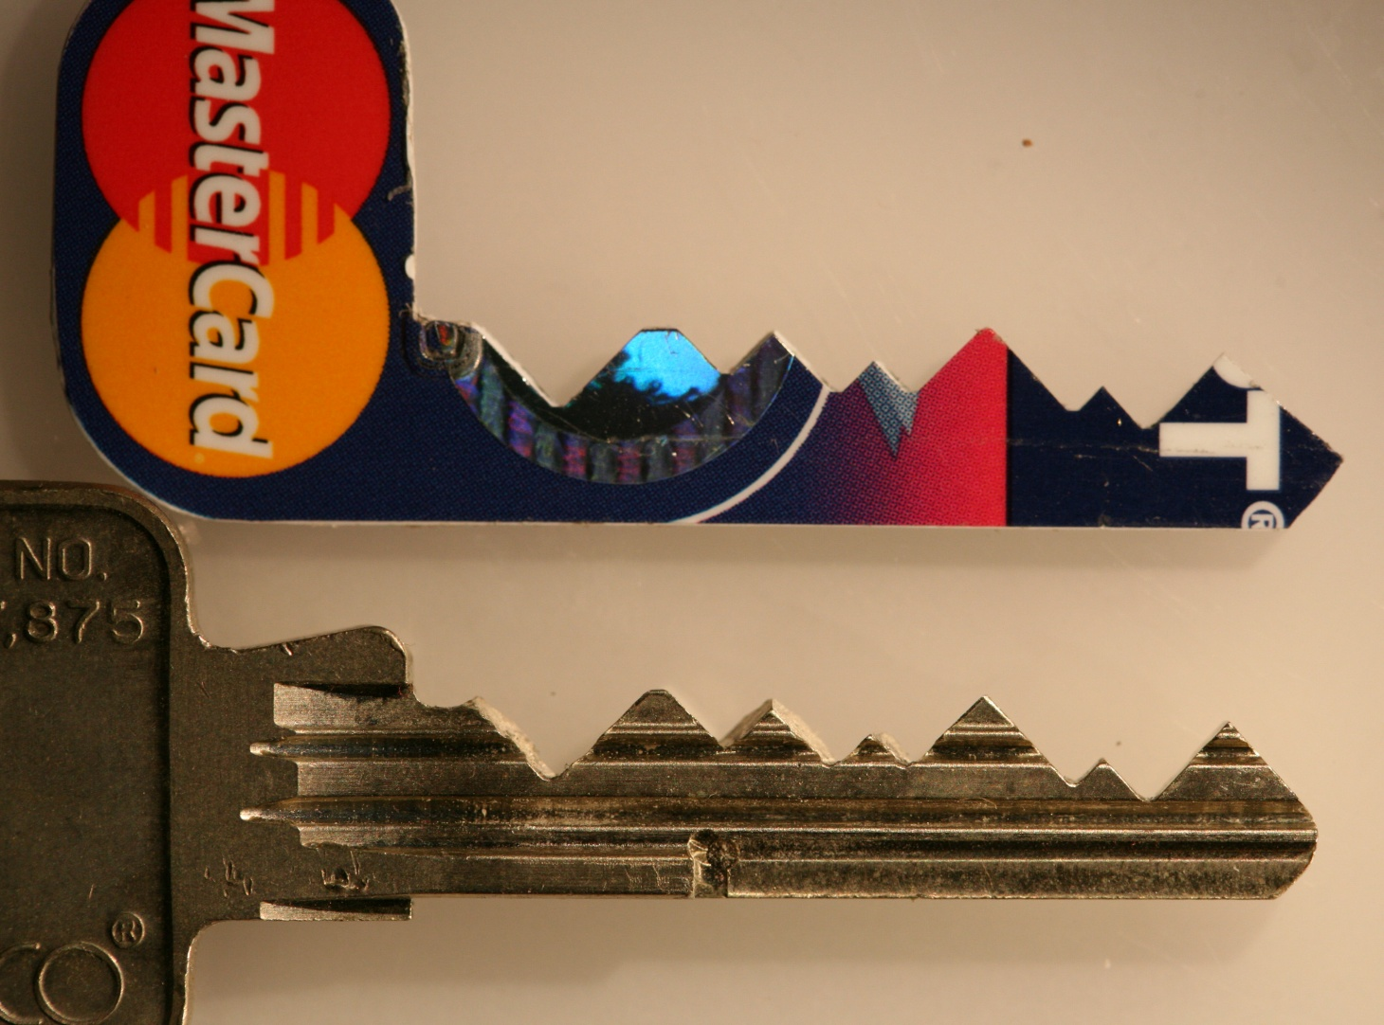
PLASTIC KEYS

Slide 95
BUMPING:
IT ALL STARTED WITH BUMPING AND JENNALYNN IN 2006
  OUR LOCKS ARE “BUMP-PROOF”
  OUR LOCKS ARE “VIRTUALLY BUMP PROOF”
  OUR LOCKS ARE “VIRTUALLY RESISTANT”

Slide 96

2007: JENNA-LYNN OPENS MEDECO BIAXIAL

Slide 97
BUMPING MEDECO LOCKS
CORRECT SIDEBAR CODE
  SIMULATED SIDEBAR CODE
PROPER BUMP KEY DESIGN
BUMPING TECHNIQUE: ADVANCED
  LESS ENERGY REQUIRED
BUMP-PROOF LOCK!!!

Slide 98
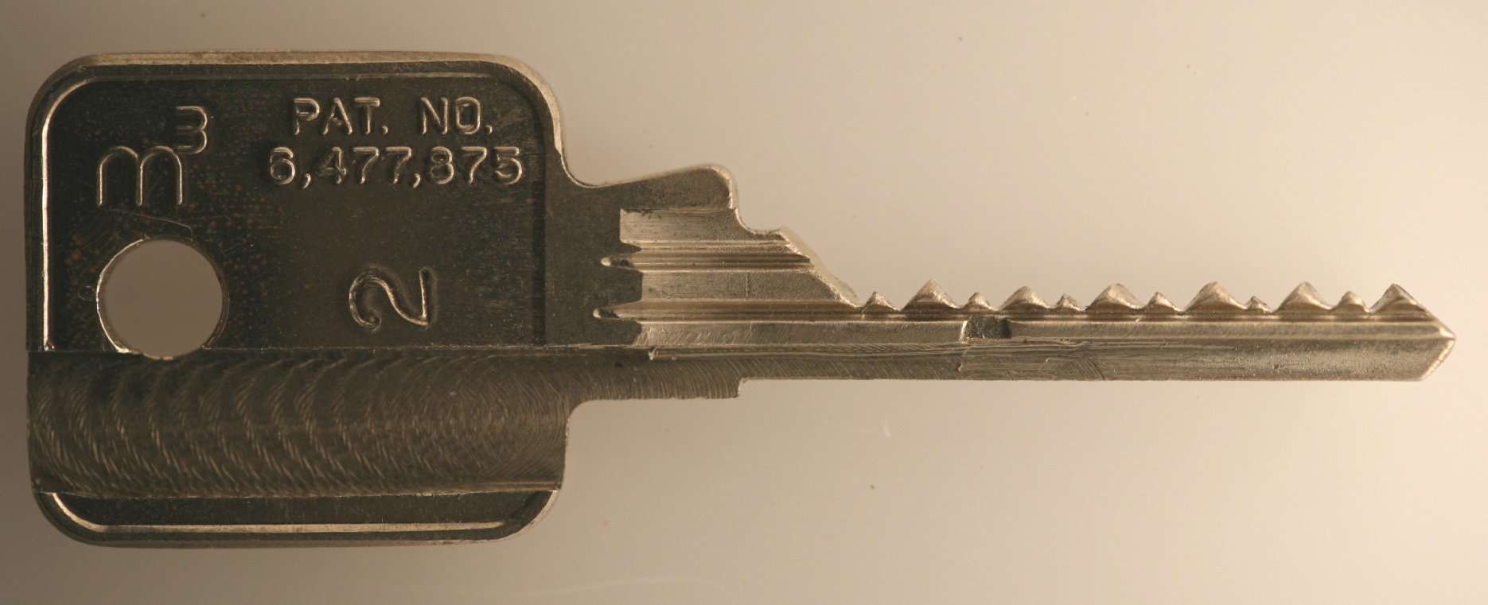
M3 BUMPKEY

Slide 99
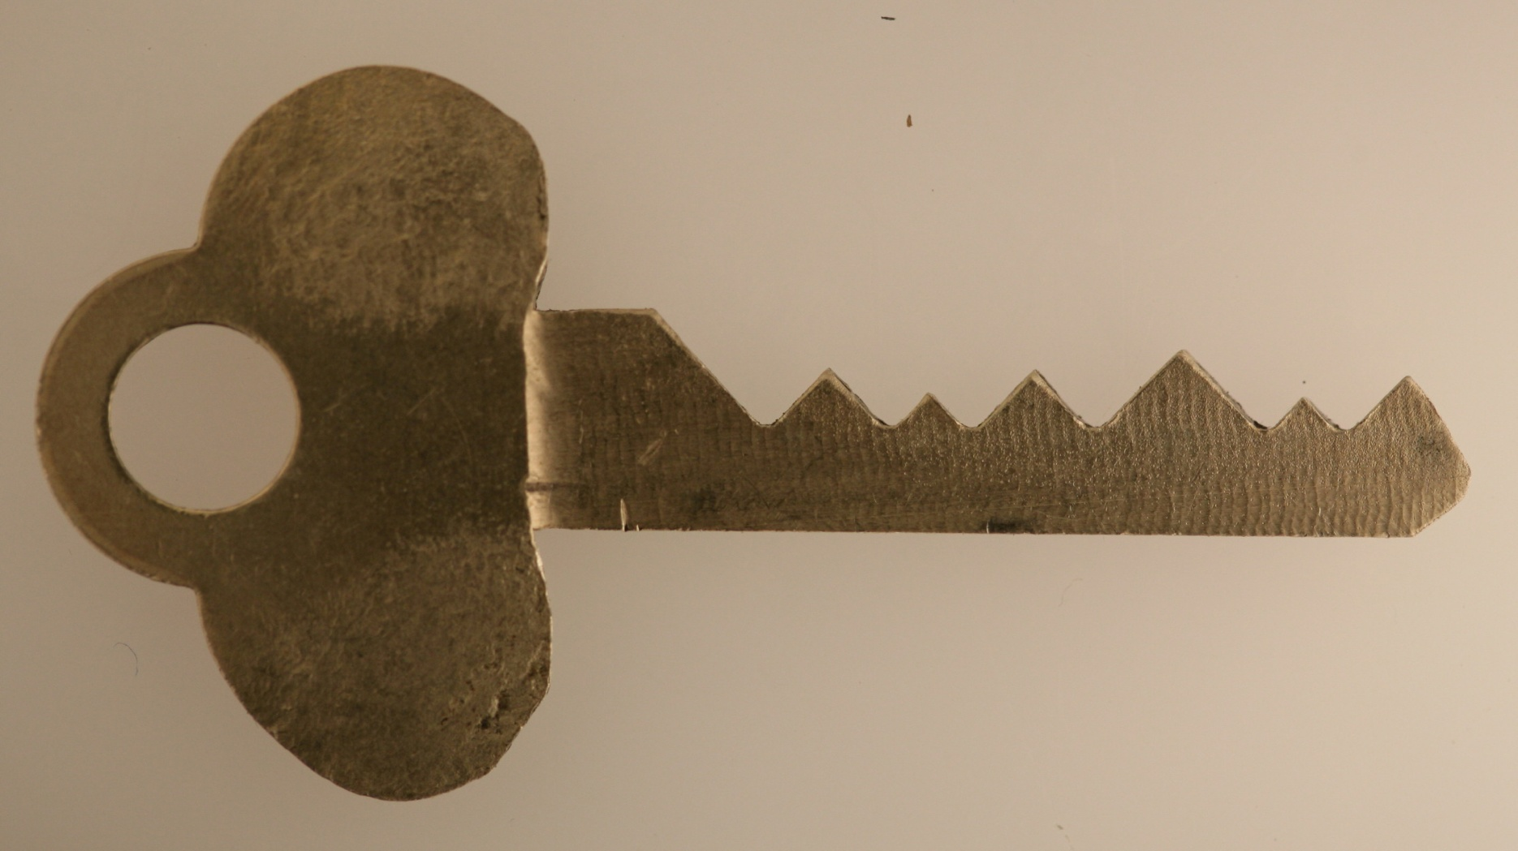
SIMULATED BUMP KEY

Slide 100

JENNALYNN 2008: DEFCON

Slide 101

HAN FEY INSPECTS LOCK

Slide 102
PICKING THE LOCK
SET THE SIDEBAR CODE
  CHANGE KEY WITH SIDEBAR CODE
  CODE SETTING KEY
  ANGLE SETTING KEYS
PICK THE LOCK AS CONVENTIONAL

Slide 103

SETTING THE SIDEBAR CODE AND PICKING

Slide 104
MEDECO RESEARCH:
Results of Project
Covert and surreptitious entry in as little as 30 seconds: standard requires 10-15 minutes
Forced entry: four techniques, 30 seconds, affect millions of locks
Complete compromise of key control
  Duplication, replication, simulation of keys
  Creation of bump keys and code setting keys
  Creation of top level master keys

Slide 105
RESULTS OF PROJECT: Bumping
Reliably bump open Biaxial and m3 locks
Produce bump keys on Medeco blanks and simulated blanks
Known sidebar code
Unknown sidebar code

Slide 106
RESULTS OF PROJECT:
Key Control and Key Security
Total compromise of key control and key security, vital to high security locks
  Duplicate, replicate, simulate keys for all m3 and some Biaxial keyways
    Restricted keyways, proprietary keyways
    Government and large facilities affected
  Attack master key systems
  Produce bump keys
  Produce code setting keys

Slide 107


M3 SLIDER:
Bypass with a Paper clip

Slide 108

SECURITY OF m3:
High Tech Wire!

Slide 109
RESULTS OF PROJECT: Picking
Pick the locks in as little as 30 seconds
Standard picks, not high tech tools
Use of another key in the system to set the sidebar code
Pick all pins or individual pins
Neutralize the sidebar as security layer

Slide 110

PICKING A MEDECO LOCK

Slide 111
RESULTS OF PROJECT: Decode Top Level Master Key
Determine the sidebar code in special system where multiple sidebar codes are employed to protect one or more locks
Decode the TMK
OWN the system

Slide 112
RESULTS OF PROJECT: Forced Entry Techniques
Deadbolt attacks on all three versions
  Deadbolt 1 and 2: 30 seconds
  Deadbolt 3: New hybrid technique of reverse picking
Mortise and rim cylinders
  Prior intelligence + simulated key
Interchangeable core locks

Slide 113

DEADBOLT ATTACK

Slide 114

DEADBOLT BYPASS: 2$ Screwdriver + $.25 materials

Slide 115


MORTISE CYLINDER

Slide 116

MORTISE ATTACK

Slide 117


REVERSE PICKING ATTACK

Slide 118
OPEN IN THIRTY SECONDS: Cracking one of the most secure locks in America
© 2008 Marc Weber Tobias and
Tobias Bluzmanis
www.security.org
mwtobias@security.org

